Slide 1
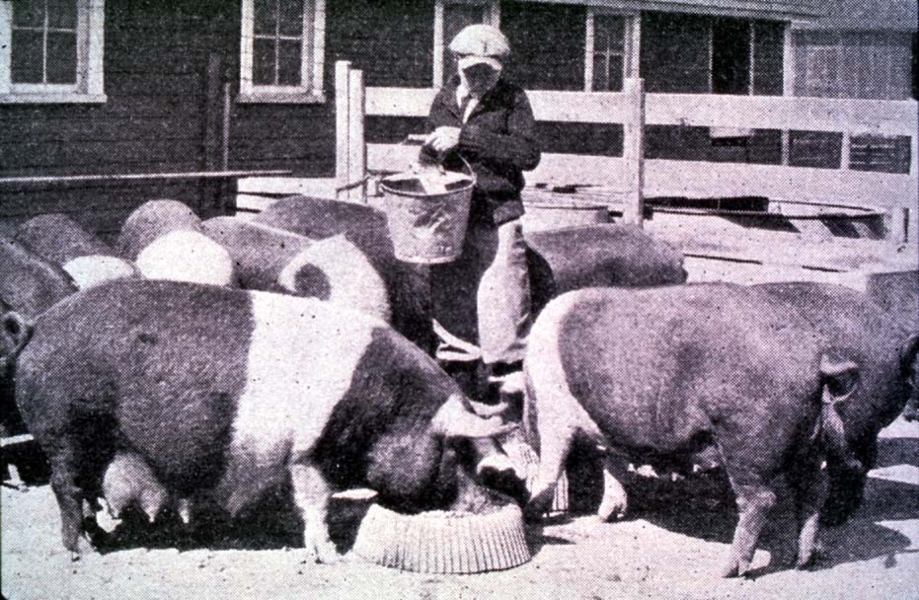
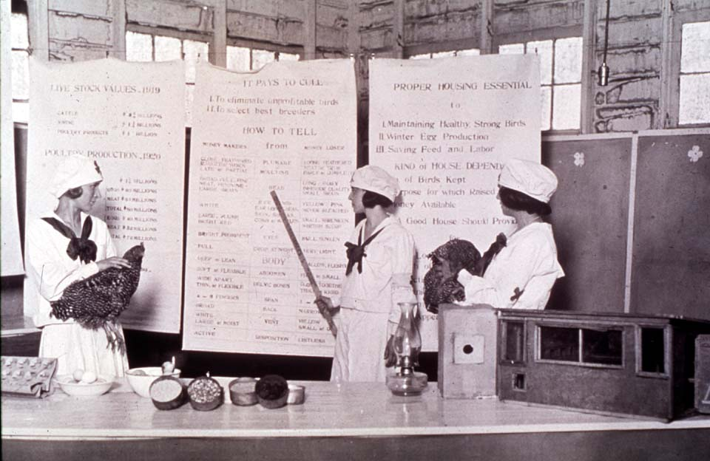
This is 4-H
History of CES
oklahoma 4-h volunteer development
Notes:
Instructor Preparation – Allow 6-8 hours of preparation for 1 hour of instruction.
Review all materials thoroughly. Do any additional research or preparation to make yourself comfortable with the materials or to give it your personal touch.
Determine what other topic/subject matter will be presented with this “core” subject matter. It could be a special event/activity that will focus on Video Production and recording an interview/oral history, an educational piece on how youth should prepare for the “Famous People” category at your communication event, introducing the OK Hobbies and Collectibles project, National 4-H History Preservation Program, the heritage portion of the Citizenship project area, etc. This is a good topic to encourage, embracing and learning about History through 4-H programming.
Prepare handouts that complement the subject matter.
Revised 2017
Teaching Outline
Unit 1: History of Cooperative Extension Service
PowerPoint Presentations
Unit 1: History of Cooperative Extension Service
Activities
4H101: Lesson 3 Discovering the Org Structure and Hist of 4-H
History of Extension_Activity Sheet
History of Extension_Answers
Handouts
4H101: Appendix B_LGB
Newsletter Support Materials
The Great American Invention
Self Study Series
4HVOL201A_History CES and 4-H
4HVOL201A - Answers

Slide 2
History of the Cooperative Extension Service
1862 Morrill Act Establishing Land-Grant Colleges
1862 Institute - Oklahoma State University
1890 Institute – Langston University
1914 Smith-Lever Act – established the Cooperative Extension Service
Notes:
During President Lincoln’s term in office, Congress pass the Morrill Act in 1862 providing land and partial funding for the development of a university in every state to make higher education accessible to the people of that state.
The Morrill Act was latter expanded in 1890 establishing seventy colleges and universities which historically served Blacks. Other expansions occurred 1966 – 2003 establishing sea, urban, space, Native American, and sun grant colleges.
Later during President Theodore Roosevelt’s term the Smith-Lever Act of 1914 created the USDA Cooperative Extension Service and designated land-grant universities to administer Extension Programs.

Slide 3
The Purpose for Cooperative Extension
Education
Research Based Information
Formal and Informal Education
4-H Youth Development
Home & Community Education
Notes:
Extensions primary purpose is education. Education for families, youth, adults, communities and business. As an extension of the university the materials are based on academic studies and/or research.
Both formal and informal educational settings offer different strengths to extension’s outreach. Formal education is classroom or workshop based curriculum taught by a trained teacher or extension educator. Informal extension education happens outside the classroom, in after-school programs, with community-based organizations, museums, libraries or at home.
All youth programs initiated, organized or implemented by the Extension Service wear the 4-H label. The 4-H program can be defined as a youth development program which utilizes a variety of program methods and areas of interest to reach and teach youth 5 to 19 years of age.
The Home and Community Education program is an adult program that encourages continuing education in all aspects of home and community life. Its mission is to be well-informed and able to handle changes related to home and community.

Slide 4
“Cooperative” refers to a partnership between…
Federal
Education
Research
State
County
Extension
Notes:
Extension is under the umbrella of the National Institute of Food and Agriculture of the United States Department of Agriculture.
At the state level we are part of the land-grant universities of Oklahoma State University and Langston University receiving funding as part of higher education.
The Extension office in each county is also funded by county government or possibly a sales tax.
The Cooperative Extension Service symbol is a triangle which symbolizes three primary purposes – Education, Research and Extension.
Basic, Applied and Integrated Research supports 13 national areas. Some of which include Agriculture and Food Biosecurity, Families, Youth and Communities and Technology and Engineering.
Education program emphasis areas and promote teaching excellence, enhance academic quality, and help develop the scientific and professional workforce.
Extension being the Cooperative Extension System, a non-formal educational program implemented in the United States designed to help people use research-based knowledge to improve their lives.

Slide 5
Who is OCES? Oklahoma Cooperative Extension Service
Agriculture Sciences & Natural Resources
Family & Consumer Sciences
Rural Development
4-H Youth Development
Notes:
For us, it's personal. Oklahoma Cooperative Extension Service county educators and area, district and state specialists develop science-based educational programs to help Oklahomans solve local issues and concerns, promote leadership and manage resources wisely.
Programs focus on:
Increasing opportunities for agricultural enterprises
Natural resources and environmental management
Food, nutrition, health and safety education
Youth, family and community development

Slide 6
Participation
The Oklahoma Cooperative Extension Service programs are open to all eligible persons regardless of race, color, national origin, genetic information, sex, age, sexual orientation, gender identity, religion, disability, or status as a veteran, in any of its policies, practices or procedures.
Notes:
http://biopec.okstate.edu/?page_id=2097 (November 18, 2016)
Oklahoma State University, in compliance with Title VI and VII of the Civil Rights Act of 1964, Executive Order 11246 as amended, and Title IX of the Education Amendments of 1972 (Higher Education Act), the Americans with Disabilities Act of 1990, and other federal and state laws and regulations, does not discriminate on the basis of race, color, national origin, genetic information, sex, age, sexual orientation, gender identity, religion, disability, or status as a veteran, in any of its policies, practices or procedures. This provision includes, but is not limited to admissions, employment, financial aid, and educational services. The Director of Equal Opportunity, 408 Whitehurst, OSU, Stillwater, OK 74078-1035; Phone 405-744-5371; email: eeo@okstate.edu has been designated to handle inquiries regarding non-discrimination policies: Director of Equal Opportunity. Any person (student, faculty, or staff) who believes that discriminatory practices have been engaged in based on gender may discuss his or her concerns and file informal or formal complaints of possible violations of Title IX with OSU’s Title IX Coordinator 405-744-9154.
Issued in furtherance of Cooperative Extension work, acts of May 8 and June 30, 1914, in cooperation with the U.S. Department of Agriculture, Director of Oklahoma Cooperative Extension Service, Oklahoma State University, Stillwater, Oklahoma. This publication is issued by Oklahoma State University as authorized by the Vice President, Dean, and Director of the Division of Agricultural Sciences and Natural Resources.

Slide 7
Activity
Introduce STEM recording Oral History project http://4h.okstate.edu/projects/science-and-technology/photography-and-video-resources, National 4-H History Preservation Program http://4-hhistorypreservation.com/voices/ or OK Hobbies and Collectable Project 4H.HLTH 402-413
Notes:
Hobbies and Collectables Curriculum
4H.HLTH.402 Collectibles
4H.HLTH.403 Preserving vintage Clothing and Textile Products Part 1
4H.HLTH.404 Preserving vintage Clothing and Textile Products Part 2
4H.HLTH.405 Storage and Display of Textiles
4H.HLTH.406 Books, Paper Docs & Photos
4H.HLTH.408 Preserving Memorabilia
4H.HLTH.409 History Mystery Part 1
4H.HLTH.410 History Mystery Part 2
4H.HLTH.413 Authentication Card
4H.PDL.111 Personal Development – Documenting our 4-H Heritage
Dustcovers
Preserving and Restoring Furniture Coatings
Padded Hanger
Video Production and Filming – Preserving our 4-H Heritage: interviews and experiences

