Slide 1
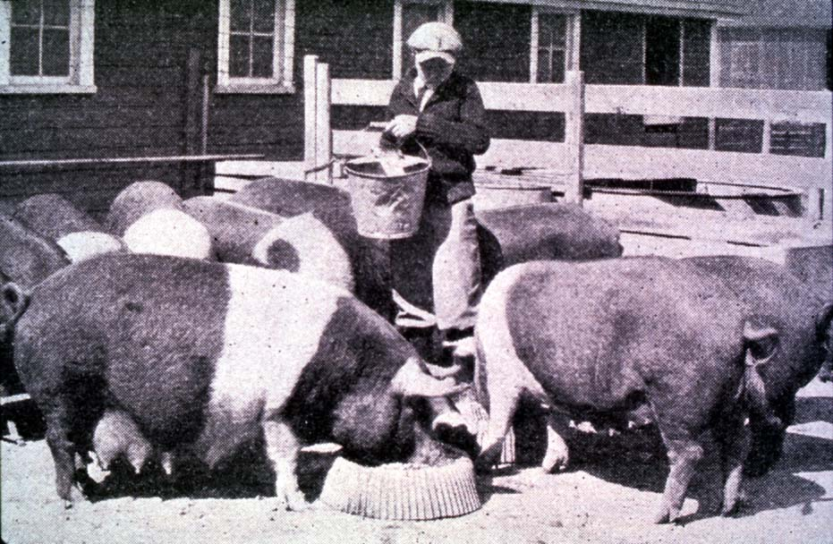

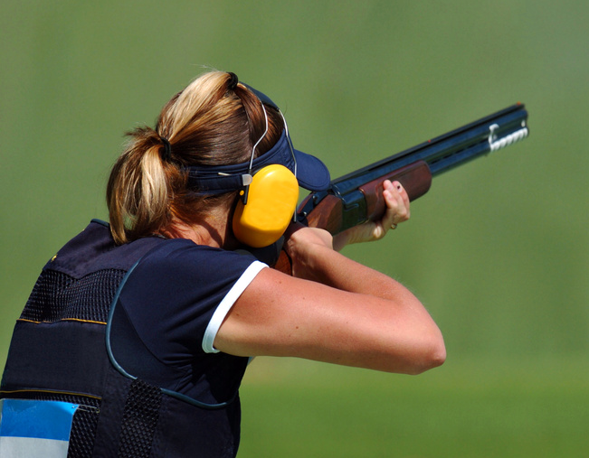


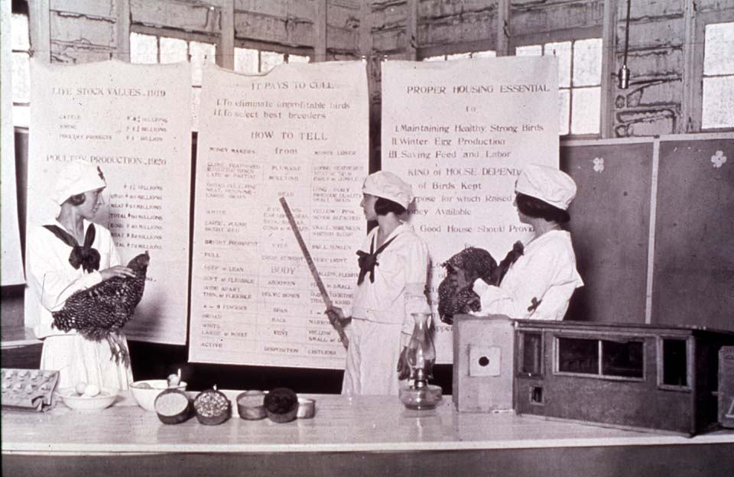
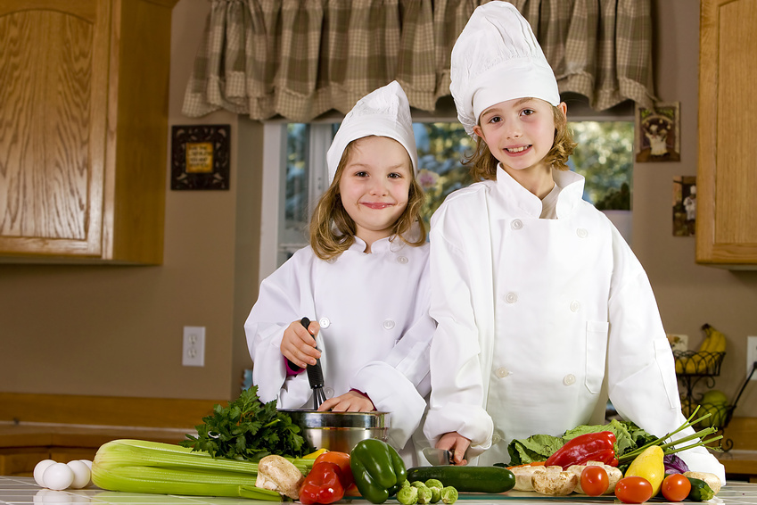
Getting the Most Out of the 4-H Experience
Events and Activities
oklahoma 4-h volunteer development
Notes:
Instructor Preparation – Allow 6-8 hours of preparation for 1 hour of instruction.
Review all materials thoroughly. Do any additional research or preparation to make yourself comfortable with the materials or to give it your personal touch.
Determine what other topic/subject matter will be presented with this “core” subject matter. It could be a special event/activity that will focus on the CES 2014 Centennial Celebration, an educational piece on how youth should prepare for the “Famous People” category at your communication event, introducing the OK Hobbies and Collectibles project, National 4-H History Preservation Program, the heritage portion of the Citizenship project area, etc. This is a good topic to encourage, embracing and learning about History through 4-H programming.
Prepare handouts that complement the subject matter.
Down load the OCES Centennial PSA 100 Years of Oklahoma Extension (video 3:35 minutes) http://toolbox.okstate.edu/100-years to play with slide
Teaching Outline and Activity
4H101 – Lesson 9: Using a Skllathon for Experiential Learning
4H101 - Lesson 16: Recognizing 4-H’ers Accomplishments
Handouts that complement the session:
4H.VOL.105 Recognition Model
4H.VOL.107 Judging
4H.VOL.108 Understanding 4-H Events and Activities
4-H Project Planning Guide
Goal Setting Worksheet for Jr. Members
“Plan the Work” Calendar
Understanding 4-H Judging – Rutgers Extension
4-H Horse Judging Standards Danish System-Iowa State Extension
PowerPoint Presentations
Unit 2 – Getting the Most Out of the 4-H Experience
Getting Off on the Right Foot
This is Jeopardy
Self Study Series
for volunteers who can not attend this training in person.
4H.VOL.202D – Understanding 4-H Events and Activities
4-H Newsletter Support Material
Preparing for 4-H Events and Activities
Purpose for 4-H Events and Activities
What Evaluation Teaches

Slide 2
Recognition and Motivation
Show support and encouragement
Make suggestions for changes and improvement after recognizing several good points
Teach them how their work will be evaluated

Slide 3
Purpose for
4-H Activities and Events
An extension of project work
Educational
Learn by Doing
Method for evaluation
Develops leadership skills
Notes:
Extension of Project Work
Most activities and events provide an opportunity to share the knowledge and skills being learned through individual project work.
Educational Purpose
The objective of any 4-H activity or event should be an educational foundation which encourages life skill development.
“Learn by Doing”
An activity or event provides opportunities to learn by doing at many levels.
As an individual the member learn by doing through preparation.
At the local club level members learn by doing in planning, preparing and doing a project.
At the county level members may serve in a leadership role and assist with the actual planning and implementation of the activity or event.
Method for Evaluation
Established standards for knowledge and skills assist the member in identifying areas of growth and areas requiring greater attention. Through evaluation members are encouraged to continue developing skills and to reset goals.
Develop Leadership Skills
As members and volunteers develop skills and acquire knowledge they become valuable resources in the planning, conducting and evaluating activities and events.

Slide 4
Philosophy of 4-H Events
4-H Events provide an opportunity for education, evaluation and recognition.
Examples: Public Speaking, Fabric and Fashion, Share the Fun, Food Show, Meats Contest, Dog Show, etc.
Notes:
Activity – Thinking Outside the Box
Identify and relate relevance to an individual 4-H project “Why Should I Participate.”
Example: Communications
Fabric and Fashion
Healthy Living
Share the Fun
County Fair

Slide 5
Philosophy of 4-H Activities
4-H Activities provide an opportunity for education, participation and fellowship.
Examples: Camp, Tour, Exchange Trip, Picnic, etc.
Notes:
Activity – Thinking Outside the Box
Identify and relate relevance to an individual 4-H project “Why Should I Participate.”
Example: Communications
Fabric and Fashion
Healthy Living
Share the Fun
County Fair

Slide 6
Preparing for
Activities and Events
Identify and relate the relevance to an individual’s project.
Research
Prepare
Practice
Present
Evaluate
Notes:
Activity – Thinking Outside the Box
Identify and relate relevance to an individual 4-H project “Why Should I Participate.”
Example: Communications
Fabric and Fashion
Healthy Living
Share the Fun
County Fair

Slide 7
Seek Opportunities for Communications
Encourage the identification of and opportunities for developing communication skills of all kinds.
Public Speaking
Working Displays
Displays
Posters
Photography
Printed Materials
Website
PowerPoint

Slide 8

Forms of 4-H Recognition
Participation
Progress Toward Personal Goals - Setting and achieving personal goals
Standards of Excellence – Danish System of Blue, Red and White Awards
Peer Competition – Placing items First, Second and Third
Cooperation - involves all parties in the decision making process

Slide 9
Forms of Recognition
Participation
Emphasizes the importance of being involved in an educational experience.
Taking part is significant for some people.
Progress Toward Self-Set Goals
Setting realistic goals and then planning how to achieve the goals.
Key to Success - An adult working cooperatively with the young person to evaluate progress toward goals.

Slide 10
Forms of Recognition
Achieving Standards of Excellence
Standards are established and used to evaluate project work.
All who meet the standards are recognized by a designated rank.
Peer Competition
Results when one seeks to be the best or better than another.
Winners and losers.

Slide 11
Forms of Recognition
Cooperation
The primary goal of 4-H is to help young people become self-directing, productive and contributing citizens.
Recognizing those who work together to learn and achieve goals is important.
When working together, a person examines their own skills and abilities and explores solutions beyond their own ideas.

Slide 12
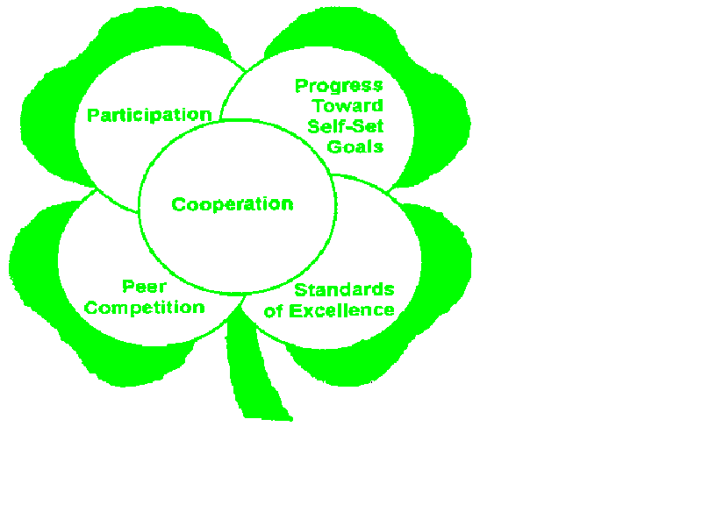
4-H Recognition Model
A club and county program should have a healthy blend of all five forms of recognition.

Slide 13
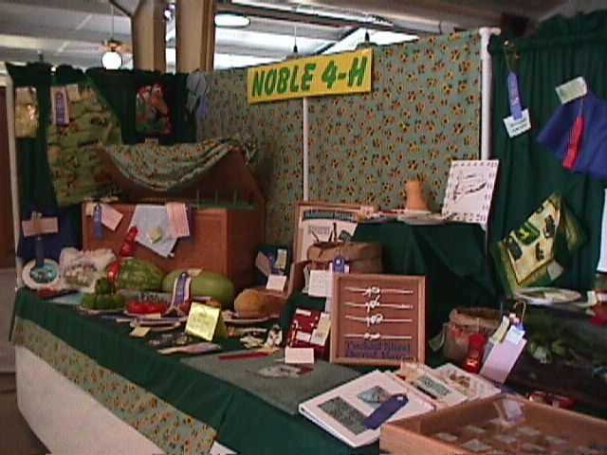
Most Common Form of
4-H Evaluation
Judging - the comparison of differences when selecting one article, animal or product instead of another because of defined qualities and standards.

Slide 14
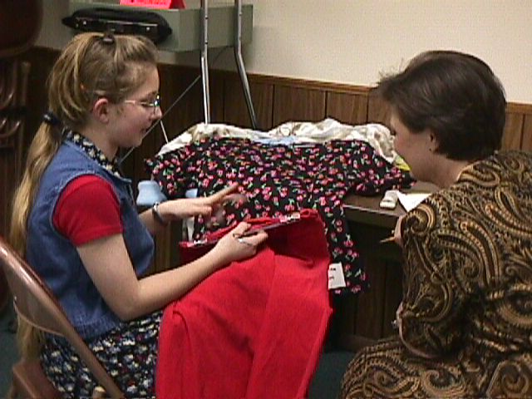
Evaluation Teaches
Knowledge and understanding of qualities and standards.
To choose wisely.
To identify desired qualities in a finished product.

Slide 15
What is Learned from Evaluation?
Learn to evaluate an animal or article in terms of the ideal - not the scorecard.
Some projects have established standards. The project manual or leader’s guide will outline these standards if they have been written for a specific project.

Slide 16
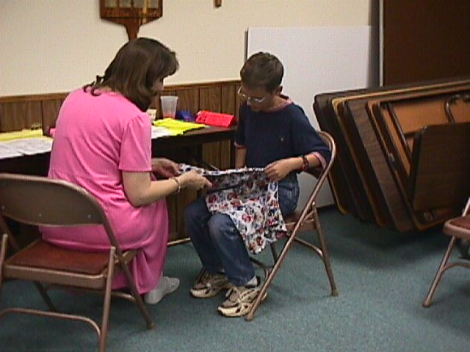
Evaluation with Standards
Some projects have established standards. If standards have been established the project manual or leader’s guide will outline the standards.

Slide 17
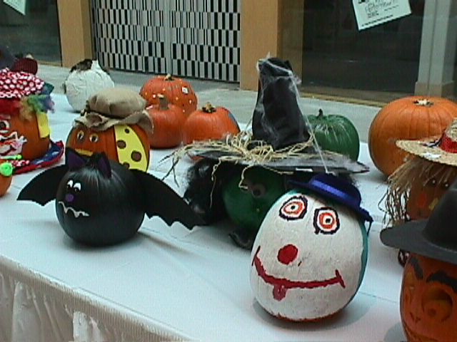
Evaluation without
Established Standards
General qualities to look for:
Good Overall Appearance
  Lettering and lines are straight and color is appropriate and pleasing
Quality Work
Attempt to Master a New Skill
Practicality Combined with Creativity and Versatility

