Slide 1
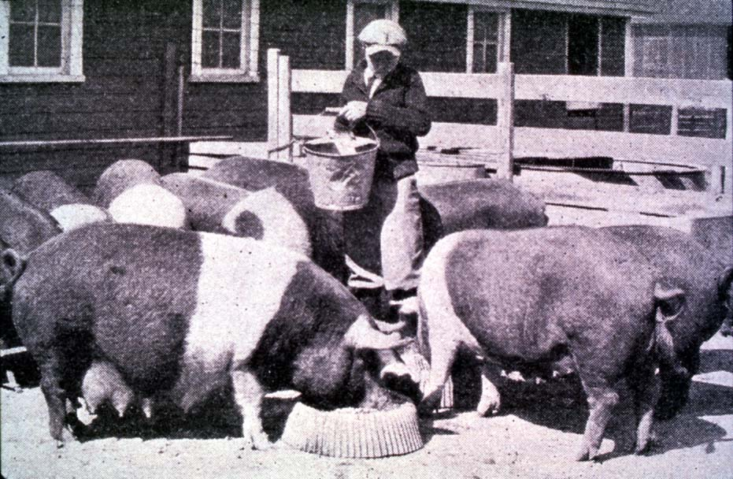




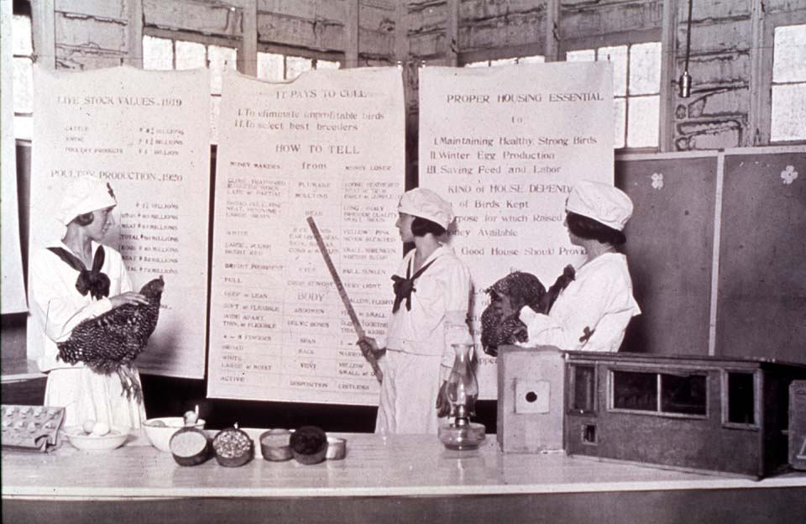

Getting the Most Out of the 4-H Experience
Public Speaking
oklahoma 4-h volunteer development
Notes:
Instructor Preparation – Allow 6-8 hours of preparation for 1 hour of instruction.
Review all materials thoroughly. Do any additional research or preparation to make yourself comfortable with the materials or to give it your personal touch.
Determine what other topic/subject matter will be presented with this “core” subject matter. Any topic could be used to encourage, embracing and learn about Public Speaking or doing a presentation of any kind.
Prepare handouts that complement the subject matter.
2015 Resources and Curriculum: http://4h.okstate.edu/literature-links/lit-online/communication-expressive-arts/speaking
Twelve individual topics are located in the Handout file for Unit 2 Section 5 - Public Speaking.

Slide 2
Importance
The best way for 4-H members
to learn public speaking is by
observing the example volunteers
and experience older youth provide.
“Set the example and standard.”

Slide 3

Purpose for Public Speaking
Gain and share subject matter knowledge
Learn to organize their ideas in a clear manner
Develop self-confidence about your abilities and skills
Develop and display physical skills
Develop specific public speaking skills

Slide 4
Public Speaking by Age
Younger Youth – Need more help, supervision and direction. Emphasis should be on gaining self-confidence, sharing with others and learning the steps in organizing, preparing and presenting a presentation.
Older Youth – Expand beyond the local club. Provide leadership to younger youth and begin planning, organizing and presenting workshops using public speaking skills.

Slide 5
Helpful Definitions
A 4‑H Talk - An oral presentation in which the member does not rely on posters/illustrations or objects. All illustrations are communicated through descriptions used in the speech.
Simply, the 4-H member paints a picture or tells a story through words.

Slide 6
Helpful Definitions
4-H Illustrated Talk - An oral presentation in which the member uses posters/illustrations or objects to emphasize/illustrate specific points in the speech.
A member does not actually make or demonstrate how to do something in an illustrated talk.

Slide 7
Helpful Definitions
4-H Demonstration - A means of sharing information with an audience by showing them how to do something. In this oral presentation the member shows how to make an item or complete a task.
When a demonstration is finished the 4‑H member will have a finished product to show.

Slide 8
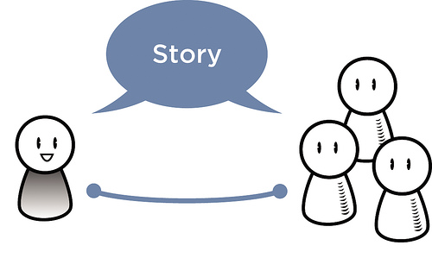
Purpose for the Presentation
Inform
Persuade
Inspire
Entertain
Notes:
To inform ( explain or teach. This type of presentation helps the listener know or understand more about a topic.
To persuade (or convince). The listener is encouraged to accept a challenge, change an attitude, or take action as a result of this presentation
To inspire. The presentation should have emotional impact on listeners. The topic, examples, and delivery, contribute to an inspirational presentation.
To entertain. This presentation is designed to fit a specific occasion the audience to enjoy. It may involve additional speaker/audience interaction.

Slide 9

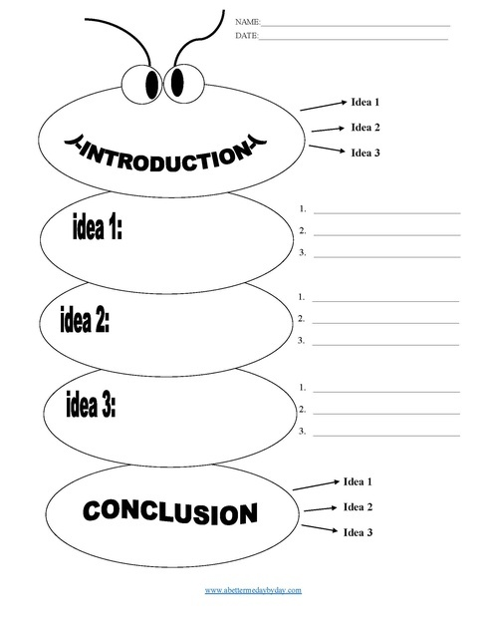
The 4-H Presentation
Introduction
  Gain attention while introducing subject
Body
  Vital points of subject matter
Conclusion
  Brief summary
  Appeal for action
Notes:
Introduction – Captures the attention of the audience. It introduces the central thought of the presentation and appeals to the interests of the audience. It can make the first request for action from the listener.
Possibilities: story, startling statement, statistics, quote, challenge, anecdote, familiar saying , reference to common experience with humor, question, limerick, etc.
Body – Presents the major points through discussion, facts, visuals and examples. This is the longest section of the presentation. There should be a logical sequence to the points.
Three ways to help listeners remember the message – repetition; examples and focus on the group interest
There is no one best way to deliver the main points. Personal style and audience are key. Be yourself.
Conclusion – Restates the central thought and summarizes the major highlights of the presentation. It makes a final appeal to the audience for action. It alerts the listeners hat you are coming to the end of the presentation and provides a final, memorable statement to the group.
The conclusion could be a summary of points; a story or a quote. Do not over use quotes. Use your own thoughts.
Listeners tend to remember the first an last things said. Give the introduction and conclusion special attention.

Slide 10



Selecting a Subject
Choose a topic that:
Interests you
You know something about
Suits your time limits
Can be researched and written about in the time available
Appeals to your audience

Slide 11
Steps in Organizing Project
Step 1 – Goal “Do a Child Care speech at local 4-H club meeting in December 20xx”
Step 2 – Project Form “Illustrated Talk on Child Good Guidance”
Step 3 – Get People Involved “Club Leader, Public Speaking Project Leader”
Step 4 – Resources “Project Manual, Red Cross, YMCA”
Step 5 – Step-by-Step “Timeline the plan of action”

Slide 12
Step 5: My Plan of Action
Step 5.1 – In September, talk with Public Speaking Project Leader about how to select a topic, research the topic, organize and writing the speech and how to present a speech.
Step 5.2 - Select a topic/subject in September. Narrow the topic so that it is focused and specific.
Step 5.3 – In October, research the topic/subject by using at least 4 resources. Resource will include available 4-H project literature, interviewing one specialist in the field, completing a Internet search, and using one other source.

Slide 13
My Plan continued…
Step 5.4 – In October, organize the material in a sequence that shows what I have learned and its importance or relevance.
Step 5.5 – In October, write the introduction, body and conclusion of the speech. The introduction should stimulate interest in the subject and catch the audiences attention. The body of the speech will state the facts and what was learned. The conclusion will briefly summarize the subject and leave the audience wanting to learn more or take action.

Slide 14
My Plan continued…
Step 5.6 - By November 1, review the written speech with 4-H Project Leader.
Step 5.7 – In October, ask club leader to be placed on the agenda to present my speech at the December 4-H Meeting.
Step 5.8 – During November, practice by myself and by presenting it for family, friends and my 4-H Project Leader.
Step 5.9 - Present speech at December 6, 4-H
Club meeting.

Slide 15
Steps in Organizing Project continue…
Step 6 – Consider Alternatives
“Present talk in November or January at club meeting, present talk to another club or class at school.”
Step 7 – Put the Plan into Effect
“Work your plan.”

Slide 16
Steps in Organizing Project continue…
Step 8 – Test and Evaluate Step-by-Step
“If a step is not completed ask: Why and make adjustments to bring yourself back on track.”
Step 9 – Follow-Through
“Do what you set out to do.”

Slide 17
Steps in Organizing Project continue…
Step 11 – Project Evaluation
“When the presentation is complete ask: What did I learn? How would I do things differently? What is my next goal?”

Slide 18
Pointers for Visuals
Visuals include posters, handouts, PowerPoint slides, demonstration materials, etc.
Understanding - does it have a point
Simplicity - limit the visual to one or two ideas
Neatness
Color
Readability
Size
Notes:
Do not have visuals for the sake of having visuals. Visuals strengthen and do not detract from the subject matter. They can not make up for good content and a well organized presentation.
To learn more about visuals go to supporting presentation “Making 4-H Visuals as Good as Your Ideas”. Located in PPT folder.
Handout folder: T-8203 Do-it-yourself Visuals

Slide 19

Self Evaluation
T-3 unit 2.8 Examining your plan

Slide 20
Activity
Presentation
Notes:
Have a adult volunteer to do a brief demonstration. You provide everything and give them a few minutes to become acquainted with the supplies, posters, and topic.
Ideas: Demonstrate making a dip. Demonstrate opening a can with a can opener. Folding a napkin. Have fun with the topic because the point is to have a live demonstration to evaluate – from the perspective of the audience and the presenter.
Invite a good public speaker to come and present to the group and then ask them to share their story in acquiring knowledge and skill.

Slide 21
Social Graces
Napkin Etiquette
“My Health for Better Living”
Notes:
Napkin, plate, cup and place setting

Slide 22

Classic Folded Napkin
Start with open napkin. Fold napkin in half to form a triangle.

Slide 23

2. Fold tip of triangle into the middle.

Slide 24


3. Fold remaining sides down, creating a smaller square.

Slide 25


4. Fold flaps behind creating a triangle

Slide 26

Fold the napkin along center to create a classic fold

Slide 27
Napkin Placement
  Before the meal
  During the meal
  After the meal
Notes:
Using a table napkin properly is more than just swiping at your mouth while eating spaghetti or some other messy food. Whether the napkin is made of paper or cloth, the manner of politely using it stays the same.
Before
After you're seated, wait for your host or guest of honor to pick up the napkin and place it on his lap. Use this signal as an indicator for you, the guest, to do the same. You can find the napkin either to the left of the forks, beneath the forks, or on the main plate. In a restaurant, the napkin may be folded in a fancy way and placed on the plate or in a glass.
It's not necessary to fully open a large napkin; just fold it in half. However, you can completely open a smaller luncheon napkin. If your napkin falls on the floor during a very formal event, do not retrieve it. You should be able to signal a member of the serving staff that you need a fresh one.
During
The napkin remains on your lap throughout the entire meal and should be used to gently blot your mouth.
If you need to leave the table during the meal, place your napkin on your chair and quietly excuse yourself from the table. Don't refold it.
After
When you leave the table at the end of the meal, place your napkin loosely left of your plate or in the cent of your place setting if the plate has been cleared. It should not be crumpled or twisted, nor should it be folded.
No matter what the occasion, you shouldn't flap your napkin around like a flag before placing it in your lap, and don't tuck your napkin into your shirt like a bib. Never use a napkin to wipe off lipstick or to blow your nose!

Slide 28
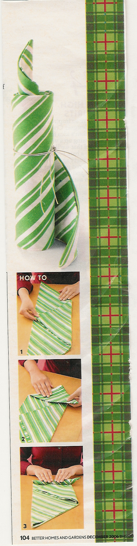
Notes:
Another fun demonstration idea.

Slide 29

Plant and Food Science a Natural Combination for Healthy Living
“My Health for Better Living”
Notes:
Print all 6 slides on 11 X 17 paper and mount on poster board for quick visuals.

Slide 30
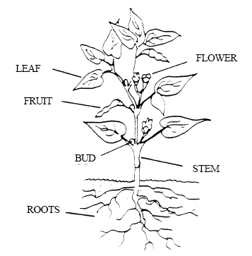
Major Organs of a Plant
Notes:
Flower – to pollinated so it becomes a fruit.
Fruit – to produce seed so other plants can be produced.
Roots - take water and minerals from soil for the plant to make food.
Stem – moves water and minerals from roots to other parts of plant. Retuns food to be stored in roots.
Leaf – makes food. When sun shines on a leaf, it takes carbon dioxide and the water that is already in the plant to make sugar. Chlorophyll in the leaves help make this possible. As the food is being made, the plant gives off oxygen which is important to animal life. “Photosynthesis”

Slide 31
Plant to Plate
Plant Organs consumed for nutrition:
  Stem
  Leaf
  Seed
  Root
  Bulb
  Flower
  Fruit
Notes:
Stems – asparagus, celery, rhubarb
Leaf – lettuce, spinach, cabbage, parsley, swiss chard, collard greens, dill,
Seed – corn, wheat, soy, beans, peas, bean, lima bean
Roots – beets, carrots, radishes, turnip, sweet potato
Tubers – potato, (fleshy tuberous root)
Bulb – garlic, onion, water chestnuts
Flower – broccoli, cauliflower, brussel sprouts
Fruits – apples, oranges, banana, cherry, berries, pumpkin, cantaloupe, tomatoes, eggplant, okra, pepper, squash, watermelon, cucumber, grape, plum, apricot, peaches

Slide 32
Spinach Dip
1 cup of low fat salad dressing
1 cup low fat sour cream (8 oz)
1 (10 oz) package of frozen chopped spinach (thawed and juices squeezed out)
1 pkg of Knorr Swiss Vegetable Soup Mix
1 can sliced Water Chestnuts (drained and washed)
Mix all ingredients in a large bowl. Refrigerate before serving.
Serve with fresh vegetables or crackers.
Makes 14 servings
Notes:
Let the dip set over night for the best flavor.

Slide 33
Vegetable Products in Recipe
Salad Dressing
Soybean Oil - bean
Corn syrup – corn seed
Sugar – sugar cane stem or beet tuber
Starch – corn or wheat seed
Mustard - seed
Paprika -stem
Garlic - bulb
Dip Mix
carrot, onion, tomatoes, celery, leeks, cabbage, peas, potato starch, corn protein, soy bean oil, spices
Spinach – leaf
Water chestnuts – bulb
Served with vegetables or crackers. Crackers being made from grain – the seed of a plant.

Slide 34
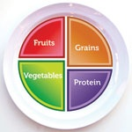
Spinach Dip Nutritional Information
76 calories per serving
3% dietary fiber
3% trace iron
8% vitamin C
31% vitamin A
6% folic acid
Notes:
The USDA encourages us to eat 5 A Day, that is 5 servings of vegetables and fruits each day, along with drinking lots of water and getting plenty of exercise to maintain our health.
Spinach Dip Nutritional Information – 76 calories per serving
9% total fat
5% saturated fat
3% cholesterol
2% carbohydrate
3% dietary fiber 7% sodium
3% trace iron
8% vitamin C
31% vitamin A
6% folic acid
Plant and Food Science are a natural combination for Healthy Living.
Fruits and Vegetables are filled with vitamins and minerals.
We receive physical exercise from producing our own gardens and encourage good mental health by having a hobby such as gardening or cooking.
Through both my plant and food science 4-H projects I am able to achieve as our 4-H pledge states
“My Health for greater living in my club, community, country and world.”

Slide 35
Activity
Evaluate Visuals
Notes:
Have examples of visuals for the group to evaluate.

Slide 36
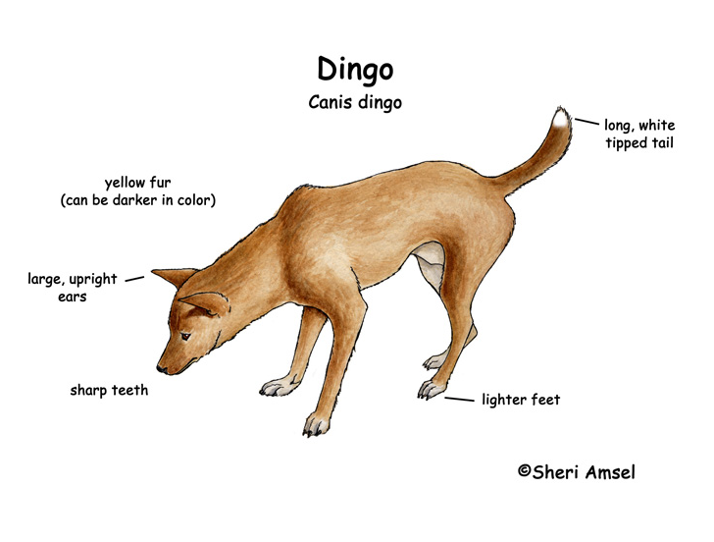
How does this visual measure up?

