Slide 1
Cannons & Catapults

Slide 2
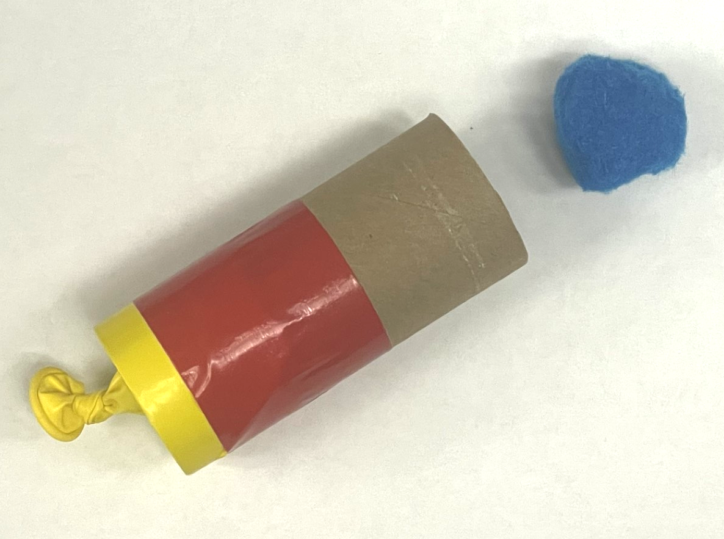
Build a Cannon
Trim the top off the balloon and tie a knot in the stem end.
Stretch the open end of the balloon (the end you cut off) over one end of the toilet paper tube / pool noodle. Center it so the knot in the balloon is centered on the hole in the tube/noodle.
Use duct tape to secure the balloon to the tube/noodle.
To fire the cannon, load it with a pom pom, then pull back on the knot on the balloon and let it go!

Slide 3
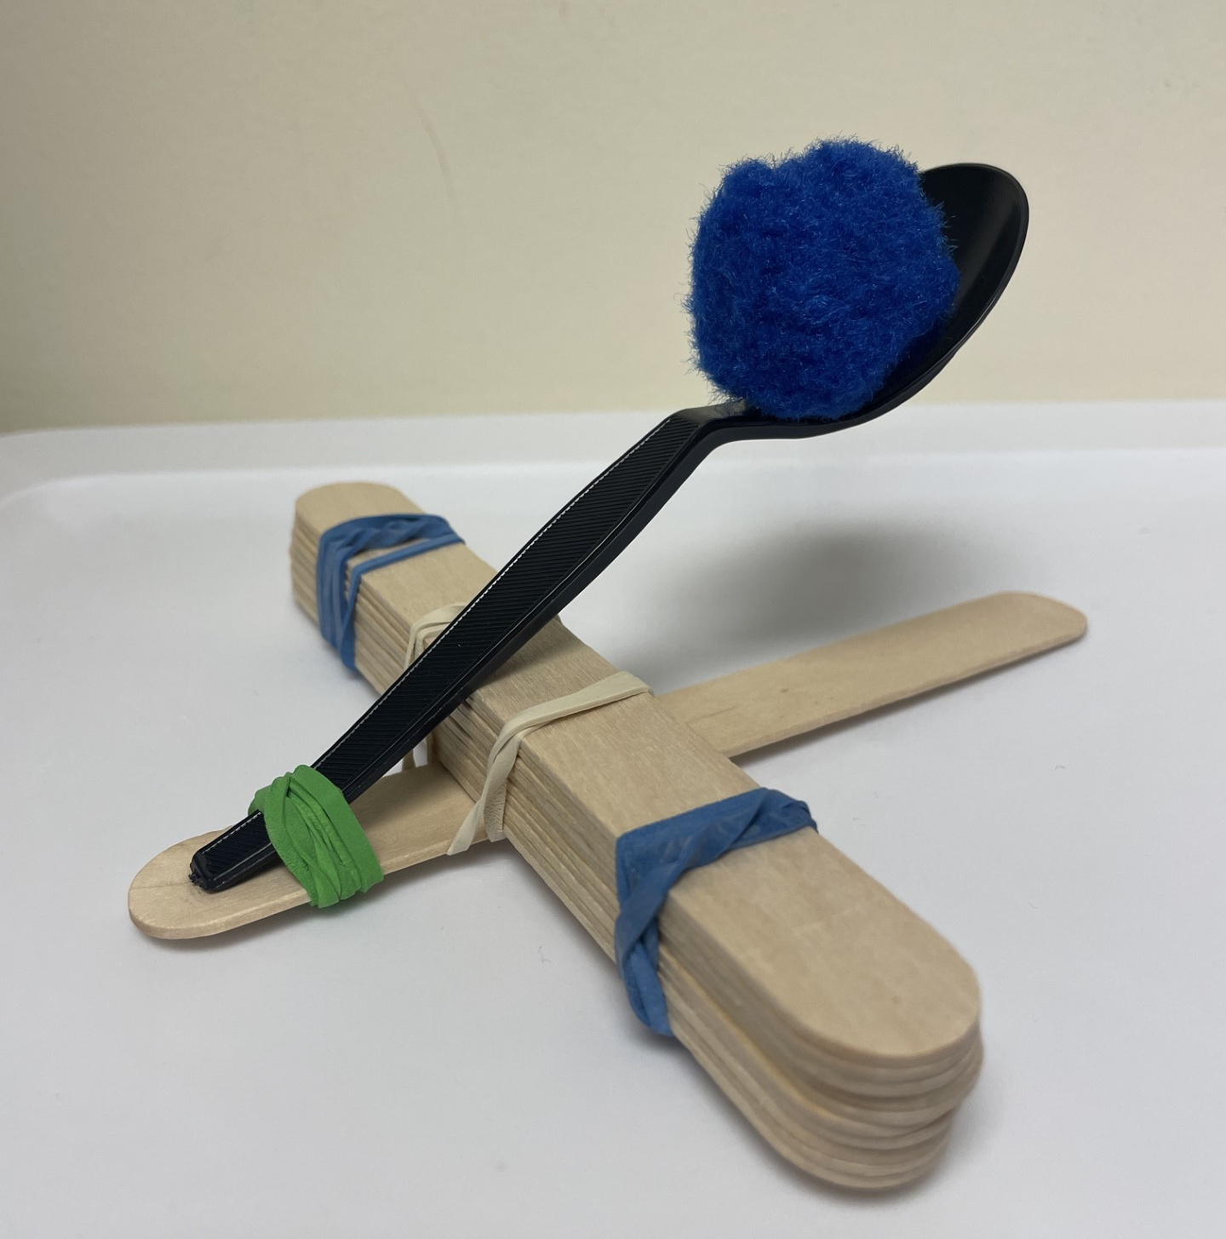
Build a Catapult
Stack 10 jumbo craft sticks together and wrap a rubber band around each end.
Take one jumbo craft stick and a spoon. Use a rubber band to attach them together at one end.
Separate the spoon and the craft stick and insert the
stack of craft sticks from step one in between them.
Use rubber bands to secure the catapult together.
Push down on the spoon and release to launch your
pom pom!
Notes:
A sample design

Slide 4
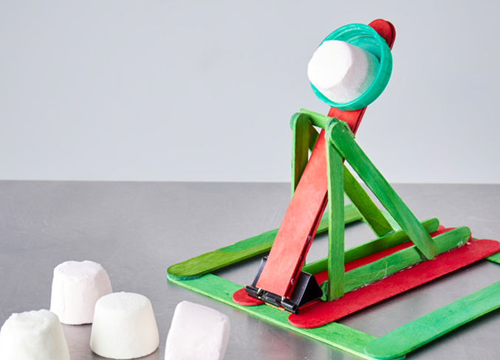
Build a Catapult - continued
See the Guiness Book of World Records Marshmallow Catapult design from CLOVER or research other ideas online!
Notes:
Another Example – research other ideas online!
The Guiness Book of World Records Marshmallow Catapult design from CLOVER:
National 4-H Council. “Marshmallow Catapult.” CLOVER by 4-H, 21 Sept. 2023, 4-h.org/clover/activities/marshmallow-catapult/.

Slide 5
Newton’s Laws of Motion
1st Law - An object at rest will remain at rest until an outside force acts upon it.
  What outside force is acting on our pom pom?
2nd Law - Force = Mass x Acceleration
  What append when you apply more/less force?
  What happens if you use a heavier or lighter mass?
3rd Law - For every action there is an equal and opposite reaction.
  Identify the action & equal and opposite reaction.

Slide 6
Energy Transformations
First Law of Thermodynamics: Energy cannot be created or destroyed, only transferred from one form to another.
What energy transformations take place with your cannon/catapult?
Elastic Energy: a kind of potential energy stored in elastic bands

Slide 7
Reflection
Were you successful? Why or why not?
What changes would you make to your design?
What is another example of one of Newton’s Laws in action?
What is another example of an energy transformation?

Slide 8


Contact Information
Kelly Wardlaw
4-H STEM Specialist
k.wardlaw@okstate.edu
Oklahoma State University as an equal opportunity employer, complies with all applicable federal and state laws regarding non-discrimination and affirmative action. Oklahoma State University is committed to a policy of equal opportunity for all individuals and does not discriminate based on race, religion, age, sex, color, national origin, marital status, sexual orientation, gender identity/expression, disability, or veteran status with regard to employment, educational programs and activities, and/or admissions. For more information visit https://eeo.okstate.edu

