Slide 1
Cup Constellations

Slide 2
What are Constellations?
What are some Examples?
Notes:
Explain that before we had computer, televisions, radios, or even books, people entertained each other by telling stories based on the images they saw in the sky. It was a way to entertain and educate. Stories were used to pass on history and important cultural beliefs and lessons.

Slide 3
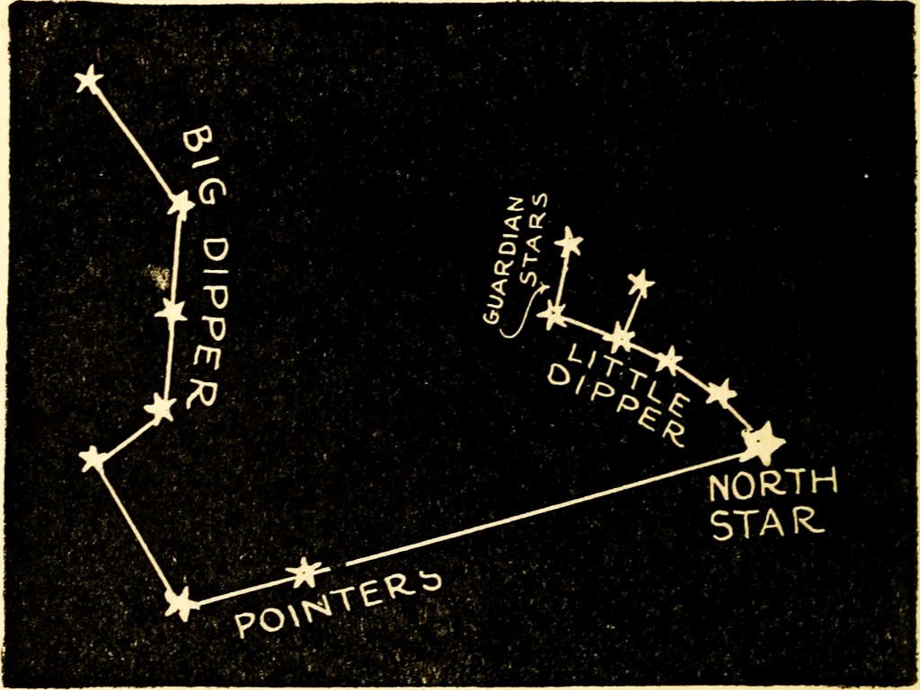
The North Star
Notes:
“For Explorers, particularly sailors (and pirates), Constellations had a more practical purpose. The stars were used for navigation.
Sailors used the North Star to determine their Latitude (see the Compass & Quadrants lesson) An easy way to locate the North Star is th use the “Pointer” stars in the Big Dipper.”
Fun Facts -
The name of the North Star is Polaris.
Contrary to popular belief, Polaris is not the brightest star in the sky. That designation goes to Sirius a star in the Canis Major Constellation. For Harry Potter fans, you might recognize that name as Harry’s Godfather Sirius Black, it is no coincidence that his animagus is a dog! Do you notice any other “stars” in the Black family tree?
The Southern Cross - an asterism in the constellation Crux - plays a similar role in the southern hemisphere, pointing south.

Slide 4
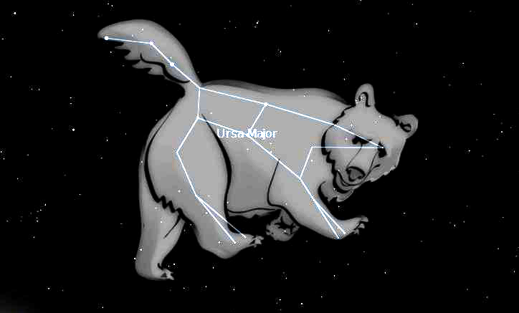
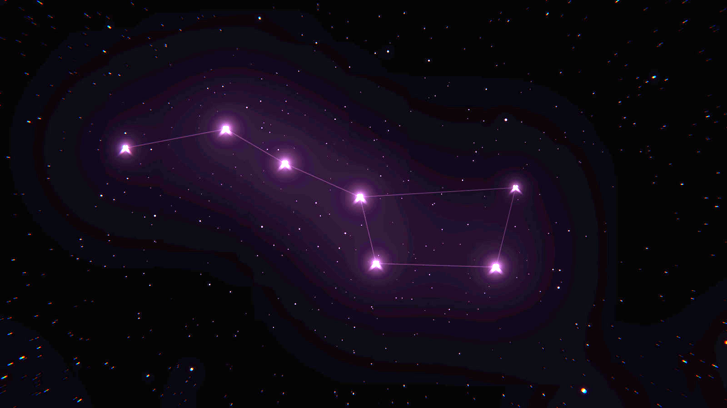
Constellation
vs.
Asterism
A group of stars forming a recognizable pattern often named for a mythical figure. There are 88 defined Constellations
A familiar pattern or group of stars, having a popular name but smaller than a constellation.
Notes:
Fun Note - The “Big Dipper” is not a constellation, it is a part of the constellation Ursa Major. A familiar group of stars like this with a popular name is called an Asterism.

Slide 5
Cup Constellations Project
Choose your constellation.
Cut out the circle and securely attach it to the bottom of the cup. A bit of tape could be used in needed.
Carefully use the push pin to poke holes in each of the stars/dots on in the constellation.
Look through the open end of the cup to view your constellation!
You could also shine a light through the cup to project your constellation on a wall or ceiling!
Notes:
“Today, we are going to make a model of a constellation. Planetarium are places people can go to see images of the stars and planet projected on the ceiling. We will be able to use our models to project images too.”
Note: The constellations are printed backwards on the sheet - but when you look through the inside of the cup or project the image, it will look as it should!
Safety:
Use caution with the pushpins - they are sharp.
If outside when looking through the cups, be sure to caution students to not look directly at the Sun.

Slide 6
Reflection
What purposes have Constellations served?
Why did you choose the constellation you used?

Slide 7


Contact Information
Kelly Wardlaw
4-H STEM Specialist
k.wardlaw@okstate.edu
Oklahoma State University, as an equal opportunity employer, complies with all applicable federal and state laws regarding non-discrimination and affirmative action. Oklahoma State University is committed to a policy of equal opportunity for all individuals and does not discriminate based on race, religion, age, sex, color, national origin, marital status, sexual orientation, gender identity/expression, disability, or veteran status with regard to employment, educational programs and activities, and/or admissions. For more information, visit https://eeo.okstate.edu.

