Slide 1
Pirate ship anatomy

Slide 2
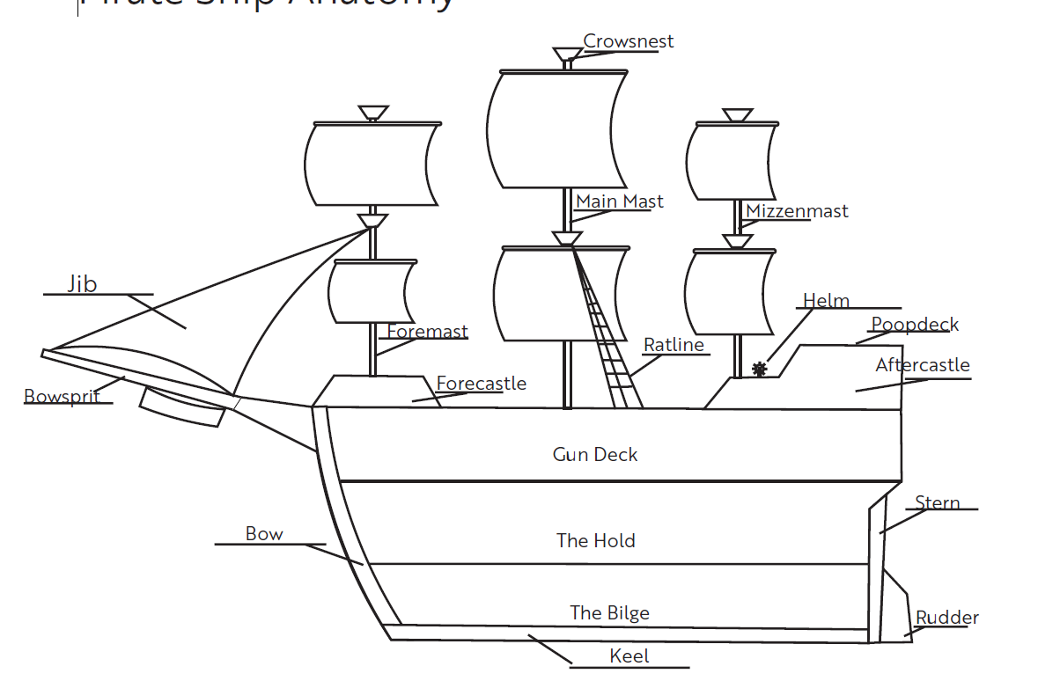
Anatomy of a ship
Notes:
Have students use this diagram to label the picture on their worksheet.
You may choose to use Signs to label different areas of the building/classroom. For example, label the front of the classroom the “Bow” and the back of the classroom the “Stern”
The bathroom on a boat is called the “Head”
The kitchen is called the “Galley”
“Cabin” refers to sleeping quarters

Slide 3
Directions on a Boat
Port - the left side
(when facing the Bow)
Starboard - the right side (when facing the Bow)
Fore - shortened from forward, refers to the front section of the boat, or the Bow
(rhymes with wow)
Aft - opposite of fore, to move to the back or stern of the boat
Notes:
“The terms “front, back, right, left” are not used on a boat - rather you should refer to the directions as “Fore, Aft, Starboard, and Port”
Remember “Port” by using the mnemonic “The Boat Left Port” (port is on the left).”
Want to learn more pirate terms? Check out https://www.pirateglossary.com - use with caution not all terms may be appropriate for children!

Slide 4
Design & build a paddle boat

Slide 5
Propulsion
the act or process of moving something forward
Notes:
“What do pirate ships use for propulsion?”
“Today we will be using a rubber band to provide propulsion for our boats.”

Slide 6
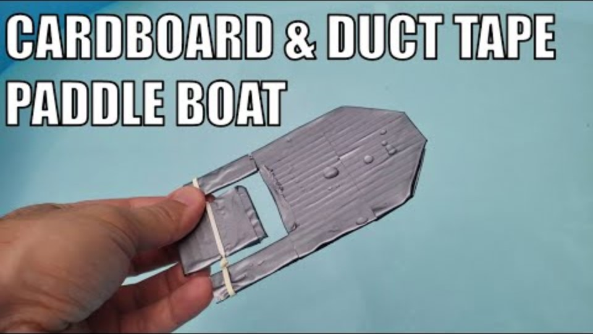
How to create Cardboard and duct tape paddle boat
Notes:
Video Link: https://www.youtube.com/watch?v=bwAuJWCy1S0&t=1s
ONLY SHOW THE FIRST 5 SECONDS
The rest of the video shows how to construct this specific style of paddleboat.
Briefly discuss and demonstrate how the rubber band / paddle provides the propulsion for our boat:
When you “wind up” the rubber band it stores energy called potential energy. When the paddle is released, that potential energy is transformed to kinetic energy which spins the paddle.
The paddle wheel on the boat works by transferring the rotational motion of the paddle to propulsive motion that pushes the boat forward.
The larger the paddle wheel blades the faster the boat will go. The bigger blade displaces more water pushing the boat faster.
Something else to consider: a pointed bow (front) minimizes drag from water resistance and helps the boat move through the water.

Slide 7
Energy Transformations & Propulsion
The paddle wheel on the boat works by transferring the rotational motion of the paddle to propulsive motion that pushes the boat forward.
When you “wind up” the rubber band it stores energy called potential energy. When the paddle is released, that potential energy is transformed to kinetic energy which spins the paddle.
The larger the paddle wheel blades the faster the boat will go. The bigger blade displaces more water pushing the boat faster.
Something else to consider: a pointed bow (front) minimizes drag from water resistance and helps the boat move through the water.

Slide 8
Definitions
Potential Energy - stored energy
Kinetic Energy - motion energy
Drag - resistance of a fluid, force that opposes motion

Slide 9
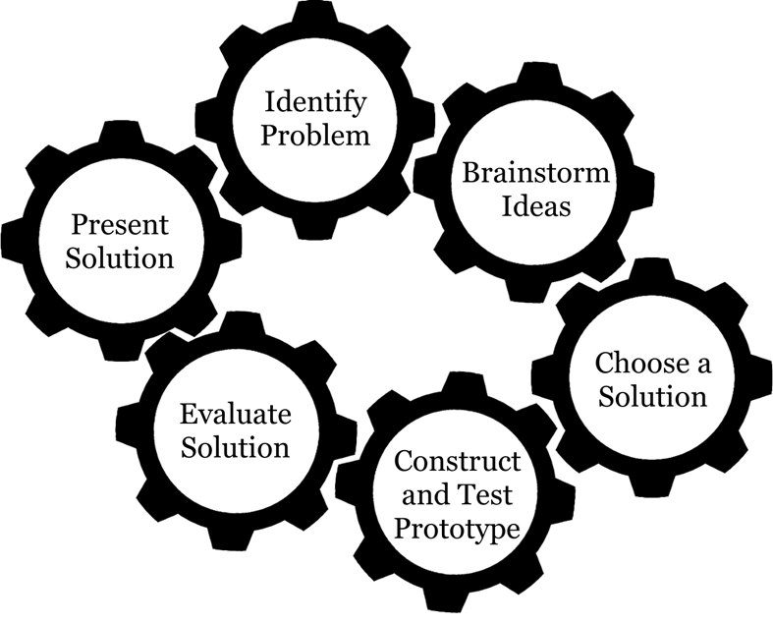
Engineering Design Process
Notes:
“Remember our Engineering Design Process? We are going to use this to help us with our design!”

Slide 10
Identify the Problem
Notes:
Have students Identify the Problem. Encourage them to state the problem in their own words.

Slide 11
Brainstorm & Sketch Ideas
Notes:
Make some sketches of your ideas.

Slide 12
Choose a Solution
Draw your chosen design,
complete with measurements!

Slide 13
Construct & Test Prototype
Use Duct tape to make
your design waterproof!

Slide 14
Evaluate Solution
Time to Test your Boat:
Stretch the rubber band across the gap on your boat.
Slide the paddle through the rubber band, twist it about 20 times.
Be sure to hold the paddle in place so it does not unwind!
Put your boat in the water and watch what happens.

Slide 15
Present Solution
Demonstrate and explain your boat to a partner.
Notes:
Have students partner up and share their boat designs. Demonstrate how the boat works and explain what works, what changes they would make, etc.

Slide 16
Reflection
Were you successful? Why or why not?
How far did your boat travel?
What happens if you wind the paddle 30 times?
What changes would you make to your design? Why?
Draw and label a picture of your final design.

Slide 17


Kelly Wardlaw
4-H STEM Specialist
k.wardlaw@okstate.edu
Oklahoma State University, as an equal opportunity employer, complies with all applicable federal and state laws regarding non-discrimination. Oklahoma State University is committed to a policy of equal opportunity for all individuals and does not discriminate based on race, religion, age, sex, color, national origin, marital status, disability, or veteran status with regard to employment, educational programs and activities, and/or admissions. For more information, visit https://eeo.okstate.edu.

