Slide 1
Penny Boat Challenge

Slide 2
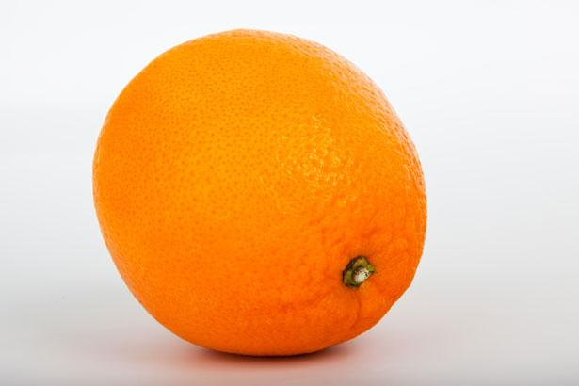
Will it Float?
Notes:
Show students an orange and ask - “Will it float?”
Gently place the orange in a bowl of water - “What happened?”
Now, peel the orange and hold it up for students to see. Ask again, “Will it float?”
Gently place the peeled orange in a bowl of water - “What happened?”

Slide 3
Why did the orange float with the peel on, but not with the peel off?
Notes:
Give students a portion of the rind to observe.
Give them a chance to come up with ideas before providing the explanation.
Explanation: The rind of the orange contains lots of tiny air pockets which help the orange float, similar to a life jacket. When you remove the rind, or take off the life jacket, the orange sinks.

Slide 4
Bonus Fact!
Scurvy was a common disease among pirates and sailors. Scurvy is caused by a lack of Vitamin C, commonly found in lemons, limes, and oranges!
Notes:
Learn more than you ever wanted to know about Scurvy here:
https://sciencehistory.org/stories/magazine/the-age-of-scurvy

Slide 5
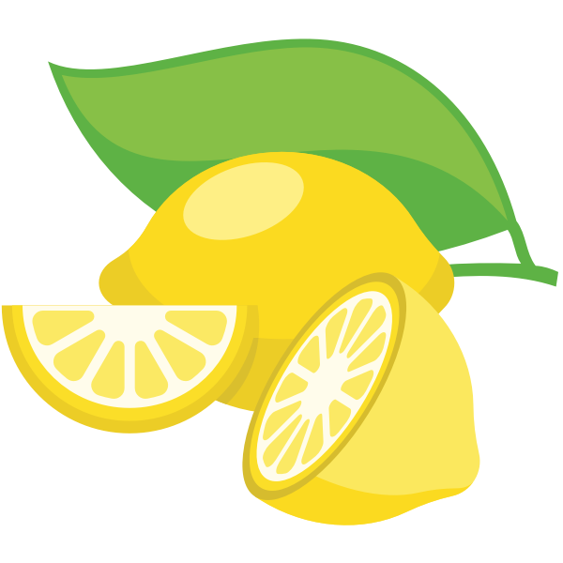
Scurvy
When Life Doesn’t Give You Lemons!

Slide 6
Buoyancy
Objects float when the weight of the object is less that the weight of the water displaced.
Also known as
Archimedes Principle
Notes:
To learn more check out: https://mocomi.com/buoyancy/

Slide 7
Challenge Rules
Each group will receive only ONE sheet of heavy duty aluminum foil that measures 30cm x 30cm.
You will not receive a replacement for ANY reason!
Pennies are the only items that will be added to the boat.
Once water enters the boat, or if any part of the boat touches the bottom of the container, your turn is over.
The last penny will NOT be counted in the total amount held.
Students will have 5 minutes to plan and 10 minutes to build their boats.
Notes:
Instruct students to make a prediction and brainstorm some ideas for their boat on their worksheet.

Slide 8
Test Procedure
One member of your group will be responsible for adding the pennies to the boat.
Two members of the group will be responsible for keeping count and watching for signs of water entering the boat.
Once you are finished testing, record your total number of pennies - remember NOT to count the last penny added!
It is your responsibility to collect all used pennies and dry them thoroughly for the next group. Pennies must be DRY for the test.
Notes:
Remind students to record the total number of pennies their boat held - remember NOT to count the last penny added.

Slide 9
Reflection
How did you solve this problem?
What worked? What didn’t work?
What would you change if you had a chance to do this activity again?

Slide 10

Contact Information
Kelly Wardlaw
4-H STEM Specialist
k.wardlaw@okstate.edu
Oklahoma State University as an equal opportunity employer, complies with all applicable federal and state laws regarding non-discrimination and affirmative action. Oklahoma State University is committed to a policy of equal opportunity for all individuals and does not discriminate based on race, religion, age, sex, color, national origin, marital status, sexual orientation, gender identity/expression, disability, or veteran status with regard to employment, educational programs and activities, and/or admissions. For more information, visit https://eeo.okstate.edu

