Slide 1
Sphero BOLT Robots

Slide 2
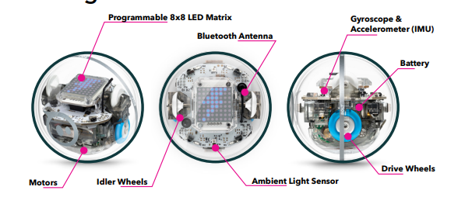
About the Sphero BOLT

Slide 3
Program Types
Drive – drive the robot like a remote-control car, no coding necessary
Draw – draw a path on the screen for your BOLT to travel, change the colors and speed by clicking on the tools on the bottom left of the screen
Blocks – use drag and drop block coding to design a program for your robot, gives you more control and write more complex programs
Text –use JavaScript to write code

Slide 4
Connecting
Tap the "Connect Robot" icon at the top right of your screen.
Select your robot type.
Hold your robot next to the device and select it to connect. If you are using multiple robots, look for the robot with the strongest bluetooth signal.
Tip: If you are connecting with a group, connect one at a time, otherwise you may not know which BOLT you connected to. Once you have connected, change the color of your robot to help you keep track of it!
Troubleshooting: If a Sphero cannot be detected move your device closer to the robots. If you are unable to connect, close the app, then reopen it and try again

Slide 5
How to Aim
Click on the aim icon, this will bring up a wheel that lets you aim the robot
Blue light indicates the “back” of the robot
i.e. when you tell your robot to go forwards it will move in the opposite direction of the blue light
Move the wheel so the blue light is point toward you
Aim Often!
check your aim each time before running a program to make sure your robot is oriented correctly

Slide 6
Let’s get connected!
Once you get connected:
Practice Driving your robot
Click on the “drive” button in the lower left corner
Change to color of your robot using the color wheel on right side
Practice “aiming” – button on lower left of drive screen
Experiment with the speed of your robot – slider bar just to the right of the “joystick”
To close “Drive”, click in the blurred area at the top of the screen

Slide 7
Using Blocks
Go to the “My Programs” screen in the app
Click on the + sign
Enter a program name i.e. FirstName Blocks1
Under “Choose Program Type” click Blocks
Make sure Sphero BOLT is selected under “Choose Compatible Robots”
Click Create

Slide 8
Using Blocks - continued
Blocks are divided into color-coded sections:
blue is movement
green blocks control lights
red plays sounds
Other colors indicate operators, sensors, variables and functions – these all come in for more complex codes.

Slide 9
Using Blocks – Build your program
To build your program:
Click on the first movement block (roll 0 at 0 speed for 0s) and drag it up to connect to the “on start” program block. Click on the 0s to add values for direction, speed, and time.
How far does your Sphero roll at a chosen speed in 2 seconds?
What speed and time values should you use to get your Sphero to travel 1 foot (30cm)
Use the Exit Program block (purple) to end or stop the program

Slide 10
Code a Square
Build a program to have your Sphero make a square
Use the Exit Program block (purple) to end or stop the program
Experiment with Blocks
Make your Sphero a different color for each side of the square.
Have your Sphero stop and make a sound at each corner.
Have your Sphero count and show the number of sides using the animation matrix.
Drive a square with sides that are exactly 2 feet.
Repeat the square 3 times using the Loop Block.

Slide 11
Reflection
What values did you use for heading inputs?
Did your BOLT roll in a square? Why or why not?
What different blocks did you try? What did they do?
What changes did you make to your program?
Compare your program to a neighbor. Are they exactly the same? Why or why not?
Is there ONE right way to write a program?
How do you know if you were successful?

Slide 12
Questions?

Slide 13

Contact Information
Kelly Wardlaw
4-H STEM Specialist
k.wardlaw@okstate.edu
Oklahoma State University, as an equal opportunity employer, complies with all applicable federal and state laws regarding non-discrimination and affirmative action. Oklahoma State University is committed to a policy of equal opportunity for all individuals and does not discriminate based on race, religion, age, sex, color, national origin, marital status, sexual orientation, gender identity/expression, disability, or veteran status with regard to employment, educational programs and activities, and/or admissions. For more information, visit https://eeo.okstate.edu.

Slide 14
Draw
Go back to the “My Programs” screen in the app
If you have “Drive” open, just click in the blurred area at the top of the screen to close
Click on the + sign
Enter a program name i.e. FirstName Draw1
Under “Choose Program Type” click Draw
Make sure Sphero BOLT is selected under “Choose Compatible Robots”
Click Create

Slide 15
Draw - continued
This opens a grid canvas for you to draw on
Notice the Aim button is on the top right
Next to Aim is the Drive button which opens the drive screen
The color wheel is at the bottom right
This also brings up the speed bar
Undo/redo buttons are to the right of the color wheel
Draw a square
Aim Often!
Click on the Start button to send the program to your robot

