Slide 1
Sphero Treasure Hunt
Notes:
If students have not done any coding with the Sphero BOLT Robots, it is recommeded you complete the Sphero Basics lesson prior to trying this ones to lay the groundwork.
“So far we have driven our robots, and used block coding to write a program for the robot to follow. Today we are going to learn how to use functions.”

Slide 2
Functions
A reusable group of blocks you can use anywhere in the program to perform specific tasks
This program uses 8 predefined functions:
Forward, Backward, Right, Left, Forward-left, Forward-right, Back-left, and Back-right
Each of these functions contains a sound, color, and movement.
Notes:
“Functions let you define a reusable group of blocks that you can reuse anywhere in the program. This program has 8 functions: forward, backward, right, left, forward-left, forward-right, back-left, and back-right. In this activity, the functions are already defined and ready for you to use. Each of these functions contains a sound, color, and movement.”

Slide 3
Functions for Sphero to reach treasure
→ → → ↑ ↑ → ↓ ↓
Forward
Forward
Forward
Left
Left
Forward
Right
Right
Exit Program
Notes:
“In this lesson, we will use the Functions (forward, backward, right, left, forward-left, forward-right, back-left and back-right) to write a program for our Sphero to reach the treasure.”
*See Slide 12 for a sample Sphero program for this treasure map.
Note:
Forward = →
Left = ↑
Right = ↓

Slide 4

How to video
Notes:
Video Link: https://www.youtube.com/watch?v=g62Thbu3Sxo

Slide 5
On your Sphero Edu app
Go to “Programs”
Click on “Sphero Programs”
Click on the magnifying glass to open the search box.
Type “Treasure Hunt” and click “search”.
Click on the “#ThursdayLearnDay Treasure Hunt” program.
If prompted, click “View Program”
This will open up your programming canvas with the function and program blocks pre-loaded.

Slide 6
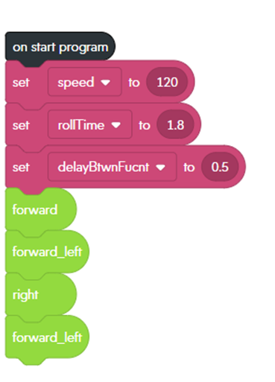
Sphero Bolt demo program
on start program – program blocks should all be connected to this starting block
Red blocks – define parameters for the functions…these blocks show up in the define function blocks
Green blocks – functions, when these blocks come up on the code, the robot complete all the actions attached under the define block for that function
Notes:
You may want to connect to a Sphero BOLT and demo this program for students to see how it works.

Slide 7
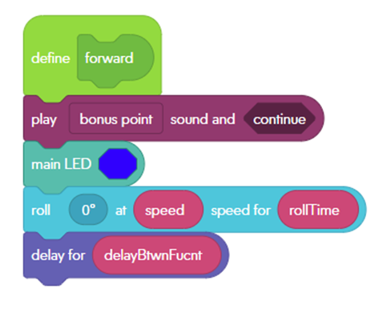
Eight functions on start
Green define block – starting point for the instructions associated with the function listed
Maroon blocks – plays sound
Teal block – changes main LED color
Turquoise blocks – movement block – notice the Red parameters that go with the values set under the “on start program” block
Notes:
You should notice the 8 Functions are defined below the on start program block. Notice that each function includes a sound, LED color, and movement instructions.

Slide 8
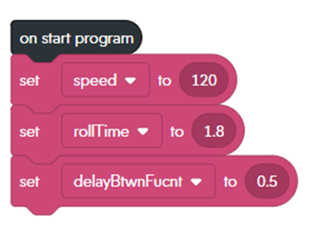
Sphero obstacle course navigation
Notes:
“One of the first things you need to decide on are values for speed and roll-time. Once you have decided on those values, come up with a plan to navigate your Sphero thru the Obstacle Course. It might be helpful to draw out a picture like shown on slide 3. Before beginning your program, delete the green function blocks attached under the “on start program” block. Then add in the functions you determined you need to reach the treasure.”

Slide 9

Start Coding!
Choose values for speed and roll time.
Hint: Open a blank program and see what speed/roll time you need to have the Sphero roll 1 foot.
Build your best code - then test & refine.
Avoid “trial & error” coding!
Use the Exit Program block to end or stop the program once you reach the treasure.
Notes:
Note - see slide 13 for instructions on creating your own function!

Slide 10
Reflection
Do you think using Functions make coding easier or harder? Why?
What are some other ways Functions could be used?
Notes:
Note - see slide 15 for instructions on creating your own function!

Slide 11
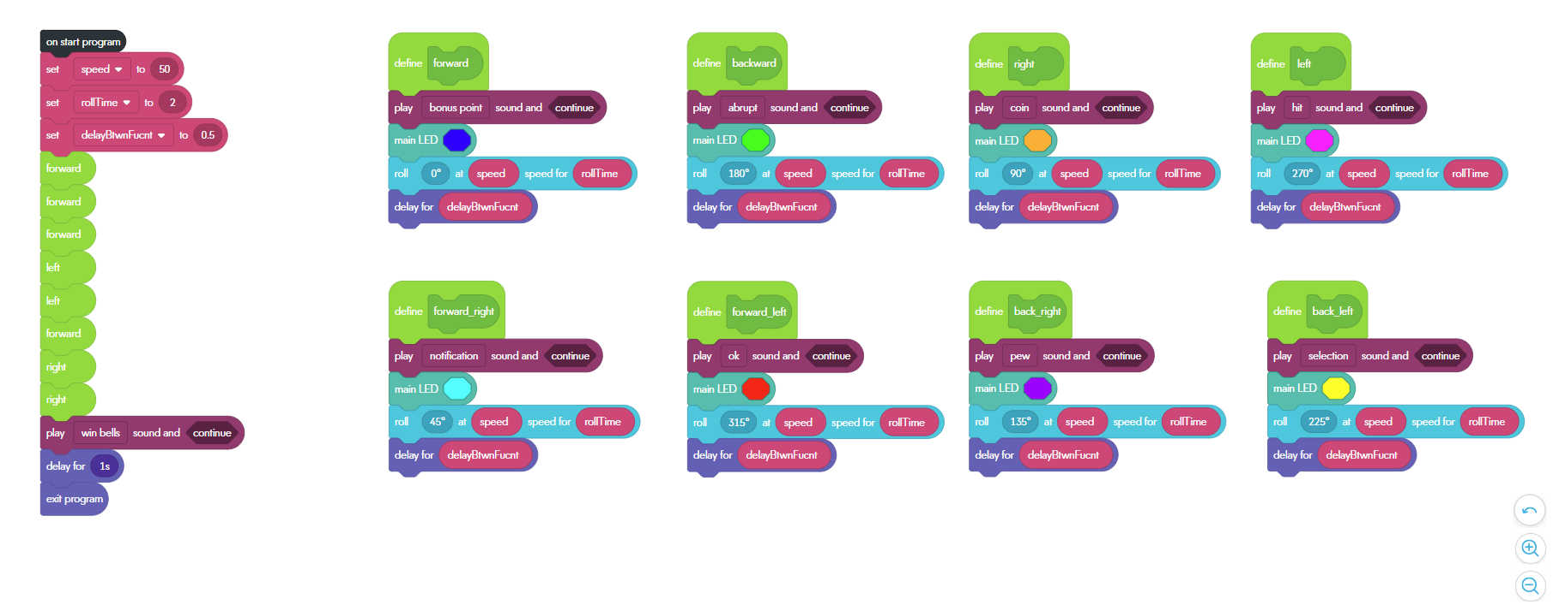
Celebration program
Notes:
Note - the end of this program includes a “celebration” where the Sphero plays a “win” sound before the program exits.

Slide 12
Create your own function
Go to the “Functions” section of the block code menu.
Click “Create a Function”
This will create a new block in your block menu and add a “Define” block on your workspace.
Drag and drop the commands you want to use for the new function by connecting them to the “Define” block.
Now when you use this function in your code, it will complete this set of defined commands.

Slide 13


Contact information
Kelly Wardlaw
4-H STEM Specialist
k.wardlaw@okstate.edu
Oklahoma State University, as an equal opportunity employer, complies with all applicable federal and state laws regarding non-discrimination. Oklahoma State University is committed to a policy of equal opportunity for all individuals and does not discriminate based on race, religion, age, sex, color, national origin, marital status, disability, or veteran status with regard to employment, educational programs and activities, and/or admissions. For more information, visit https://eeo.okstate.edu.

