Slide 1
Strange New Planet

Slide 2
New Discovery!
A New Planet has been discovered!
Your job is go find out all about it!
What questions do you have?
How might you answer those questions?
Today, we are going to learn about some of the ways NASA Scientists learn about planets and other objects in our Solar System and Beyond!

Slide 3
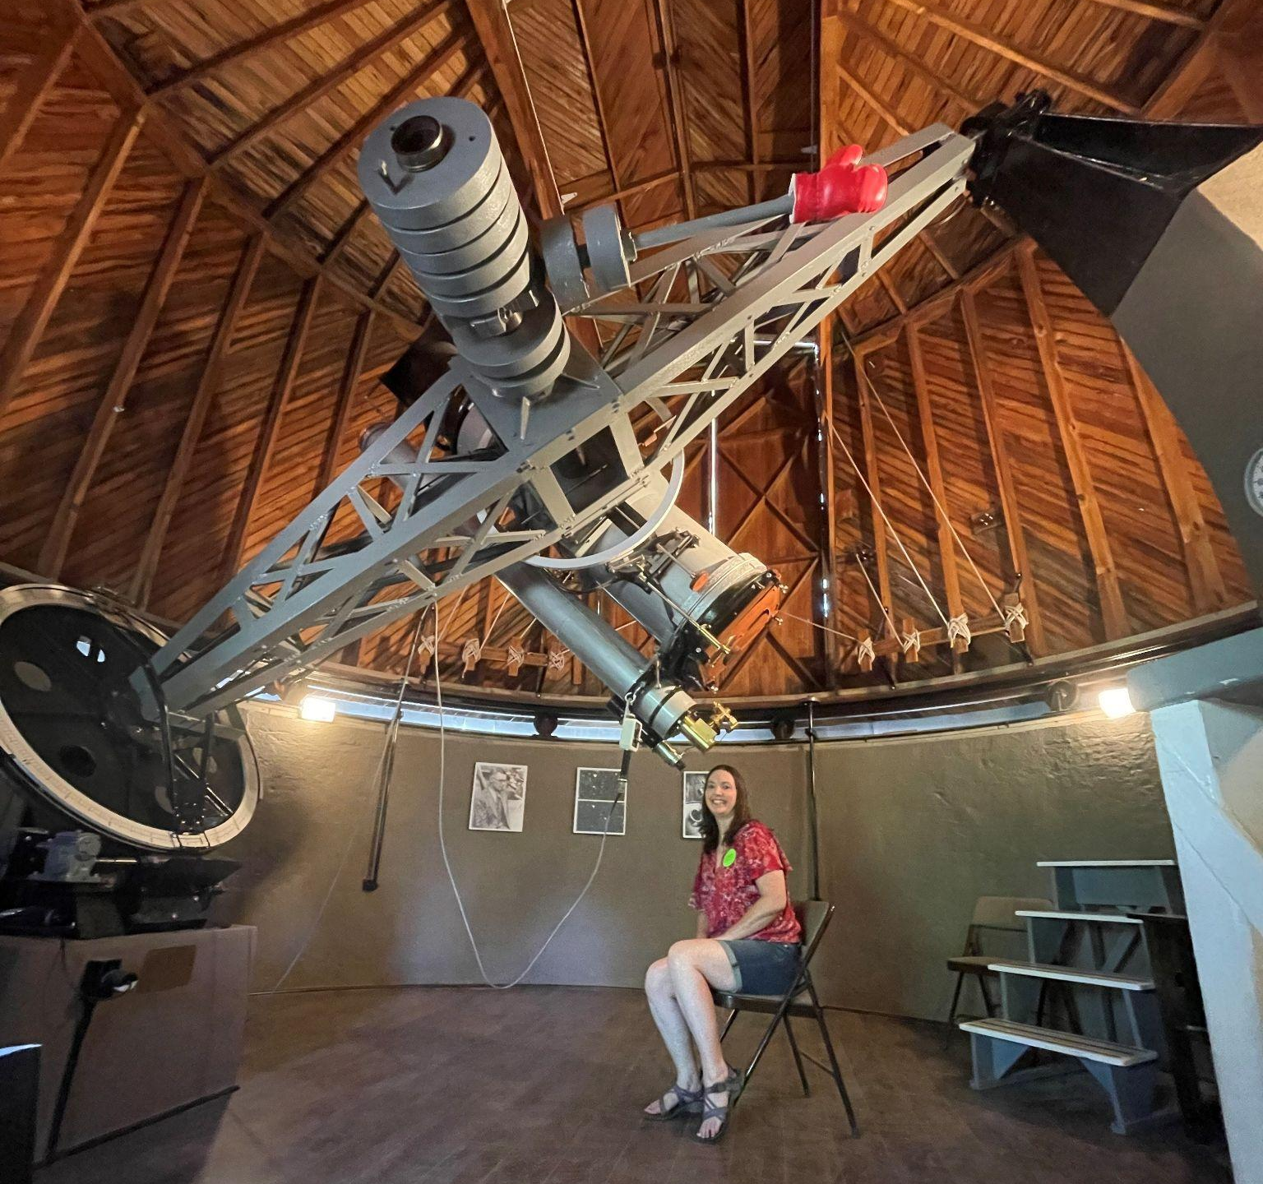
Earth Based Observatory
Start by observing your planet through your telescope - only look through the telescopes! You will have 30 seconds!
What do you observe?
What questions do you have?
Write/draw observations/questions on
your worksheet.
What does the Blue Cellophane represent?
Lowell Observatory, Pluto Discovery Telescope Flagstaff, Arizona
Credit: Kelly Wardlaw

Slide 4
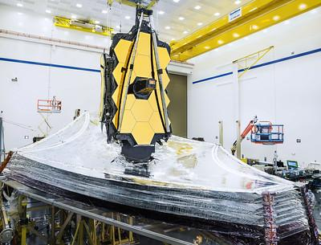
Space Based Telescope
Take one giant step forward and remove the blue cellophane from your telescope - we will make our next observations from space.
Like before, you have 30 seconds, and may only make your observations using your telescope!
What did you learn?
What questions do you have?
Record on your worksheet.
James Webb Space Telescope
Credit: NASA/Chris Gunn

Slide 5
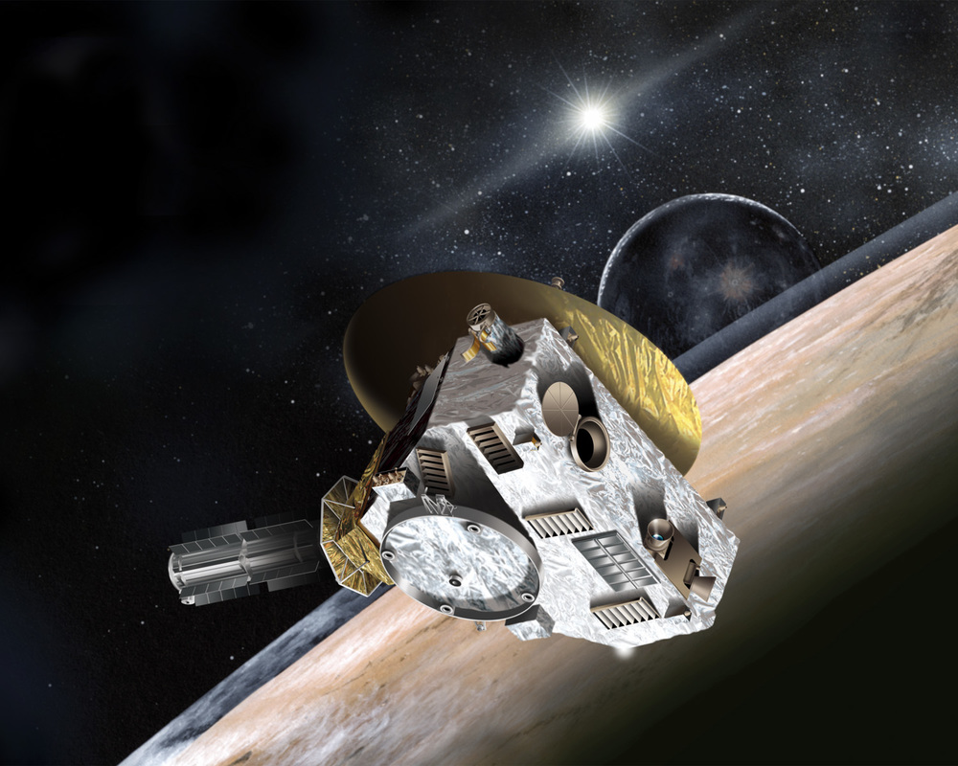
Flyby
Flies By Planet/Object
Generally, the first type of mission
Like driving by a house, what are some things you could learn?
What did you learn?
What questions do you have?
Record on your worksheet.
New Horizons
Credit: Johns Hopkins University Applied Physics Laboratory/Southwest Research Institute (JHUAPL/SwRI)
Notes:
Launched in Jan 2006 on its way to flyby Pluto, closest approach in July 2015
The cost of the mission, including the launch vehicle and operations through the Pluto-Charon encounter, will be roughly $650 million. Divided among the population of the United States at launch, over the 10-year duration of the mission, this comes out to about 20 cents per person, per year.
5

Slide 6
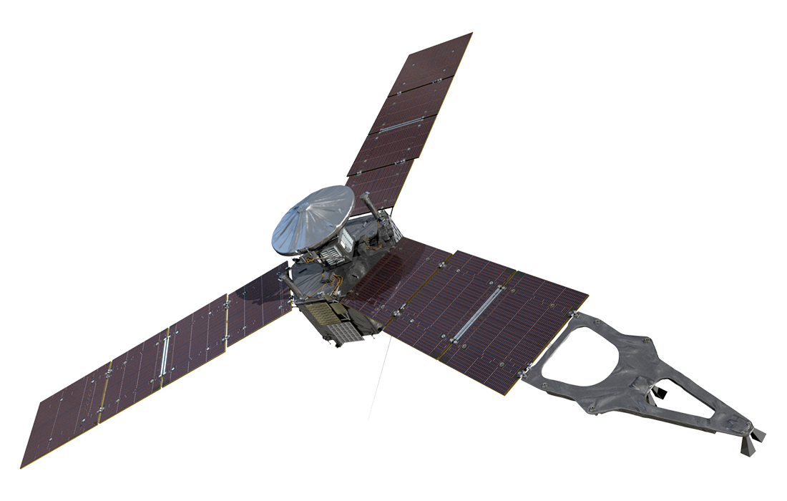
Orbiter
Goes into orbit around planet
Like walking around the house, what other things might you notice?
What did you learn?
What questions do you have?
Record on your worksheet.
Juno
​Credit: NASA/JPL-Caltech
Notes:
Juno – launched Aug 5, 2011, entered orbit July 4, 2016
Mission extended thru Sept 2025, or the end of spacecraft’s life
Cost - $700 million
6

Slide 7
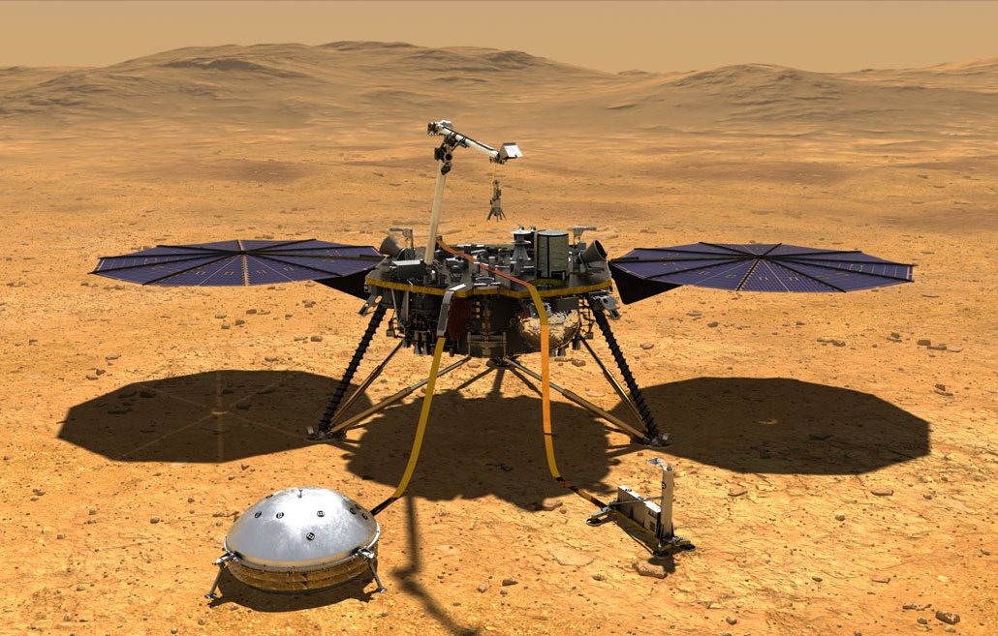
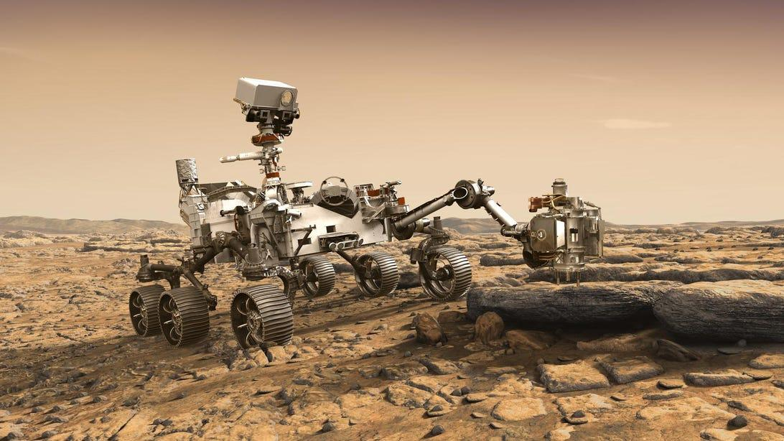
Lander
Lands on surface of planet
Can be stationary or rover!
Like going inside the house, now what can you learn?
What questions do you have that might be answered on a lander or rover mission?
Record on your worksheet.
Insight
Perseverance
​Credit: NASA/JPL-Caltech
Notes:
Insight – launched May 5, 2018, landed Nov 26, 2018. planned mission length about 2 years, extended thru Dec 2022
Cost $800 million
The InSight mission has two major goals, each with several science investigations, designed to help uncover the process that shaped all of the rocky planets in the inner solar system.
To understand how rocky planets formed and evolved, InSight will study the interior structure and processes of Mars by determining:
The size of the core, what it is made of, and whether it is liquid or solid.
The thickness and structure of the crust.
The structure of the mantle and what it is made of.
How warm the interior is and how much heat is still flowing through.
InSight will figure out just how tectonically active Mars is today, and how often meteorites impact it. For this, it will measure:
How powerful and frequent internal seismic activity is on Mars, and where it is located within the structure of the planet.
How often meteorites impact the surface of Mars.
https://www.jpl.nasa.gov/missions/insight
Perseverance – Launched July 30, 2020, landed Feb 18, 2021. planned mission length 687 Earth days. Special note: carried the Ingenuity Helicopter!
Perseverance - $2.2 Billion Ingenuity - $80 Million
The Perseverance rover has four science objectives that support the Mars Exploration Program's science goals:
Looking for Habitability: Identify past environments capable of supporting microbial life.
Seeking Biosignatures: Seek signs of possible past microbial life in those habitable environments, particularly in special rocks known to preserve signs of life over time.
Caching Samples: Collect core rock and "soil" samples and store them on the Martian surface.
Preparing for Humans: Test oxygen production from the Martian atmosphere.
All address key astrobiology questions related to the potential of Mars as a place for life. The first three consider the possibility of past microbial life. Even if Perseverance does not discover any signs of past life, it paves the way for human life on Mars someday.
https://science.nasa.gov/mission/mars-2020-perseverance/
7

Slide 8
Remember - these are all robotic missions, there are no people on board!

Slide 9
Questions?

Slide 10
Credits
Image Credits:
Lowell Observatory, Pluto Discovery Telescope, Flagstaff Arizona: Kelly Wardlaw
James Webb Space Telescope: NASA/Chris Gunn
New Horizons: Johns Hopkins University Applied Physics Laboratory/Southwest Research Institute (JHUAPL/SwRI)
Juno, Insight, Perseverance: NASA/JPL-Caltech
This presentation template was created by Slidesgo, including icons by Flaticon, and infographics & images by Freepik
Oklahoma State University, as an equal opportunity employer, complies with all applicable federal and state laws regarding non-discrimination and affirmative action. Oklahoma State University is committed to a policy of equal opportunity for all individuals and does not discriminate based on race, religion, age, sex, color, national origin, marital status, sexual orientation, gender identity/expression, disability, or veteran status with regard to employment, educational programs and activities, and/or admissions. For more information, visit https://eeo.okstate.edu.

