Slide 1
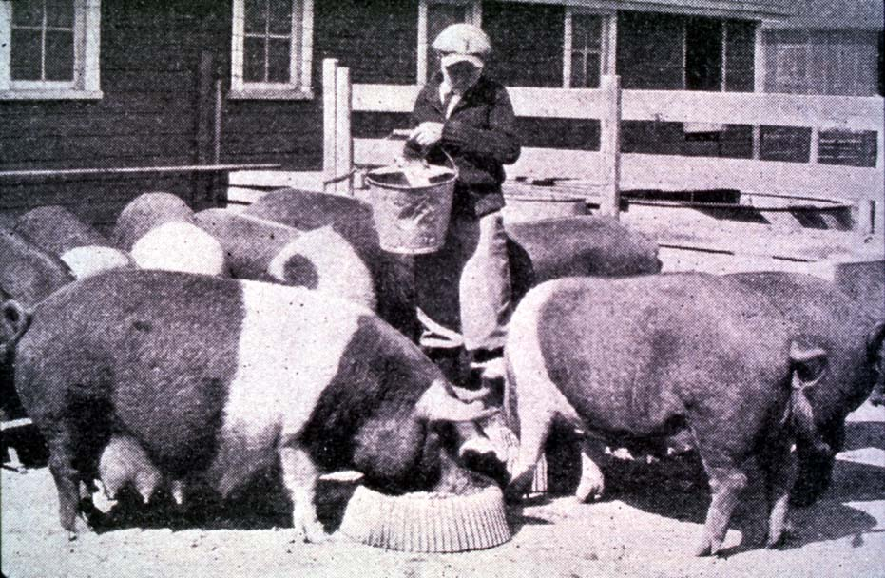


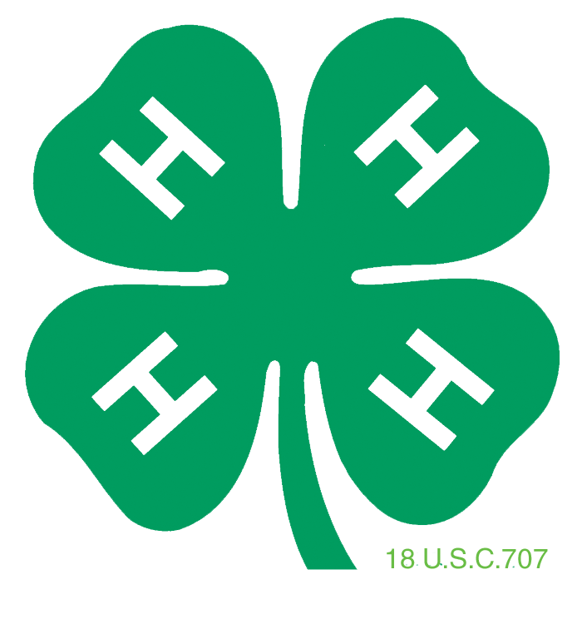

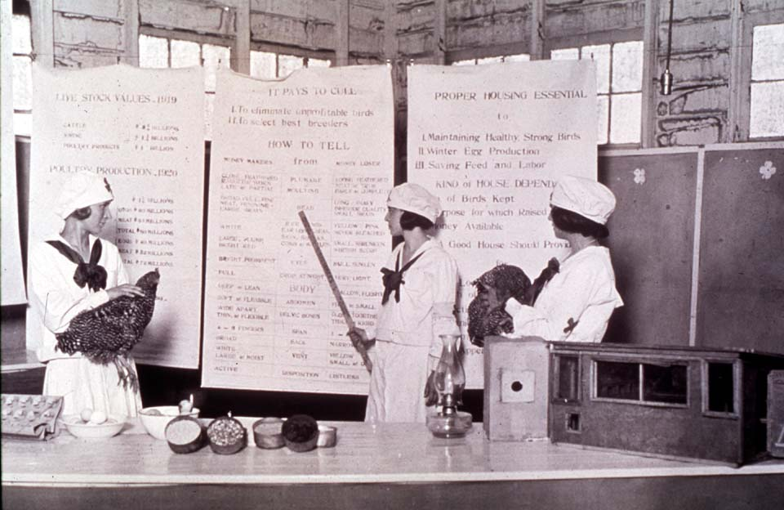


This is 4-H
History 4-H
oklahoma 4-h volunteer development
Notes:
Instructor Preparation – Allow 6-8 hours of preparation for 1 hour of instruction.
Review all materials thoroughly. Do any additional research or preparation to make yourself comfortable with the materials or to give it your personal touch.
Determine what other topic/subject matter will be presented with this “core” subject matter. It could be introducing the OK Hobbies and Collectibles project, National 4-H History Preservation Program, Grid Drawing, etc. This is a good topic to encourage, embracing and learning about History through 4-H programming.
Prepare handouts that complement the subject matter.
Teaching Outline
Unit 1 History of 4-H
4-H Guiding Principles
4-H Historic Timeline
Red Taxi - 4-H ...The Big Picture
PowerPoint Presentations
Unit 1 History of 4-H
The Great American Invention
The Great American Invention PPT Script
Activities
Word Search - History of 4-H
History of 4-H Activity Sheet
History of 4-H Answer Sheet
Grid Drawing Activity
Chris Clover Grid Drawing
Crayola Grid Drawing
Draw-the-Line
Grid- Drawing Lesson
Activities Continued
4-H 101 Lessons
Lesson 1_Introducing 4-H Youth Development
Lesson 4_Understanding the Culture of 4-H
Lesson 5_ Understanding 4-H Youth Development Delivery
Handouts
4-H Mission Mandates_ USDA
4H.VOL.111 Developing 4-H Project Work
Essential Elements of 4-H USDA
Name and Emblem_ USDA
Newsletter Support Materials
4-H is a Family Affair
Creating an Environment for Youth Development
The Great American Invention
What's in a Name?
Self Study Series
4HVOL201A_History CES and 4-H
4HVOL201A - Answers

Slide 2
History of 4-H
1999
Essential Elements
4-H was originally a means for reaching adults, through their children, with improved home and farm practices.
1972
Focus Broadened
1914
Clubs became part
of Agriculture Service
1911
4-H Name and Clover
Adopted
1902
Boys & Girls Clubs
Established
Notes:
In 1901 A.B. Graham, a school principal in Ohio, began to promote vocational agriculture in rural schools through out-of-school "clubs.“ In 1902 Graham formed a “club” of boys and girls with officers, projects, meetings and record requirements. He sought assistance of the Ohio Agricultural Experiment Station and Ohio State University. His clubs are considered the founding of 4-H.
The club concept was adopted in Iowa by O.H. Benson in Wright County and Jessie Field Shambaugh in Page county. Benson and Field designed a 3-leaf clover symbol representing the Head, Heart and Hands.
In 1911 the 4-H Name and Clover were adopted, followed by the clubs becoming part of the United States Department of Agriculture in 1914
As the nation began to urbanize and families were moving to the cities the focus of 4-H broadened. Program expansion and emphasis were on urban programming and audiences.
In 1999, a national design team was charged with determining the “critical elements in a 4-H experience.” The essential elements focus on four central concepts woven through out positive youth development.
See supplement – 4-H Historic Timeline for additional information.

Slide 3
Essential Elements of 4-H
Belonging 1. Positive Relationship with a caring adult 2. An inclusive environment A safe environment Heart | Mastery 4. Engagement in Learning Opportunity for Mastery Health
Independence 6. Opportunity to see oneself as an active participant in the future 7. Opportunity for self-determination Head | Generosity Opportunity to value and practice service for others Hands
Notes:
Handout - Essential Elements of 4-H - USDA
The Heart promotes a sense of belonging.
Caring adult acts as an advisor, guide and mentor. The adult helps set boundaries and expectations for young people.
Clubs and programs provide an inclusive environment that creates a sense of belonging, and encourages and supports positive and specific feedback.
A 4-H environment should be fearful or harmful physically or emotional.
The Health encourages mastery.
Mastery is the process of building knowledge, skills and attitudes over an extended period of time. Capable 4-H member demonstrate their experiences, knowledge and skill through project work.
Engaged youth are mindful of the subject area, building relationships and connections in order to develop understanding. Through self-reflection, youth have the ability to self-correct and learn from experience.
The Head encourages independence.
Youth are engaged in their own future, making choices and developing skills necessary for a transition into adulthood.
Youth have opportunities to have impact on life’s events rather than passively submitting to the will and whims of others, growing their sense of self-determination.
The Hands develop a sense of generosity.
4-H members find their self by losing them self in the service of others.

Slide 4
What is 4-H?
Youth development component of the Cooperative Extension Service
Largest youth serving organization in the world
Primary purpose is education and youth development
Notes:
Handout – 4H.VOL.114 Youth Development
Preparation – Read 4H 101 Lesson 1 and 3 and Red Taxi: 4-H The Big Picture.
The traditions of 4-H are organized around building community spirit and connections among individuals. The 4-H Youth Development program is delivered in a cooperative structure between youth, interested adult volunteers, the professional expertise of the land-grant universities and the United States Department of Agriculture. At the cornerstone is the creation of opportunities for youth to develop skills and confidence for leadership and self-discipline.
AS the largest youth serving organization in the world. 4-H is available in all 50 states and more than 80 countries worldwide offering real-world experiences created for youth to develop skills, practical knowledge and wisdom through observing, doing and living. Youth “learn by doing,” acquiring a sense of responsibility, initiative and self-worth. Through discovery youth learn to learn and develop themselves by personalizing experiences, raising questions and seeking answers important to themselves, their families, peers and their community.
The 4-H program believes that “youth development” is not something you do TO youth, but is the result of programming WITH youth. It is dependent upon the family and adults focused on the principles and practices that create positive opportunities for young people. 4-H volunteers are partners in creating a positive environment for education and youth development.

Slide 5
4-H Name and Emblem
4-H Colors
The 4-H colors are green and white.
White symbolizes purity and high ideals.
Green, nature’s most prominent color symbolizes growth.
4-H Name and Emblem www.nifa.usda.gov/nea/family/res/youthdev_res_name_emblem.html
4-H Ritual
I Pledge …
My Head to clearer thinking,
My Heart to greater loyalty,
My Hands to larger service, and
My Health to better living,
For My Club, my Community, my Country and my World.
Notes:
Handout – 4H.VOL.121 Understanding 4-H
Preparation – Read 4H 101 Lesson 4.
The 4-H Program is represented by a green four-leaf clover with a right turned stem and the letter “H” in white or gold on each leaflet. The emblem became the official 4-H emblem by an act of Congress in 1948.
Use of the 4-H name or emblem signifies agreement to the principles of youth development. They are protected by Title 18 of the United States Code, Section 707 (18 U.S.C. 707) and are afforded the same status and regard as the White House and Presidential Seals. Handout – Name and Emblem_USDA
There are specific ways to use and display the emblem in print and electronically. Some criteria include but not limited to:
Not altering the image
Color being PMS – 347 green
Gold or white H’s on the leaves
Stem to right
Never superimpose anything over the Emblem or use it as a watermark.
When used by collaboration, the 4-H Emblem should be the same size and proportion as the other logos.
4HVOL121, Understanding 4-H and USDA fact sheet Name and Emblem will provide additional information and a more comprehensive understanding of 4-H.

Slide 6
4-H educates through…
Individual Project Work
Local Clubs
County, District and State Activities and Events
Short-Term Programs
School Enrichment
Afterschool Programs
Notes:
Preparation – Read 4H 101 Lesson 5 and 4-H Guiding Principles
Education and youth development occur through Individual Project Work, Local 4-H Clubs, Activities and Events, Short-Term Programs, School Enrichment and Afterschool Programs.
Each child enrolls in “projects” of interest. The self-directed project allows the youth to develop knowledge and skills.
4-H clubs provide a safe environment for developing positive relationship.
Activities and events are provided at the local, county, district and state levels. Activities are fun and educational. Events tend to be competitive.
Short-term educational programs are offered at the local and county level as workshops, project clubs or day camps.
4-H curriculum is made available to schools through what is called School Enrichment. The curriculum enhances the learning experiences taking place in the class room.
Educational programs are conducted in Afterschool programs taking place in organized child care programs.

Slide 7
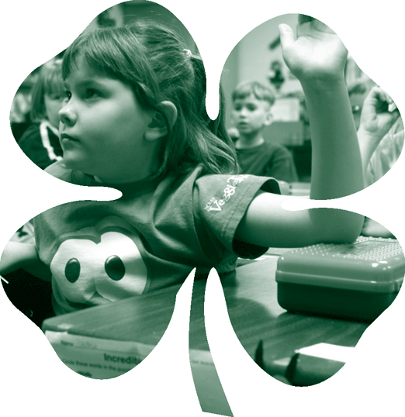
4-H Membership
5-19 years old
Traditional membership 9-19 years old
Cloverbuds – non-competitive program for 5-8 year olds
http://4h.okstate.edu/literature-links/lit-online/others/policies-and-promo-items
Notes:
Handout – 4-H Policy (updated annually) http://4h.okstate.edu/literature-links/lit-online/others/policies-and-promo-items
All youth programs initiated, organized or implemented by the Extension Service wear the 4-H label. The 4-H program can be defined as a youth development program which uses a variety of program methods and areas of interest (known as projects) to reach and teach youth 5 to 19 years of age.
In Oklahoma, youth ages 5-8 years old are known as “Cloverbuds.” The Cloverbud program is a non-competitive, fun informal educational program to acquaint youth with 4-H. There is no competitive evaluation of a child’s exhibit/project. Children of this age are not developmentally ready for competition. The emphasis of Cloverbuds is to help each child grow and develop at his or her own pace and sample the smorgasbord of opportunities provided by 4-H. As a result of their participation, the child is more informed about project selection when they enroll as a member at the age of 9.

Slide 8
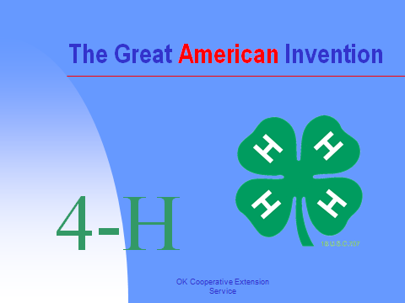
PowerPoint
Notes:
PowerPoint – The Great American Invention could be shown or narrated to enhance the history presented in this lesson.

Slide 9
Activity
Introduce National 4-H History Preservation Program http://4-hhistorypreservation.com/voices/ or OK Hobbies and Collectable Project 4H.HLTH 402-413
Notes:
Hobbies and Collectables Curriculum
4H.HLTH.402 Collectibles
4H.HLTH.403 Preserving vintage Clothing and Textile Products Part 1
4H.HLTH.404 Preserving vintage Clothing and Textile Products Part 2
4H.HLTH.405 Storage and Display of Textiles
4H.HLTH.406 Books, Paper Docs & Photos
4H.HLTH.408 Preserving Memorabilia
4H.HLTH.409 History Mystery Part 1
4H.HLTH.410 History Mystery Part 2
4H.HLTH.413 Authentication Card
4H.PDL.111 Personal Development – Documenting our 4-H Heritage
Dustcovers
Preserving and Restoring Furniture Coatings
Padded Hanger
Video Production and Filming – Preserving our 4-H Heritage: interviews and experiences
National 4-H History Preservation Program http://4-hhistorypreservation.com/voices/

Slide 10
Activity
Grid Drawing – “Art is science made clear.” Wilson Mizner
Cartoon Comic Strip Art
Notes:
PROJECT AREA - Expressive Arts: Visual Arts, Drawing, Painting, Sculpture, Crafts, Leather, etc.
Grid Drawing – video http://edtech2.boisestate.edu/matthewklaber/506/Lesson%202/earthy/grid%20drawing%20lesson.html Instructor Matt Klaber
Grid Drawing: is a tool used by artists to help them isolate shapes of subjects, thus making it easier to define and draw accurately. Artists use the grid system to transfer scale drawings that look natural and without distortion. Michelangelo gridded the Sistine Chapel, in fact he got his students to do it for him!
Two other grid drawing lessons are also included in the Activities file.
Cartoon Comic Strip Art – adapted from OMK Yellow Ribbon Activity Guide, pg 109
Learn to draw a comic strip using the “Grid” method. Recreate and draw cartoon and comic strip characters using a simple method. Apply the art method as you learn to draw pictures of family, friends, nature and animals, as well as making posters and displays.

