Slide 1
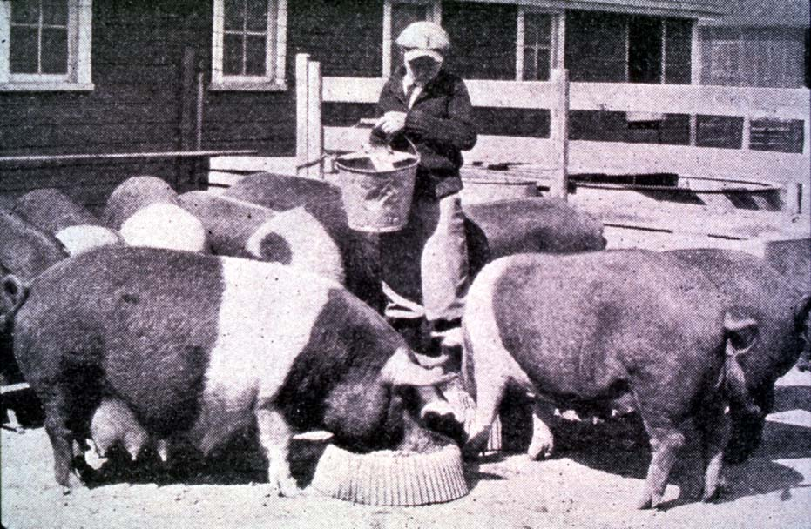




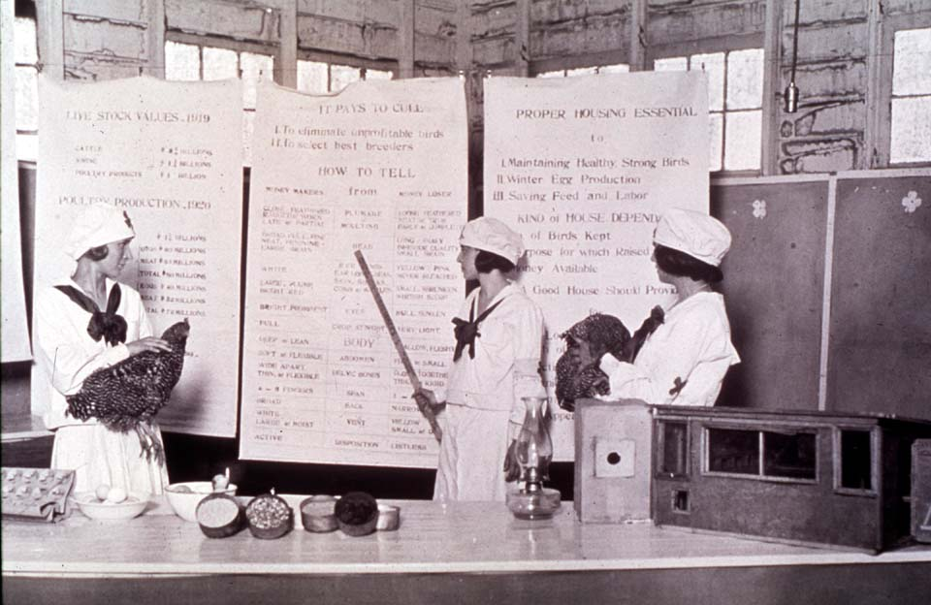

Getting the Most Out of the 4-H Experience
Selecting a Project
oklahoma 4-h volunteer development
Notes:
Instructor Preparation – Allow 6-8 hours of preparation for 1 hour of instruction.
Review all materials thoroughly. Do any additional research or preparation to make yourself comfortable with the materials or to give it your personal touch.
Determine what other topic/subject matter will be presented with this “core” subject matter. It could be a special event/activity that will focus on the CES 2014 Centennial Celebration, an educational piece on how youth should prepare for the “Famous People” category at your communication event, introducing the OK Hobbies and Collectibles project, National 4-H History Preservation Program, the heritage portion of the Citizenship project area, etc. This is a good topic to encourage, embracing and learning about History through 4-H programming.
Prepare handouts that complement the subject matter.
Down load the OCES Centennial PSA 100 Years of Oklahoma Extension (video 3:35 minutes) http://toolbox.okstate.edu/100-years to play with slide
Teaching Outline and Activity
4H101 –Lesson 8: Knowing and Using 4-H Curricula
4H101 – Lesson 9: Using a Skillathon for Experiential Learning
Handouts that complement the session:
4H.VOL.111 – Developing 4-H Project Work
PowerPoint Presentations
Unit 2 – Getting the Most Out of the 4-H Experience
This is Jeopardy
Self Study Series – for volunteers who can not attend this training in person.
4H.VOL.202B – 4-H Project Work vs. project
4-H Newsletter Support Material
Adults Role in 4-H Project Work
Selecting a 4-H Project

Slide 2
Selecting a 4-H Project
Interests, needs and capabilities of the member
Opportunity for sufficient challenge and growth
Family situation
Availability of adequate financing
Availability of equipment and space
Availability of leadership

Slide 3
Sample of 4-H Projects
Health and Fitness
Electric Energy
Food Science
Leisure Education
Animal Science
Entomology
Sport Fishing

Slide 4
Work Smart …
Piggyback Projects
“Piggybacking” is the idea of adding a related project to an existing one to provide a broader or more challenging experience. Several projects can be piggybacked in one year or someone may choose to make a logical transition from one project to another over several years.

Slide 5
Piggybacking Projects
Food Safety
Health
Electric Energy
Safety
Leisure Ed.
Food Science
Crafts
Meat Science
Fishing
Horticulture
Entomology
Animal Science

Slide 6
A Working Example…
4-H Project Work: Horticulture
Projects related to Horticulture for the beginner:
Poster - Parts of a Wildflower Blossom
Illustrated talk on the Pollination of a Flower
Herbarium Cards
Landscaping Home Grounds
Grow Onions, Peppers and Tomatoes
Vermi Composting
Tree Leaf Collection
Insect Collection
25 Topical Postmarks
Poster on Recipe Modification for Healthful Eating
Canned Tomatoes
Hanging Storage Unit
Work Apron or Tote Bag
Flat Flyer or Brochure
Display on Botany and Zoological Sciences
Jr. Nature Craft and Candle
Photos of Plant Life and Scenery

Slide 7
An Example of Piggybacking a Horticulture Project
Horticulture: Herbarium Cards, Landscaping Home Grounds, Onions, Peppers, Tomatoes
4-H Wildlife: Wildflower Study - Poster of Parts of a Wildflower Blossom
Environmental Stewardship: Vermi Composting
Forestry: Tree Leaf Collection
Entomology: Insect Collection
Postmarks: 25 Topical
Nutrition: Poster on Recipe Modification for Healthful Eating
Food Preservation: Canned Tomatoes
Design and Construction: Interior Design and Construction - Hanging Storage Unit; Apparel Design and Construction – Work Apron or Tote Bag
Technology Exhibits: Flat Flyer or Brochure
Science Discovery: Display on Botany and Zoological Sciences
Leisure Education: Jr. Nature Craft or Candle
Photography: 4 Photos of Plant Life and Scenery

Slide 8
Effective Project Development
Beginning Level
Use the first few years to explore projects, try different things, “taste the 4-H smorgasbord”!
Becoming focused to early is not always healthy for the development of the child.
Intermediate Level
Become focused and centered on developing a project(s) of interest.
Advanced Level
Think “outside the box” as project work is being planned. Make your project unique and tailored to you and your interests.

Slide 9
Activity
Piggybacking 4-H Projects
Piggybacking – Card Game
Notes:
4-H members need to be encouraged to explore a variety of projects and participate in a diverse set of experiences. Volunteer participation in this game will encourage and challenge adults to think of the extra ordinary relationships, in turn helping them counsel new families in project explanation and selection.
Participation teaches how projects relate and how learning about one subject can lead to the interest and exploration of another subject, both essential to getting the most out of the 4-H experience. 4-H project exploration is essential to career exploration and the development of 4-H members.
4H.VOL.136 Piggybacking Card Game
Game play encourages the following life skills development: Critical Thinking, Wise Use of Resources, Learning to Learn, Communications, Cooperation, Responsible Citizenship and Teamwork.
The game was developed for both adult and youth education. 2-6 players play a game similar to Concentration.
Objective of the game is to gain an understanding of:
The diversity of 4-H projects available to members
How projects interrelate to one another
How to expand ones exploration of the 4-H project experience.

Slide 10
Introduce a
New Project Area
Notes:
Introduce a “new” project and curriculum.
Activity
4H101 – Lesson 8: Knowing and Using 4-H Curricula
or
Select and lead an activity from the curriculum.

