Slide 1
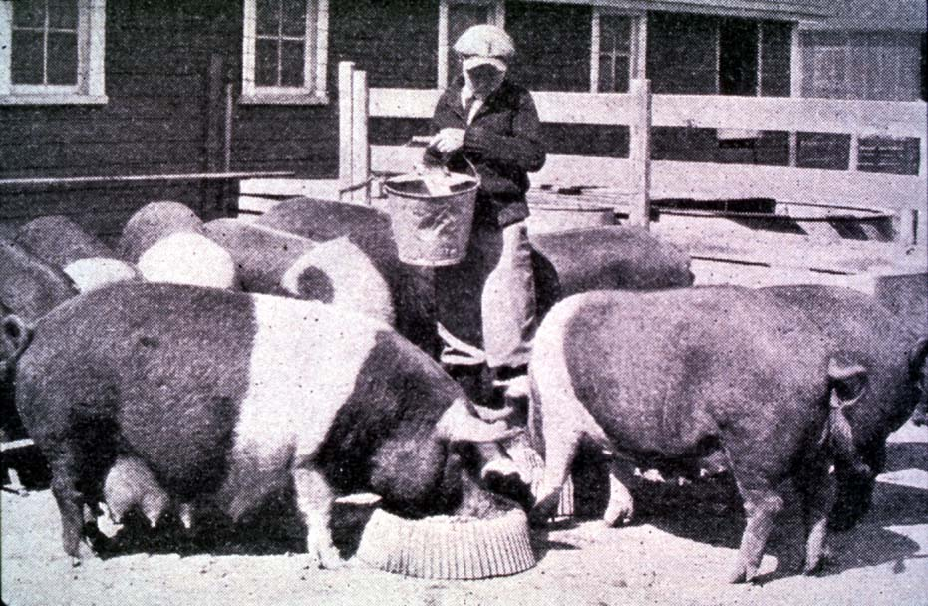




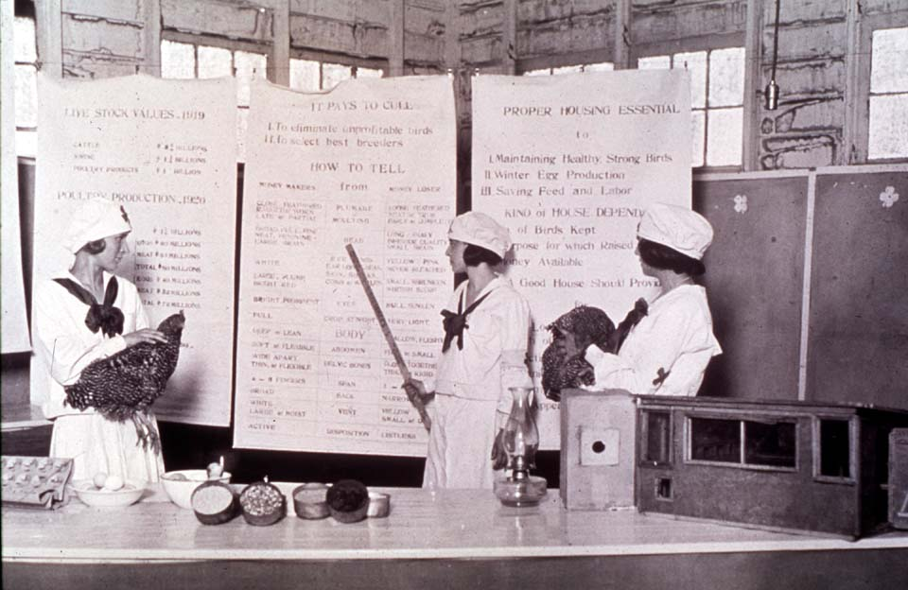

Getting the Most Out of the 4-H Experience
4-H Project Work
oklahoma 4-h volunteer development
Notes:
Instructor Preparation – Allow 6-8 hours of preparation for 1 hour of instruction.
Review all materials thoroughly. Do any additional research or preparation to make yourself comfortable with the materials or to give it your personal touch.
Determine what other topic/subject matter will be presented with this “core” subject matter. It could be a special event/activity that will focus on the CES 2014 Centennial Celebration, an educational piece on how youth should prepare for the “Famous People” category at your communication event, introducing the OK Hobbies and Collectibles project, National 4-H History Preservation Program, the heritage portion of the Citizenship project area, etc. This is a good topic to encourage, embracing and learning about History through 4-H programming.
Prepare handouts that complement the subject matter.
Down load the OCES Centennial PSA 100 Years of Oklahoma Extension (video 3:35 minutes) http://toolbox.okstate.edu/100-years to play with slide
Teaching Outline and Activity
4H101 – Lesson 7: Using an Experiential Learning Model
4H101 – Lesson 8: Knowing and Using 4-H Curricula
Handouts that complement the session:
Being a 4-H Parent
4-H Project Planning Guide
Goal Setting Worksheet for Jr. Members
“Plan the Work” Calendar
4H.VOL.109 – Planning
4H.VOL.110 – Goal Setting
PowerPoint Presentations
Unit 2 – Getting the Most out of the 4-H Experience
This is Jeopardy
Getting Off on the Right Foot
Self Study Series – for volunteers who can not attend this training in person.
4H.VOL.202B – 4-H Project Work vs. project
4H.VOL.202C – Teaching Goal Setting and How to Plan
4-H Newsletter Support Material
10 Steps to Quality 4-H Project Work
Adults Role in 4-H Project Work
Goal Setting
Planning is the Key to Success
Reasons to Plan 4-H Project Work
Where 4-H Project Work Comes Up Short
Working the 4-H Project
Working Your 4-H Plan

Slide 2
Skill | Life Skill | Application to Real Life
Reading a recipe or mixing chemicals | Learning to Learn | Following directions – from a “put-together” to employer instructions on the job
Schedule for planting and harvest or meal preparation | Planning and Organization | Coordinating school, work and 4-H activities; job manager/supervisor; parenting
Growing, preparing and eating fruits and vegetables | Healthy Lifestyle Choices and Self-Responsibility | Good nutrition, improved health, source of exercise, caring for others, or things which are reliant on you
Food preservation or use of power equipment | Responsible Citizen and Teamwork | Safe food source, decrease injury due to negligence or carelessness
Working side-by-side with a mentor, listening, watching and learning - Sharing what you learn | Cooperation, Nurturing Relationships, Communication | Respect for experience and gaining knowledge; active listening as a spouse or employee; speaking/communicating instructions or information

Slide 3
4-H Project Work vs. project
The term “4-H Project Work” is in reference to a single subject. (i.e. Horticulture, Foods, Safety, etc.) It is the big picture or long-term goal of what a member wants to learn.
The term “project” is in reference to the individual parts or short-term goals of the “4-H project.”

Slide 4
  How people learn best:
The Cone of Experience
4-H is “Learn by Doing”
80-90% Hear - See - Do
50% Hear - See
20% Hear
Effectiveness of learning increases as one moves up.
Edgar Dale, 1969
Notes:
The cone of experience is the reason 4-H believes in “Learn by Doing.”
4-H Projects are the hands on experiences for members.

Slide 5

4-H Project Work
Working with Models
Judging or Skit
Discussion
Demonstration
Field Trip – Tour
Exhibits – Displays
TV, Video, Internet
Illustrated Talks, Posters
Talks, Printed Material
Prepare a Meal
Prepare Menu with Food Models
Food Judging Event
World Hunger Discussion
Watches Demo by Educator
Tour Test Kitchen
Tour Exhibits at Nutrition Conference
Watch cable series “You Are What You Eat”
Poster of My Plate
Read Southern Living Magazine
80-90 %
50 %
20 %
Applying the Cone to 4-H Project Work.
Notes:
Application of the cone of experience to the 4-H project experience.
The left column includes learning activities one might experience in 4-H.
The right column is the application of these experiences to an actual project, such as Food Science.

Slide 6
4-H Project Work
Doesn’t Just Happen
It takes planning, practice and processing.
Processing allows members to apply skills to other projects and programs.

Slide 7
Adults Role in
Working the Plan
Guide 4-Her in: Developing Goals
Assist 4-Her in: Accomplishing Goals
Assist 4-Her in: Evaluating Project Work

Slide 8

Resources and People that will Help with 4-H Project Work
4-H Literature
Creditable Source: Video, Internet Sites, Books, Magazines, etc.
Club Leader
4-H Volunteers
County Extension Office
Parent-Volunteer Training
Teen Leaders
Community Resource People

Slide 9
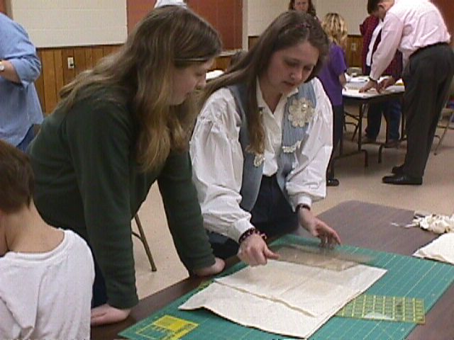
To get the Ball Rolling
on Project Work…
Orient parents and members about 4-H projects and how to set and work goals.
Work one-on-one with members to outline projects.
Work with 4-H members with similar interests in Project meetings.

Slide 10
Parent’s Role in
4-H Project Work
Aide in selecting, financing and managing.
Guide and support work without doing it for them.
Encourage follow-through and completion.
Give praise and encouragement.
Assist in gathering tools and supplies.

Slide 11
Parent’s Role in
4-H Project Work
Encourage record keeping.
Provide support and transportation.
Assist organizational, project, activity and teen leaders.
Become a project or activity leader.
Serve on committees to plan and implement club activities or project meetings.
Become a certified 4-H volunteer.
Notes:
Support includes financial and moral support.

Slide 12
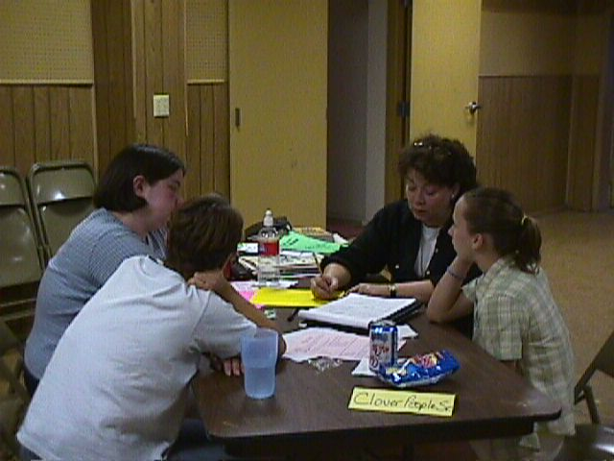
Making it Happen
Set Goals
Work the Plan
Present Your Work
Seek Evaluation
Refine Skills
Set New Goals

Slide 13
10 Steps
to a Quality 4-H Project
Commitment to accomplishing goals.
Devote time to 4-H.
Have an objective outside resource person.
Encourage group projects and activities as member matures.
Beware of burnout.
Plan around known conflicts.

Slide 14
10 Steps
to a Quality 4-H Project
Be creative! Think big! Look for opportunities! Reach out and include others!
Ask serious questions:
  Is the activity important enough to justify the time it takes?
  Who will benefit from what I am planning?
  Do my community service activities deal with real needs and issues?
  What are my motives?

Slide 15
10 Steps
to a Quality 4-H Project
Expect setbacks and adjust accordingly.
Encourage personal growth – stretch!

Slide 16
Reasons for Planning
Meetings and project work are more interesting and have a better-balance.
Allows member(s) to take part.
Gives families a feeling of security and direction.
Sets an example and provides experience in planning ahead.
Helps distribute the leadership and various responsibilities.
Notes:
Successful 4-H club work requires planning on the part of the member and the club.
Planning the year’s program is one of the most important responsibilities a volunteer will have for reaching members. The success or failure of the club to expand, interest new members, and retain current membership depends largely on the programs and activities planned and carried out. A well-balanced and preplanned program provides a solid foundation for a successful year. Planning 12 months in advance…
1. Makes more interesting and better-balanced meetings.
2. Allows member(s) to take part.
3. Gives families a feeling of security and direction.
4. Sets an example and provides experience in planning ahead.
5. Helps distribute the leadership and various responsibilities.
Each club will be unique in its membership. Therefore, it is necessary to plan the program accordingly. A good program for regular club meetings will reflect the interests and needs of all members.

Slide 17
What is Planning?
Planning is determining what
you want to accomplish, working
out beforehand how it is to be
done, deciding who will be
responsible for each step, and
having every phase written down.

Slide 18
Steps in Planning
Set a broad goal or objective.
Decide what form the project will take.
Get everyone affected involved.
Consider the resources available.
Develop a step-by-step course of action to complete. (Step five is done concurrently with step six.)

Slide 19
Steps in Planning
Develop and communicate a sound organization of who is to do what, when and with what skills/resources.
Consider the alternatives.
Put the plan into effect.
Test/evaluate the plan at each stage of completion.

Slide 20
Steps in Planning
Follow-through to completion,
readjusting the plan as necessary.
11. Evaluation of final project.

Slide 21
Step 1. Steps in Planning
Identify the things you know.
Determine Long-Term Goal(s) – the overall purpose and objectives of “Things I want to Learn”.
Establish Short-Term Goal(s) – the steps needed to achieve the Long-Term Goal.
  1 project a month
  1 public speaking opportunity at local club
  Exhibit in 2 county competitive events
  Participate in 1 county activity
Set Goals
Notes:
Set goals and work toward those goals. A goal must be written; otherwise, it is only a wish.
A goal is a projected accomplishment; an objective; an end; the purpose towards which endeavor is directed.
Short-term goals – the immediate, expected results.
Long-term goals – the overall purposes and objectives.
Short-term goals are steps used to achieve a long-term goal. They are easy to measure, and they serve to break down the long-term goal into workable units or steps.
The difference between having a goal and having it become reality is action. The achievement of goals doesn’t just happen – it is caused to happen through action, usually action on the part of the person with the goal.
In order to be a goal, it has to be conceivable; that is, it has to be capable of being put into words. It must be achievable by human beings. It must be measurable in accomplishment. It must be desirable to the person setting it. It must be controllable to the person who has it; others must not have control over it happening event though they are permitted to assist with its accomplishment.
Types of Individual Goals: Service, Leadership, Physical, Mental, Financial, Values, Moral, Spiritual, Big Dreams, Academic.
How to make it happen:
Make goals specific so that it is possible to know when the goal is achieved.
Determine what must be done to achieve each goal.

Slide 22
Step 2. Project Form
What exactly has to be done?
When does it have to be done?
Where is it to be done?
Who does what?
How is it to be done?
Make the decision and write it down.

Slide 23
Step 3. Involve Others
Good planning must involve everyone affected to assure both understanding and commitment.
Planning should be a cooperative process. People enjoy ownership in the planning process.
Communicate

Slide 24
Step 4. Available Resources
All of the following are resources:
Talents, Skills and Ideas
Availability of Leadership
Facilities, Equipment, Materials, and Supplies
Time and Support
Finances
Publicity
Explore and Include

Slide 25
Step 5. Action Plan
Step-by-step course of action from start to finish. Avoid generalities. Be specific. Have commitment and agreement at each step.
Include a:
  timeline for completing each step,
  list of specific, detailed resources required for each step of the plan.
Write it Down

Slide 26
Step 6. Sound Organization
Responsibilities are determined and assigned.
People know what is expected, when to perform and whose talents or skills, as well as, resources are needed to do the job.
Instructions are clear and specific.
Leadership is responsible and reliable.
Good Communications

Slide 27
Step 7. Alternatives
Most plans need to have enough flexibility to consider possible emergencies, which could affect the completion of the project.
Be sure to identify and write down contingent plans for possible changes or emergencies.
Be Prepared

Slide 28
Step 8. Work the Plan
Using the identified resources work at the project step-by-step towards completion.
Keep with the timetable.
Stay committed.
Stay Focused

Slide 29
Step 9. Evaluation
Experience in developing plans, how carefully the plan is thought out and how effectively written each step of the plan is. All combined to determine the ease with which the plan is carried to completion.
Stretch and Grow

Slide 30
Evaluation - continued
Evaluation should take place at each stage of the plan. Ask the following questions:
  Was the step/plan workable and complete?
  Are alternatives needed?
  Are alternative resources needed?
  Did mistakes have to be corrected?
Stretch and Grow

Slide 31
Step 10. Follow-Through
Make the necessary adjustments to the original plan as it becomes evident that it was incomplete or unworkable.
A plan should always be practical and workable.
Commitment

Slide 32
Step 11. Evaluation
Final Project
Formal Evaluation
Informal Evaluation
Reset Goals based on Evaluation
How You Did

Slide 33
These planning steps apply to all areas of the 4-H Experience.
Planning is the Key!

Slide 34
Steps Apply to…
Writing a Speech
Planning a 4-H Project Year
Planning a Club Year
Serving on a Club or County Committee
Long-Term Goals such as Increased Participation in 4-H

Slide 35
Start Small to Teach
Planning Concept
Writing a Speech
Step 1 – Goal “Do a Child Care speech at local 4-H club meeting in December 20xx”
Step 2 – Project Form “Illustrated Talk on Good Guidance”
Step 3 – Get People Involved “Club Leader, Public Speaking Project Leader”
Step 4 – Resources “Project Manual, Red Cross, YMCA”

Slide 36
Start Small to Teach
Planning Concept
Step 5 and 6 – Step-by-Step Plan and
Timeline with Details
My Plan of Action
Step 1 – In September, talk with Public Speaking Project Leader about how to select a topic, research the topic, organize and writing the speech, and how to present a speech.
Step 2 - Select a topic/subject in September. Narrow the topic so that it is focused and specific.

Slide 37
Start Small to Teach
Planning Concept
My Plan continued…
Step 3 – In October, research the topic/subject by using at least 4 resources. Resource will include available 4-H project literature, interviewing one specialist in the field, completing a Internet search, and using one other source.
Step 4 – In October, organize the material in a sequence that shows what I have learned and its importance or relevance.

Slide 38
Start Small to Teach
Planning Concept
My Plan continued…
Step 5 – In October, write the introduction, body and conclusion of the speech. The introduction should stimulate interest in the subject and catch the audiences attention. The body of the speech will state the facts and what was learned. The conclusion will briefly summarize the subject and leave the audience wanting to learn more or take action.

Slide 39
Start Small to Teach
Planning Concept
My Plan continued…
Step 6 - By November 1, review the written speech with 4-H Project Leader.
Step 7 – In October, ask club leader to be placed on the agenda to present my speech at the December 4-H Meeting.
Step 8 – During November, practice by myself and by presenting it for family, friends and my 4-H Project Leader.
Step 9 - Present speech at December 6, 4-H Club meeting.

Slide 40
Start Small to Teach
Planning Concept
Writing a Speech continued…
Step 7 – Consider Alternatives
“Present talk in November or January at club meeting, present talk to another club or class at school.”
Step 8 – Put the Plan into Effect
“Work your plan.”

Slide 41
Start Small to Teach
Planning Concept
Writing a Speech continued…
Step 9 – Test and Evaluate Step-by-Step
“If a step is not completed ask: Why and make adjustments to bring yourself back on track.”
Step 10 – Follow-Through
“Do what you set out to do.”
Step 11 – Project Evaluation
“When the plan is complete ask: What did I learn? How would I do things differently? What is my next goal?”

Slide 42
Expanding the
Planning Process
As the learner grasps the concept of
planning, have them apply it to other
areas of the 4-H experience…
  Planning their 4-H Project year
  Serving on a club committee
  Being a club officer
  Serving on a county committee

Slide 43
“Plan the Work”
January Healthy Living Fair 3 projects – 1 poster, 1 craft, 1 food | February Public Speaking Event 1 project | March Leadership Project 1 project | April Community Service Project 1 project
May Complete medal form/record book | June Attend Workshop 2 projects | July 4-H Camp 2 projects –crafts | August Attend Awards Program 2 projects
September County Fair 12 exhibits for Fair | October Leadership Project - 4-H Promo event Tour | November Community Service Project 1 project - speech | December Present speech at club meeting.
Notes:
Explanation of Plan the Work Calendar
Begin the year by penciling in known conflicts like family vacation, sports, band, etc that will take away from time on 4-H Project Work.
Beginning with October after fall enrollment start outlining the plan month by month in general terms of what you plan to do each month.
October: Leadership Project related to a 4-H promotional event. This is a simple thing to pencil in because National 4-H Week and Oklahoma 4-H month are held in October. There is lots of opportunity to promote 4-H through displays, posters, flyers, speeches, etc. The tour will be a tour directly related to your chosen project area.
November: Community Service Project (This should be very simple to accomplish because November and December provide many opportunities for community service.) The one project to be completed is researching and writing a speech related to your project area.
December: Present speech at local club meeting. Provided you planned a head and asked to be on the agenda.
January: Participate in a county event (I.e. Healthy Living Fair) by completing 3 projects. Two of the three will be related to your main project and the third will just be for fun.
February: Participate in county event – Public Speaking Event with speech prepared in November as well as doing one more project related to project area.
March: Do one Leadership Project and 1 project related to project area.
April: Do one Community Service Project and 1 more project.
May: Complete Medal Form or Record Book.
June: Attend workshop (summer day camp, livestock judging camp, etc.) and 2 more projects.
July: participate in a County Activity – Camp. Do 2 more projects that are crafts.
August: Participate in County Activity – Awards Program and 2 more projects.
September: Participate in County Event – County Fair, exhibiting 12 exhibits made over the past 11 months (1-2 projects at a time).
At the end of the year the member will have accomplished:
Participation in:
3 County Competitive Events – Healthy Living Fair, Public Speaking Event and County Fair
2 County Activities – Camp and Awards Program
2 Community Service Projects
2 Leadership Projects
12 projects completed related to main project.
2 Educational Activities outside of individual study – workshop, tour.
2 Public Speaking opportunities – local club and county level.
Completed a medal form or record book for project area.
WOW!!

Slide 44
A Working Example
4-H Project Work: Horticulture
Projects related to Horticulture for the beginner:
Poster - Parts of a Wildflower Blossom
Illustrated talk on the Pollination of a Flower
Herbarium Cards
Landscaping Home Grounds
Grow Onions, Peppers and Tomatoes
Vermi Composting
Tree Leaf Collection
Insect Collection
25 Topical Postmarks
Poster on Recipe Modification for Healthful Eating
Canned Tomatoes
Hanging Storage Unit
Work Apron or Tote Bag
Flat Flyer or Brochure
Display on Botany and Zoological Sciences
Jr. Nature Craft and Candle
Photos of Plant Life and Scenery

Slide 45
An Example of Piggybacking a Horticulture Project
Horticulture: Herbarium Cards, Landscaping Home Grounds, Onions, Peppers, Tomatoes
4-H Wildlife: Wildflower Study - Poster of Parts of a Wildflower Blossom
Environmental Stewardship: Vermi Composting
Forestry: Tree Leaf Collection
Entomology: Insect Collection
Postmarks: 25 Topical
Nutrition: Poster on Recipe Modification for Healthful Eating
Food Preservation: Canned Tomatoes
Fabric and Fashion: Home and Personal Living Space - Hanging Storage Unit; Construction – Work Apron or Tote Bag
Technology Exhibits: Flat Flyer or Brochure
Science Discovery: Display on Botany and Zoological Sciences
Leisure Education: Jr. Nature Craft or Candle
Photography: 4 Photos of Plant Life and Scenery

Slide 46
Working the Plan
Ways to Complete Goals
Be dedicated to project work and make time for 4-H.
Write down specific short and long-term goals.
Use project manual, newsletter, fair book, yearbook, or other resources to learn subject matter and about activities and events.
Notes:
Write down short and long-term goals. Make goals specific. Determine what must be done to achieve each goal.

Slide 47
Working the Plan
Ways to Complete Goals continued…
Attend local club meetings, project meetings or workshops to learn about project work and about how to prepare for and participate in county activities and events.
Apply what is learned.
Research, organize, prepare and present one oral presentation at local club meeting.

Slide 48
Working the Plan
Ways to Complete Goals continued…
Obtain entry/registration form(s), learn how to complete the form and turn form in by deadline.
Ask a lot of questions.
Adjust for the unexpected.

Slide 49
Where 4-H Project Work
Comes Up Short
General project work shows lack of focus.
Lack of good solid project work.
Failure to show personal growth and application of project skills.
Balance between project leadership and other leadership.

Slide 50
Where 4-H Project Work
Comes Up Short
Citizenship projects and activities that really make a difference in the community or in an individual’s life.
Too much repetition.

Slide 51
Seek Opportunities for Communications
Encourage the identification of and opportunities for developing communication skills of all kinds.
Public Speaking
Working Displays
Displays
Posters
Photography
Printed Materials
Website
PowerPoint

