Slide 1
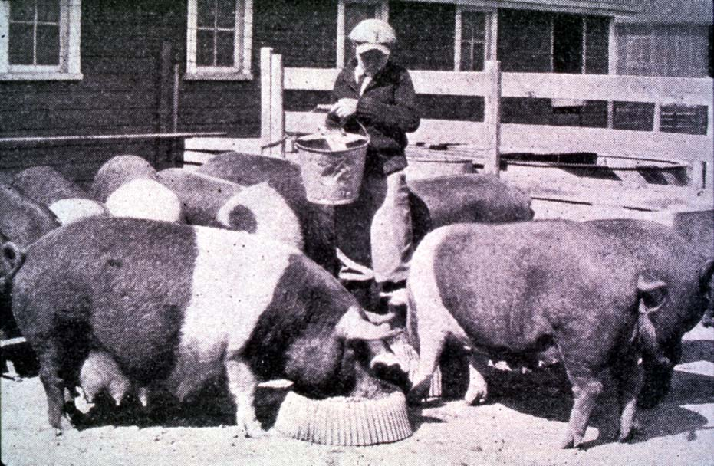
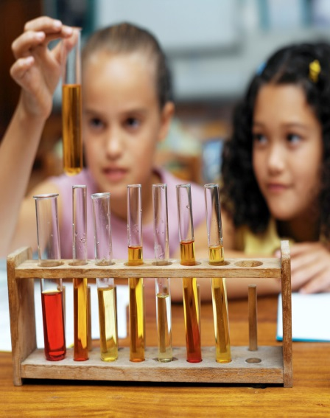
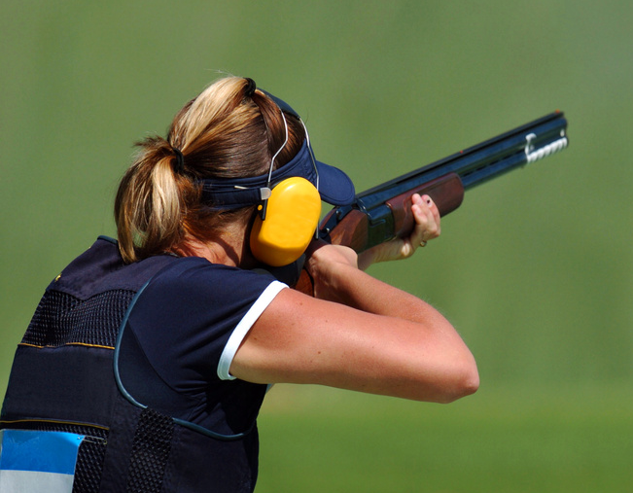


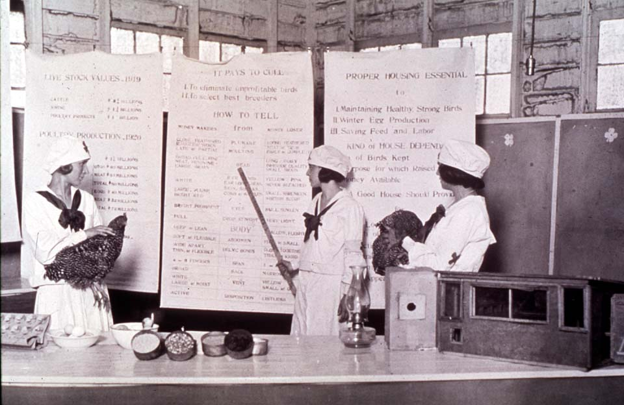
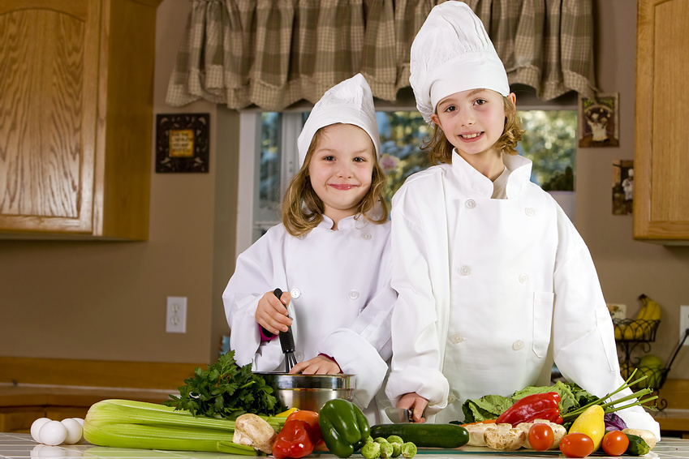
Getting the Most Out of the 4-H Experience
4-H Evaluation and Recognition
oklahoma 4-h volunteer development
Notes:
Instructor Preparation – Allow 6-8 hours of preparation for 1 hour of instruction.
Review all materials thoroughly. Do any additional research or preparation to make yourself comfortable with the materials or to give it your personal touch.
Determine what other topic/subject matter will be presented with this “core” subject matter. It could be a special event/activity that will focus on the CES 2014 Centennial Celebration, an educational piece on how youth should prepare for the “Famous People” category at your communication event, introducing the OK Hobbies and Collectibles project, National 4-H History Preservation Program, the heritage portion of the Citizenship project area, etc. This is a good topic to encourage, embracing and learning about History through 4-H programming.
Prepare handouts that complement the subject matter.
Teaching Outline and Activity
4H101 – Lesson 16: Recognizing 4-H’ers Accomplishments
Handouts that complement the session:
Targeting Life Skills Model
4H.VOL.105 – Recognition Model
4H.VOL.107 – Judging
4H.VOL.108 – Understanding 4-H Events and Activities
Understanding 4-H Judging – Rutgers Extension
4-H Horse Judging Standards Danish System – Iowa State Extension
Resource Materials
Targeting Life Skills Model
Life Skills – Definitions of skills
Targeting Life Skills Model – animated slide (2008)
PowerPoint Presentations
Unit 2 – Getting the Most Out of the 4-H Experience
This is 4-H Jeopardy
Self Study Series – for volunteers who can not attend this training in person.
4H.VOL.202D – Understanding 4-H Events and Activities
4H.VOL.202F – 4-H Recognition and Awards
4H.VOL.202G – Teaching Evaluation through Judging
4-H Newsletter Support Material
4-H Recognition Model
4-H Ribbons: What Do They Mean?
Learning from the Judging Process
What is the 4-H Philosophy and Recognition?

Slide 2
Recognition used in Judging
Participation – Participation ribbons or certificates are given to all participants.
Achieving Standards of Excellence – Danish System of Blue, Red, White Awards presented based on an established standard. No one person is singled out as “first” or “best”.
Peer Competition - 1st, 2nd and 3rd place are awarded based on projects being judged against one another. There can only be one winner!

Slide 3

Forms of 4-H Recognition
Participation
Progress Toward Personal Goals - Setting and achieving personal goals
Standards of Excellence – Danish System of Blue, Red and White Awards
Peer Competition – Placing items First, Second and Third
Cooperation - involves all parties in the decision making process

Slide 4
Forms of Recognition
Participation
Emphasizes the importance of being involved in an educational experience.
Taking part is significant for some people.
Progress Toward Self-Set Goals
Setting realistic goals and then planning how to achieve the goals.
Key to success - An adult working cooperatively with the young person to evaluate progress toward goals.

Slide 5
Forms of Recognition
Achieving Standards of Excellence
Standards are established and used to evaluate project work.
All who meet the standards are recognized by a designated rank.
Peer Competition
Results when one seeks to be the best or better than another.
Winners and losers.

Slide 6
Forms of Recognition
Cooperation
The primary goal of 4-H is to help young people become self-directing, productive and contributing citizens.
Recognizing those who work together to learn and achieve goals is important.
When working together, a person examines their own skills and abilities and explores solutions beyond their own ideas.

Slide 7
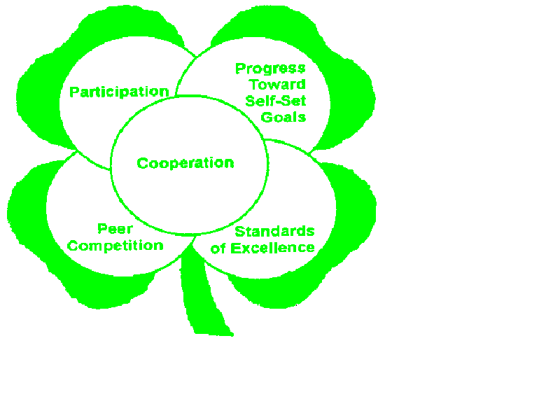
4-H Recognition Model
A club and county program should have a healthy blend of all five forms of recognition.

Slide 8
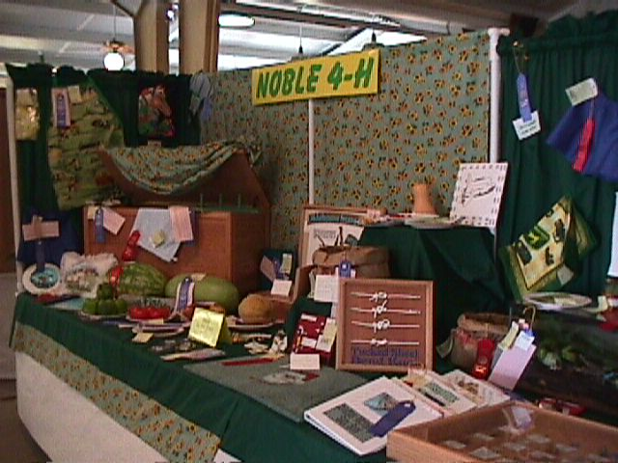
Most Common Form of
4-H Evaluation
Judging - the comparison of differences when selecting one article, animal or product instead of another because of defined qualities and standards.

Slide 9
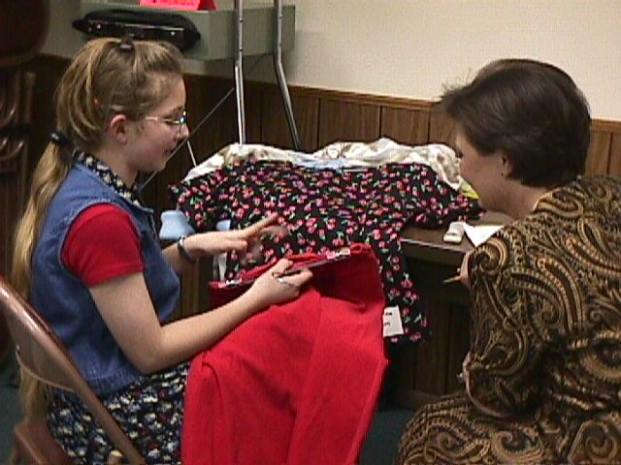
Evaluation Teaches
Knowledge and understanding of qualities and standards.
To choose wisely.
To identify desired qualities in a finished product.

Slide 10
What is Learned from Evaluation?
Learn to evaluate an animal or article in terms of the ideal - not the scorecard.
Some projects have established standards. The project manual or leader’s guide will outline these standards if they have been written for a specific project.

Slide 11
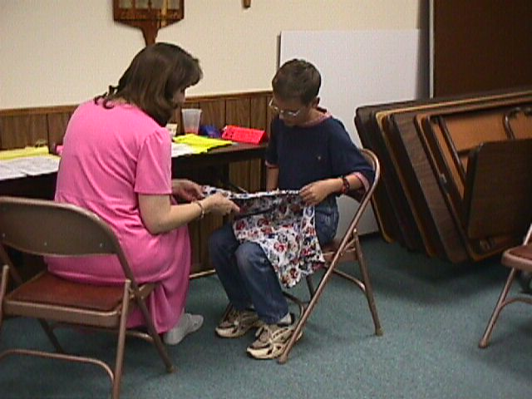
Evaluation with Standards
Some projects have established standards. If standards have been established the project manual or leader’s guide will outline the standards.

Slide 12
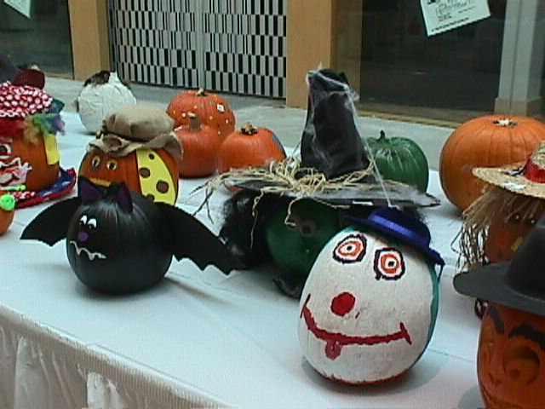
Evaluation without
Established Standards
General qualities to look for:
Good Overall Appearance
  Lettering and lines are straight and color is appropriate and pleasing
Quality Work
Attempt to Master a New Skill
Practicality Combined with Creativity and Versatility

Slide 13
Recognition used in Judging
Participation
Emphasizes the importance of being involved in an educational experience.
Taking part is significant for some people.
Progress Toward Self-Set Goals
Setting realistic goals and then planning how to achieve the goals.
Key to success - An adult working cooperatively with the young person to evaluate progress toward goals.

