Slide 1
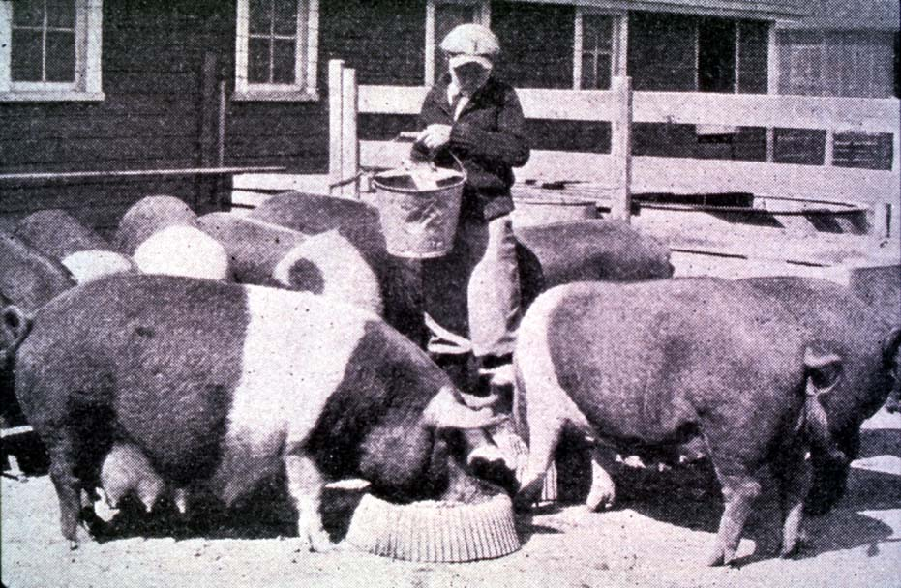




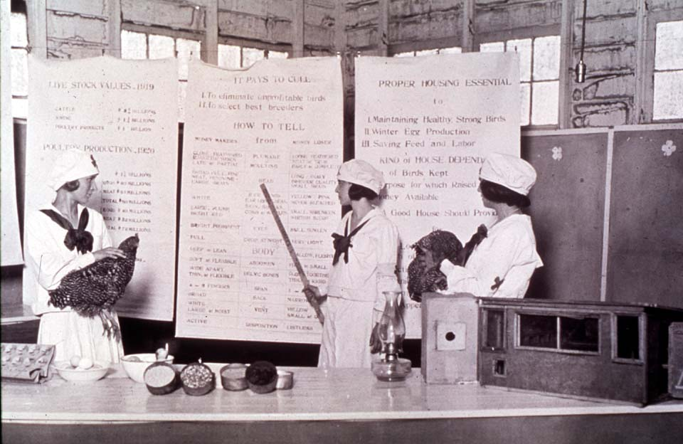

Getting the Most Out of the 4-H Experience
Record Keeping
Oklahoma 4-H Volunteer Development
Notes:
Instructor Preparation – Allow 6-8 hours of preparation for 1 hour of instruction.
Review all materials thoroughly. Do any additional research or preparation to make yourself comfortable with the materials or to give it your personal touch.
Determine what other topic/subject matter will be presented with this “core” subject matter. It could be a special event/activity that will focus on a Centennial Celebration, an educational piece on how youth should prepare for the “Famous People” category at your communication event, introducing the OK Hobbies and Collectibles project, National 4-H History Preservation Program, the heritage portion of the Citizenship project area, etc.
Prepare handouts that complement the subject matter.
Teaching Outline and Activity
4H101 – Lesson 16: Recognizing 4-H’ers Accomplishments
Handouts that complement the session:
4-H Project Planning Guide
Goal Setting Worksheet for Jr. Members
“Plan the Work” Calendar
4-H Record Keeping Pointers
Senior 4-H Record Keeping Pointers
4H.VOL.109 – Planning
4H.VOL.110 – Goal Setting
4H.VOL.105 - Recognition Model.
4H.VOL.135 – 4-H Life Skills
4H.VOL.118 - Experiential Learning
Resource Materials
Targeting Life Skills Model
Life Skills – Definitions of skills
Targeting Life Skills Model – animated (2008)
Experiential Learning Model
PowerPoint Presentations
Unit 2 Section 8_ 4-H Record Keeping
Self Study Series – for volunteers who can not attend this training in person.
None
4-H Newsletter Support Material
10 Steps to Quality Project Work
Citizenship Defined
Leadership Defined
Record Keeping
What to Keep Record Of

Slide 2
Part 1
Review of materials in previous Unit 2 Lessons
Notes:
Educator Message: If you did not conduct training from previous Unit 2 sessions prior to session 8 it is extremely important that this information is covered. Without the foundation of project work no amount of “record keeping” information will be of benefit because the member will have nothing of substance to report. Record keeping starts with solid and focused project work.
If previous sessions were conducted, use this section as a review.

Slide 3
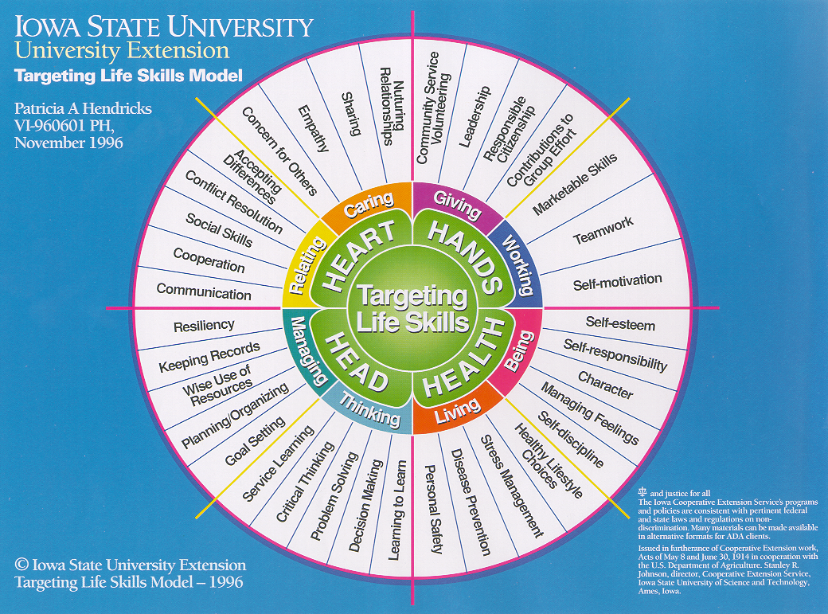
Life Skills Taught through Record Keeping
Notes:
Handout – Record Keeping Pointers (younger members/new volunteers) and/or Senior Record Keeping Pointers Most of the information in this lesson are summarized in the handouts.
Handout – 4H.VOL.135 4-H Life Skills
Talk through the actual definitions for each of the life skills as found in the handout.
Stress the difference in a Skill vs Life Skill - Example in 4H.VOL.118 Experiential Learning page 7
4-H Recognition Model has a significant role in Record Keeping. All 4 of the 5 parts are significant to the educational process in 4-H Record Keeping
Participation – attending club meetings, workshops, tours, conferences, project group meetings, county/district/state activities and events.
Progress Toward Personal Goals - Setting and achieving personal goals in their project.
Standards of Excellence – Danish System of Blue, Red and White Awards (not part of record keeping)
Peer Competition – Placing the members work as First, Second and Third. How do we prepare child for “competition,” instill resiliency and help them understand they are a winner from choosing to participate and gaining new knowledge and skills in the process.
Cooperation - Involves all parties in the decision making process.

Slide 4
4-H Recognition Model
Notes:
Use as time allows - 4H.VOL.105 Recognition Model
Handout - Essential Elements of 4-H - USDA
The Heart promotes a sense of belonging.
Caring adult acts as an advisor, guide and mentor. The adult helps set boundaries and expectations for young people.
Clubs and programs provide an inclusive environment that creates a sense of belonging, and encourages and supports positive and specific feedback.
A 4-H environment should be fearful or harmful physically or emotional.
The Health encourages mastery.
Mastery is the process of building knowledge, skills and attitudes over an extended period of time. Capable 4-H member demonstrate their experiences, knowledge and skill through project work.
Engaged youth are mindful of the subject area, building relationships and connections in order to develop understanding. Through self-reflection, youth have the ability to self-correct and learn from experience.
The Head encourages independence.
Youth are engaged in their own future, making choices and developing skills necessary for a transition into adulthood.
Youth have opportunities to have impact on life’s events rather than passively submitting to the will and whims of others, growing their sense of self-determination.
The Hands develop a sense of generosity.
4-H members find their self by losing them self in the service of others.
Slide hidden

Slide 5









Award Driven
Awards
Select Project and Set Goals
Project Work – Mastery & Completing Goals
4-H Member
Notes:
Not what we want taking place.
Do not focus on the carrot “award.” Our focus is on Positive Youth Development and the process taking place through project work.
Blue Ribbon child rather than a Blue ribbon project.

Slide 6



Member Driven
4-H Members
Select Project and Set Goals
Project Work – Mastery & Completing Goals
Evaluation and Reward
Notes:
Project Work is based on the individual’s interest, learning to set goals and the mastery of knowledge and skills
Essential Elements of Positive Youth Development - HEALTH - Mastery
Engagement in Learning - Mastery is the process of building knowledge, skills and attitudes over an extended period of time. Capable 4-H member demonstrate their experiences, knowledge and skill through project work.
Opportunity for Mastery - Engaged youth are mindful of the subject area, building relationships and connections in order to develop understanding. Through self-reflection, youth have the ability to self-correct and learn from experience.
Use project manuals/guides/skill sheets for project objectives. Materials are prepared with age-appropriate knowledge and skills. Look an the Oklahoma 4-H webpage for available Literature. Look to other 4-H programs in other states to find additional curriculum and materials to supplement project work.
Note the word REWARD, not Award. Focus the family and child on the rewards gained through process of participating in planned project work.
The project belongs to the child not the parent.

Slide 7
10 Steps to a Quality 4-H Project
Commitment to accomplishing goals.
Devote time to 4-H.
Plan around known conflicts.
Have an objective outside resource person.
Encourage group projects and activities as member matures.
Beware of burnout.
Notes:
Handout – Record Keeping Pointers (younger members/new volunteers) and/or Senior Record Keeping Pointers
Handouts – 4H.VOL.110 Goal Setting a Key to a Successful 4-H Experience and 4-H Project Planning Guide.
Learning how to set and accomplish goals in project work. A goal is not “I want to be the winner.” Focus on “I am a winner when I learn to set, work and evaluate in the process of developing my project.” Just like an athlete, musician or artist – commit time to practice (ie project work)
Using project manuals/guides for the basic goals/objectives of the project. Individual adds to the basics.
Handouts – “Plan the Work” calendar Talk through the simple process of planning and accomplishing small goals each month.
Who can provide you honest and constructive feedback.
Learning and applying the skills necessary to set and work group goals. Learning about compromise in the process.
Recognize the signs and the need to change directions or find a fresh challenge. Watch out for a child who might be peaking too soon. This is when we loose our teens to other organizations.

Slide 8
Quality 4-H Project continued…
Look for opportunities! Think big! Be creative! Reach out and include others!
Ask serious questions:
  Is the activity important enough to justify the time it takes?
  Who will benefit from what I am planning?
  Do my community service/leadership activities deal with real needs and issues?
  What are my motives?
Notes:
7. Look for opportunities. It is your project and should be tailored for the individual and their interests.
8. Besides what is being gained in knowledge, skills and possible career aspirations, how can the greater good gain from your experiences?

Slide 9
Quality 4-H Project continued…
Expect setbacks and adjust accordingly.
Encourage personal growth – stretch!
Notes:
Life is full of setbacks. 4-H is a great training ground with caring adults and a safe environment. The program can teach our youth resiliency if we put the Recognition Model into practice.
Making the Best Better. There is always room for improvement, opportunities to take what we have learned to the next level or to be introduced to a new path. Show growth in technical expertise and skills.

Slide 10
Part 2
Record Keeping and Reporting Tips

Slide 11
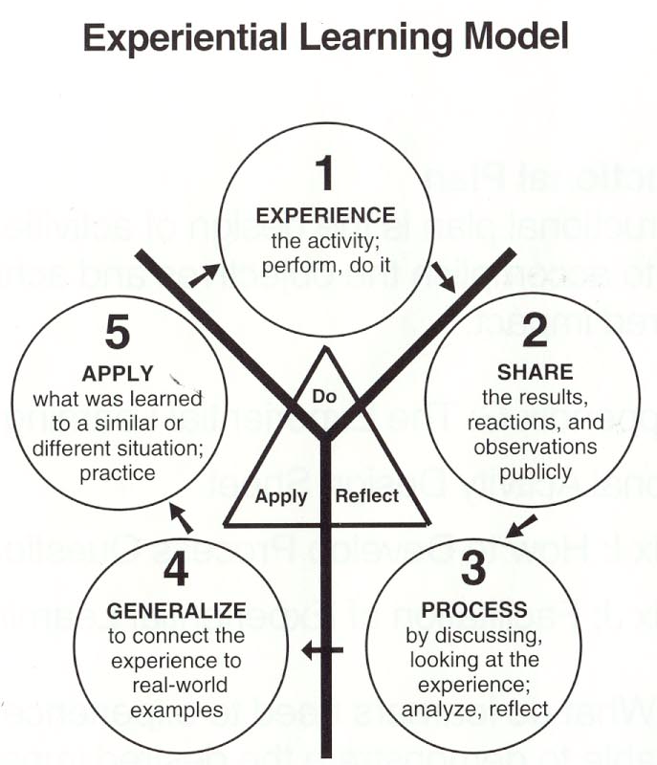
Record Keeping is
Experiential Learning
Reinforces learning and develops understanding.
Includes sharing new knowledge with others.
Answers three questions:
  What was learned?
  What does it mean?
  How is it used?
Pfieffer and Jones, 1985
Plan the work and Work the plan
Notes:
Excerpt - 4H.VOL.119 Experiential Learning
1. Participants experience the activity - perform or do it.
2. Participants share the experience by describing what happened to them.
3. Participants process the experience to determine what was most important and identify common themes and experiences.
4. Participants generalize from the experience and relate it to their daily lives.
5. Participants apply what they learned to a new situation.
Evaluating the Project Activity
The most important question is whether the child can show they have gained new knowledge/skill and practiced a life skill(s) in the process. The success indicator is an observable behavior or attitude change for both the project skill and life skill.
The questions discussed in the reflect and apply steps of the experiential model often provides excellent feedback. Even better evaluation information can be gathered by having the group apply what they have learned to another situation. If you use experiential learning successfully some of the most important results will only happen as youth apply new skills in their everyday lives.
Back to Skill vs Life Skill - Example in 4H.VOL.118 Experiential Learning page 7
Handout - 4H.VOL.109 Planning – A Key to a Successful 4-H Experience

Slide 12
Record Keeping begins with Mastery
Engagement in Learning - Mastery is the process of building knowledge, skills and attitudes over an extended period of time. Capable 4-H member demonstrate their experiences, knowledge and skill through project work.
Opportunity for Mastery - Engaged youth are mindful of the subject area, building relationships and connections in order to develop understanding. Through self-reflection, youth have the ability to self-correct and learn from experience.
Notes:
Example of this in practice. 2013 the introduction of the Design and Construction Skill sheets for Apparel, Interior and Hobbies and Textiles. They were designed taking mastery into account. The skill sheet has a three-fold purposes 1) the child and volunteer can see the variety of skills and knowledge (objectives) for each age level, 2) use the selection skills and knowledge as a means to develop goals (short and long term) and 3) offers the child an evaluation tool for self-evaluation on each project constructed.

Slide 13
Purpose for 4-H Record Keeping
Report goals and how they were completed.
Report subject matter and life skills learned and developed while working goals.
Report participation in personal development, citizenship and leadership opportunities.
Method for reflecting and analyzing.
Method for evaluation.
Notes:
Recognition Model - Progress Toward Personal Goals - Setting and achieving personal goals
Mastery - reporting what is learned.
Personal development covers activities that improve awareness and identity, develop talents and potential, build human capital and facilitate employability, enhance quality of life and contribute to the realization of dreams and aspirations.
Citizenship is much greater than community service. To be covered in slides 16-19.
Leadership – sharing knowledge and skills.
As work is recorded one can see the big picture allowing opportunity to reflect and analyze what was and was not accomplished/learned.
Reflection is a means for personal evaluation. It can be used to re-establish goals, set new goals or possibly head a new directions based on something learned or introduced to.

Slide 14
Things to Keep a Record of…
Goals
Knowledge and skills learned
Projects work completed through reports of size, scope and growth in project
  Reference materials used
  Recipes tried – categories of recipes
  Meals planned – breakfast, lunch, dinner
  Hours
  People
Notes:
Knowledge and skills learned – note successes, failures, challenges, funny and sad stories, etc. Important to communicate what was learned from these things. This is just as important as specific knowledge and skills.
Project Work –
Be specific – Hours doing what? People served, reached, effected, etc. Be honest, do not exaggerate.
The new Design and Construction Portfolio is an excellent example of developing project work –
Section 1 Projects/Products (Items being completed as part of the project.)
Section 2 Sample Techniques (Skills and Knowledge learned)
Section 3 Creative Inspirations and Ideas (Goals for future projects with a description as to why and how it might be used.)

Slide 15
Continued…
Communication - Demonstrations, talks, video, exhibits, graphic arts, news articles written, displays, posters, exhibits, photography, etc. completed
Workshops, short-courses and tours participated in
Volunteer leadership
Citizenship/Community service
Action photo’s – actual project work, citizenship and leadership
Notes:
Communications is more than public speaking. Takes on many forms of communication. Find the child's strength and nurture it.
Public Speaking starts at club meetings. Are youth having an opportunity to be successful and receive feedback before being encouraged to participate in a competitive event?
Leadership, citizenship and photo’s covered in later slide's.

Slide 16
4-H Story
Share personal growth
Reasons for choosing project.
Talk about what has been done, tried and found successful.
Share disappointments.
Business information.
How 4-H has helped you grow as a person, improve the family and better the community.
Made you a better citizen.
Influenced school and career plans.
What are future goals.
Make the story the first priority.
Notes:
Do not leave the story to the end. It is extremely import as it is the HEART of the record book. The story should not be the regurgitation of facts in the record book. The content will complement the facts and figures reported in the form.
Write the story. Let it set and then come back and edit. Let others read it and provide feedback.
It should be a conversation – the reader should feel the members disappointments and share in the triumphs. The subject matter should make one laugh, cry, celebrate and cheer for what you accomplished and/or learned.
The most successful and meaningful 4-H projects are those that demonstrate the member understands that what is learned is more important than what was won.
Best practice - Write the story. Let it set and then come back and edit. Let others read it and provide feedback.
Watch out for the use of I. we and they.

Slide 17
Definitions of Leadership
Leading an individual - one-to-one
Helping several individuals with a project in a group situation
Helping individuals learn about a project through a promotion
Planning, organizing, implementing and evaluating a program or activity
Serving as a project leader
Serving as a committee chair or officer
Representing your group at a leadership conference
Notes:
Volunteer leadership – committee member, committee chair, officer, mentor, teen leader, camp counselor, project leader, etc.
Leading another in main project area and/or another subject you have knowledge and/or skill. Leading as a mentor, coach, etc. 4-H is the lead organizer, not school or another organization. Done in the name of 4-H. This section will also include leadership in other 4-H projects and activities.
Project/SPIN group in a local club. Functioning as a teen leader working closely with a Project Leader. (presenting a workshop or presentation where you are teaching. Not speeches and demonstrations.
Items noted under Communication – exhibits, working display, video, etc.
Leadership is not helping set up chairs (service), exhibiting at the fair (project work) or giving a speech/demonstration (project work).

Slide 18

Family
Friends
Neighborhood
It starts with Me…
Clubs and Groups
Community
Heritage
Government
World
Service Learning
Notes:
Animated slide – click to talk through each.
Important to understand Citizenship is not about them (YOU) it is about others, it is about the community, club, school, etc. Citizenship is much greater than community service. Here is a the BIG picture.
Citizenship involves understanding:
Yourself first
Relationships with family, friends and neighbors
Learning responsibility as a family member, friend and member of a group/organization. Being the member of a club has responsibilities, just as being a citizens of a community/country has responsibilities.
History and how it affects things now
Traditions, customs and culture
Government, the systems, services and laws governing our society, club, or community.
Global community and our place
We are teaching youth uniquely different things at each level, ALL being part of citizenship. All are connected. Each adding to the foundation (the member) as well as progressively building on the skills and knowledge gained in each uniquely different ring.

Slide 19
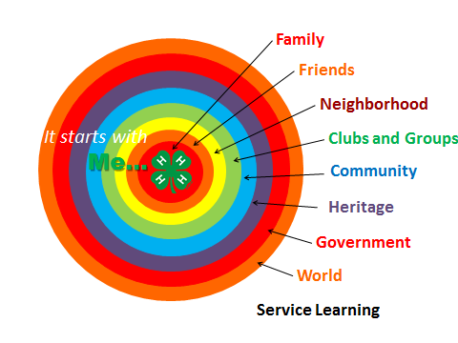
Definitions of Citizenship
The way you think, feel and act toward your family, other 4-H’ers, your school, faith groups and other people in your community.
Activities which help foster greater understanding of the role of a community citizen.
Notes:
Citizenship is the relationship between you and others. Activities which help foster greater understanding of community needs and responsibilities as a citizen.

Slide 20

Citizenship continued…
Activities which contribute to the welfare of your local club, individuals in your community or the community as a whole.
Cooperating with others to plan and carry out the duties and responsibilities of a good citizen.
Positive role model for younger members.
Doing the right thing for the right reasons.
Notes:
4. Citizenship activities can include helping an individual/ group/organization or carrying out a project individually.
Role model = Character Counts
Citizenship may not always be convenient, pretty or clean. It is about serving the needs of another. May require sacrifice.
Citizenship is not…
Teaching a workshop (leadership)
Giving a talk or demonstration (project work)
4-H Citizenship is not what you do as a member of your church youth group or another youth organization (but could be reported as other citizenship).
4-H citizenship are those things planned, implemented and evaluated wearing the clover.

Slide 21
Leadership vs. Citizenship
Do not confuse the two…
When you are leading or organizing a project, it goes in leadership, even if you are leading a community service project
Examples:
  Leadership
    Organized a calendar drive for two nursing homes
  Citizenship
    Donated 15 calendars to calendar drive for two
    nursing homes

Slide 22
Where Projects Come Up Short
Lack of solid project work.
Failure to show personal growth and application of project skills.
Citizenship - activities that make a difference in someone's life.
Lack of focus in project work.
Too much repetition in project work from year to year and section to section in the record book.
Notes:
Lack of SOLID project work is usually the failure to set goals and work a plan.
Evaluation from previous year helps one re-establish goals and to take things to the next level.
Remember it is not about you and an activity to fill the space. Citizenship is about others and how can what you are learning make another's life or situation better.
This means jumping from one thing to another and no logical transition or connection. Again back to goal setting and using project manuals as a guide.

Slide 23
Clerical Hints
Neatness
Accuracy
Spelling and Grammar
Word-processing/computers, Handwriting
  Font Size
  Spelling
Picture Section
  Photographs and captions
Notes:
Refer to the Record Keeping tip handout for details.

Slide 24
Helpful Definitions
Speech/Illustrated Presentation
Demonstration
Workshop
Short Course
Other Appearance or Presentations
Committee Appointment
Educational Booth or Display
Educational Exhibit
Working Display
Year in School
Tabbing
Notes:
Speech/Illustrated Presentation - An organized talk with an introduction, body and conclusion. Rituals, prayers, and/or presiding over meetings do not qualify as speeches.
Demonstration - To give instructions for making a finished product and show how it is done. If demonstration shows how to make two or three small items to complete one big item, it is still just one demonstration.
Workshop - To give participants actual hands-on educational experience. 1-3 hours in length.
Short Course - Could be multiple sessions or hours (may be a lecture).
Other Appearance or Presentations - Share the Fun, style shows, rituals, etc.
Committee Appointment - Should be reported only when 4-H’er is an active, contributing member of the committee.
Educational Booth or Display - Not for competition. Tells about a project.
Educational Exhibit - A competitive exhibit demonstrating a project, e.g., Foods-Nutrition exhibit.
Working Display - Display that 4-H’ers operate to answer questions or give information to public on request.
Year in School - The grade the 4-H member is in at the time the form is submitted..
Tabbing - Makes it easier for the judge to find major sections of the record book. Tabs should be uniform in length. Tabs should not extend beyond the edge of the cover.

Slide 25
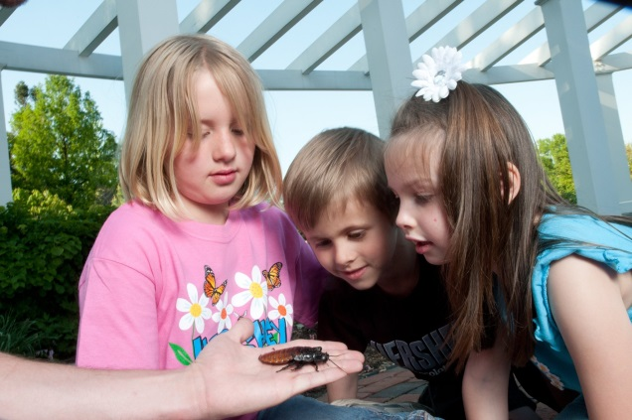
Photo Pointers
Photos should be action, active, doing and leading. Leave out the “Grip and Grin” photos of awards and recognition.
High quality photos.
Highlight project work, leadership
and citizenship.
Show growth through the years.
Logical sequence telling a story.
Respect the privacy of special audiences or others in the photo.
Notes:
Ask permission to use the picture of others when their face can be seen.
Check with agencies where service is being conducted. You may not be able to use pictures without faces being blurred.

Slide 26
Photo Pointers continued…
Effective use of white space and attractive presentation.
Digitally cropped and printed with descriptive captions. DO NOT distort, layer or shingle photos.
Real photos - use a photo mounting adhesive/rubber cement for best results.
Captions should be a mini story.
Captions may accompany each picture or it can be one documenting the page.
Notes:
Illustrated on the next two slides

Slide 27
Photo Captions
Good captions
  Avoid starting each caption with “Here I am….”; “I am….”; or “This is me doing…”
  Don’t state the obvious. Explain what is going on and how it affected your project.
  Don’t repeat yourself in the same caption. Remember, your space is limited.
  Do not write as if you are talking about yourself to someone else.
    For example: “David is shown planting a test plot of corn,”
    sounds strange if you are David.

Slide 28
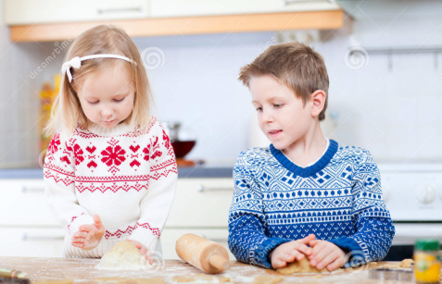

Photo Captions continued…
Poor
Making Cookies
Pesticide safety
Here I am with my collection of leaves.
Good
Teaching project group of 6-10 year olds baking techniques – 20xx
Model pesticide storage cabinet used in six community exhibits – 20xx
Collecting and identifying leaves of 24 different species of trees – 20xx

Slide 29
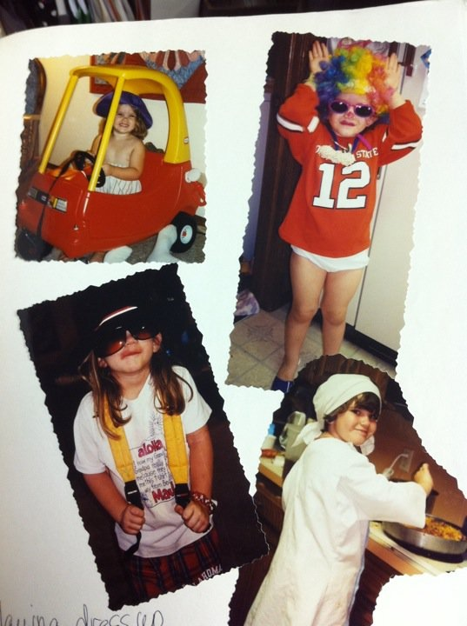
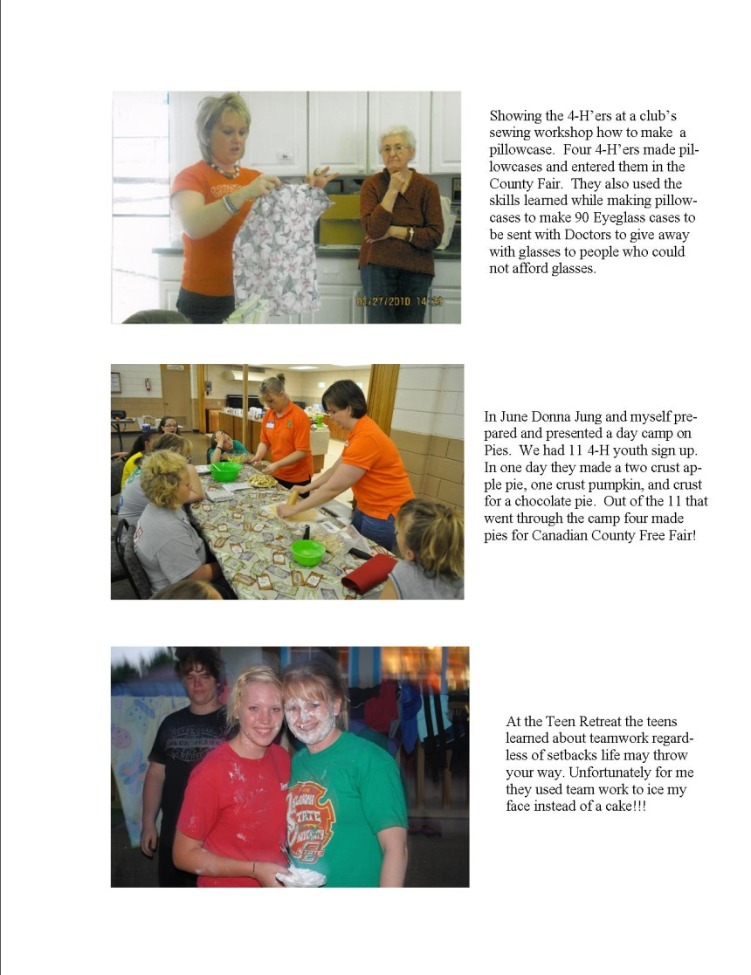
Do
Do Not

Slide 30
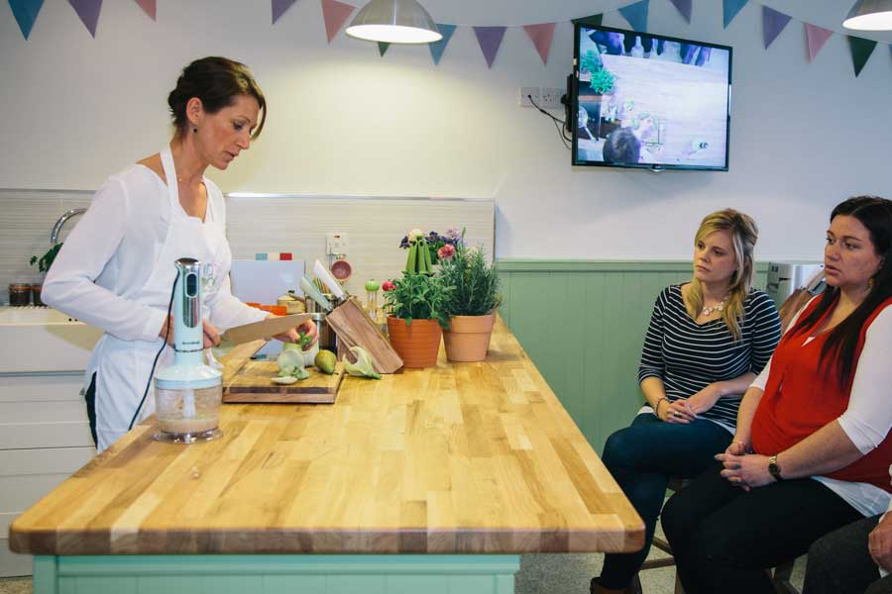
Notes:
What needs to be improved with the demonstration picture – crop and possibly add a boarder.

Slide 31
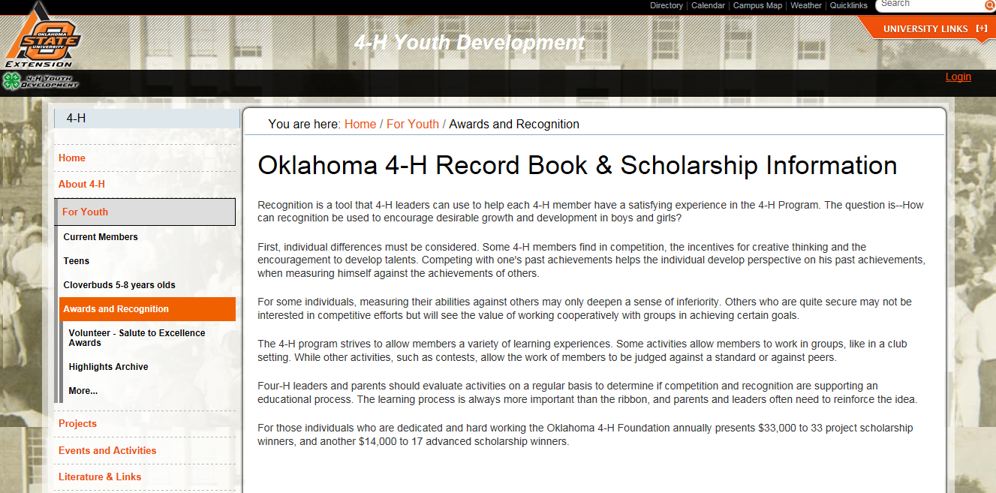
For Youth - http://4h.okstate.edu/for-youth
  Awards and Recognition
Notes:
Senior Level – look at state objectives and check the website annually for changes in scholarships and guidelines.
If the member has not been focused this is the time to focus.
It is not advised to look at the state projects and what the child has done looking for a place to “dump” everything. It is really obvious when the books are being evaluated. It is advised to counsel with the youth, looking at what they have done and where they want to focus over then next 4-5 years of project work. Select the state program which best meets their interests and will keep them motivated and focused.

