Slide 1
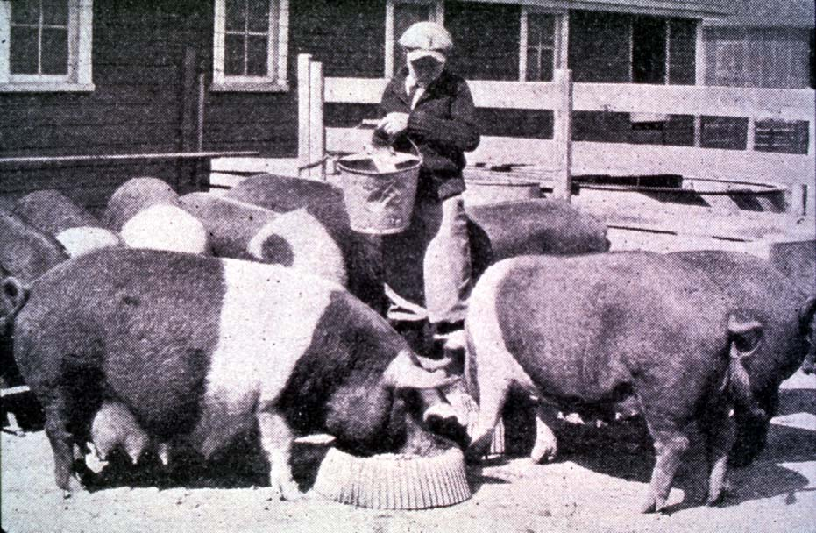




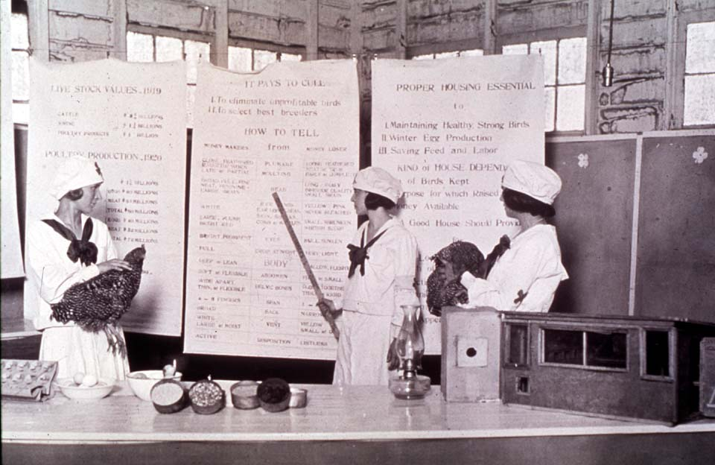

Getting the Most Out of the 4-H Experience
Leading a Project Group
oklahoma 4-h volunteer development
Notes:
Instructor Preparation – Allow 6-8 hours of preparation for 1 hour of instruction.
Review all materials thoroughly. Do any additional research or preparation to make yourself comfortable with the materials or to give it your personal touch.
Determine what other topic/subject matter will be presented with this “core” subject matter. It could be a special event/activity that will focus on the CES 2014 Centennial Celebration, an educational piece on how youth should prepare for the “Famous People” category at your communication event, introducing the OK Hobbies and Collectibles project, National 4-H History Preservation Program, the heritage portion of the Citizenship project area, etc. This is a good topic to encourage, embracing and learning about History through 4-H programming.
Prepare handouts that complement the subject matter.
Down load the OCES Centennial PSA 100 Years of Oklahoma Extension (video 3:35 minutes) http://toolbox.okstate.edu/100-years to play with slide
Teaching Outline and Activity
4H101 – Lesson 10: Knowing the Basics About Cub
4H101 – Lesson 11: Getting Clubs Started
4H101 – Lesson 14: Marketing 4-H Clubs
Handouts that complement the session:
Being a 4-H Parent
4-H Project Planning Guide
Do It Yourself Visuals
Goal Setting Worksheet for Jr. Members
“Plan the Work” Calendar
4-H Record Keeping Pointers
4H.VOL.101 – Leading a Project Group
4H.VOL.104 – Public Speaking
4H.VOL.105 – Recognition Model
4H.VOL.107 – Judging
4H.VOL.108 – Understanding 4-H Events and Activities
4H.VOL.109 – Planning
4H. VOL.110 – Goal Setting
Understanding 4-H Judging – Rutgers Extension
4-H Horse Judging Standards Danish System – Iowa State Extension
Experiential Learning Model
Resource Materials
Targeting Life Skills Model
Life Skills – Definitions of skills
Targeting Life Skills Model – animated slide (2008)
Experiential Learning Model
PowerPoint Presentations
Unit 2 – Getting the Most Out of the 4-H Experience
Getting Off on the Right Foot
4-H Volunteer Development Project Leaders
This is 4-H Jeopardy
Self Study Series – for volunteers who can not attend this training in person.
4H.VOL.202A – Developing Youth through the 4-H Experience
4H.VOL.202B – 4-H Project Work vs. project
4H.VOL.202C – Teaching Goal Setting and How to Plan
4H.VOL.202D – Understanding 4-H Events and Activities
4H.VOL.202E - Public Speaking
4H.VOL.202F – 4-H Recognition and Awards
4H.VOL202G – Teaching Evaluation through Judging
4-H Newsletter Support Material
Adults Role in 4-H Project Work
Benefits of 4-H Project Groups

Slide 2
Definitions
Project Group – small group of people with a similar interest who are members of a traditional multi-project club. The group meets outside of the regular monthly meetings. A project group may meet seasonally or year around.
Project Club – A Chartered 4-H Club with a specific interest. The group functions as a 4-H club. Programs and activities are centered on the clubs interests (i.e., horse, dog, wildlife, shooting sports, etc.).
SPIN Group/Club – Special Interest Group and/or Club
Notes:
Project Group – small group of people with a similar interest who are members of a traditional multi-project club. The group meets outside of the regular monthly meetings. A project group may meet seasonally or year around.
Project Club – A Chartered 4-H Club with a specific interest. The group functions as a 4-H club. Programs and activities are centered on the clubs interests (i.e., horse, dog, wildlife, shooting sports, etc.).
SPIN
New term being used for a project group or a project club. SPIN means “Special Interest.”

Slide 3
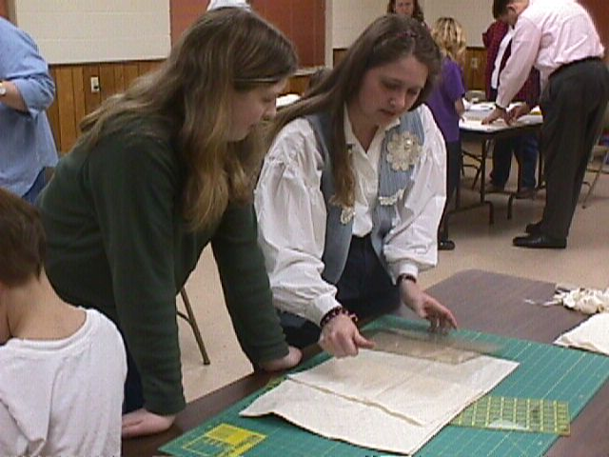
Your Role
A strong belief in the basic worth of each individual as a human being
A commitment to the personal development of each individual
The ability to relate to children, parents and other volunteers
An understanding that leadership can be fulfilling for both adults and youth
Notes:
Project leaders should be certified volunteers
Use 4-H 101 Leading a Project Group to talk through each point.
Handout the Project Leader Position Description.

Slide 4
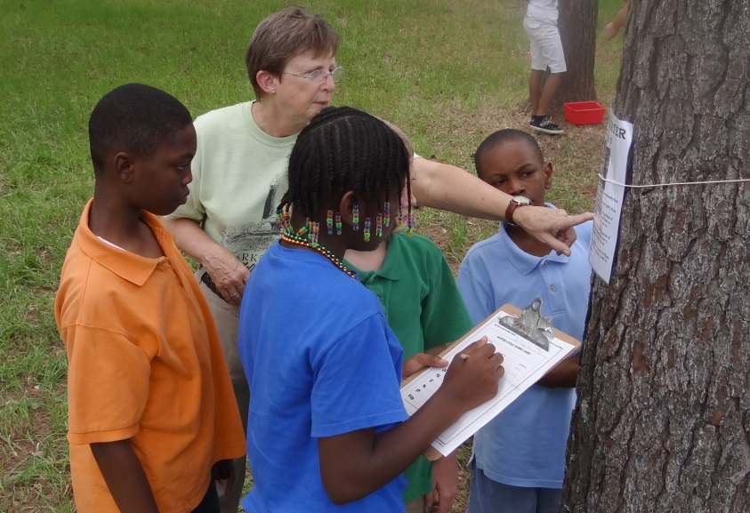
The Project Leader’s Role
isn’t mere information-giving
isn’t mere entertaining
is creating a learning environment
is structuring learning experiences
is helping the learner interact with information

Slide 5

Responsibilities
Know Project Objectives
Organize the Group
Encourage and Motivate
Apply 4-H Recognition Model
Involve Parents
Member Ownership
Records
Setting Goals
Teaching Skills/Life Skills
Participation
Journaling takes many forms.
Notes:
Use 4-H 101 Leading a Project Group to talk through each point.

Slide 6
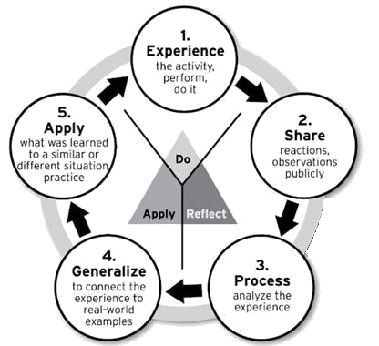
4-H Project Work should…
Reinforces learning and develops understanding.
Includes sharing new knowledge with others.
Answers three questions:
  What was learned?
  What does it mean?
  How is it used?
Experiential Learning Model
Pfieffer and Jones, 1985
Notes:
Use 4-H 101 Leading a Project Group to talk through each point.

Slide 7
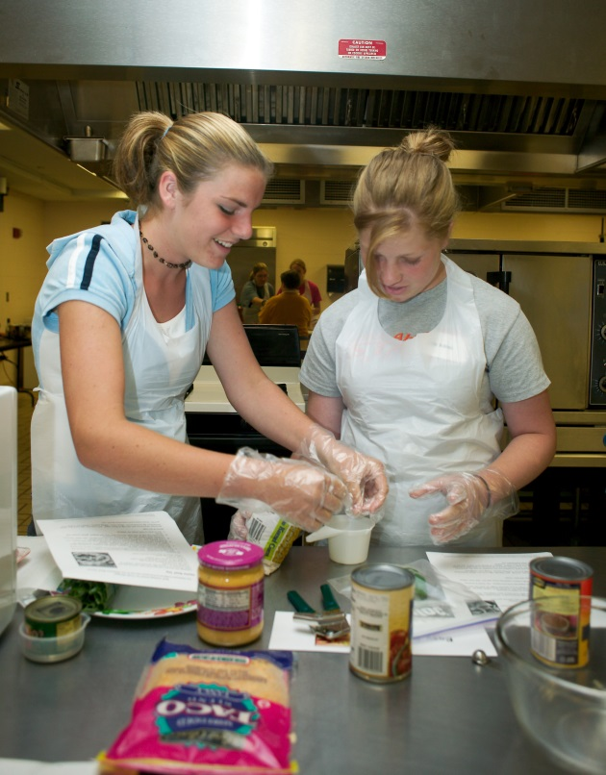
An Environment for Learning
Progress Reports
Review Materials
New Information
Activity Period
Summarize
Notes:
Use 4-H 101 Leading a Project Group to talk through each point.

Slide 8
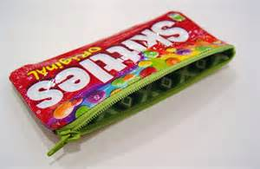
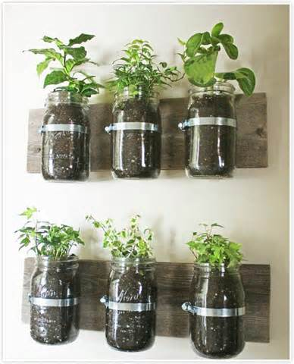
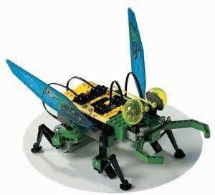

First Impressions
Plan
Peak interest
Icebreaker/Recreation/Introductions
Introduce expectation to Journal
Settle any group business
Assignments for next meeting
Informal Time
Later – 2-3rd meeting
Meet with child and record goals
Notes:
Use 4-H 101 Leading a Project Group to talk through each point.

Slide 9

Project meeting Checklist
Were the objectives of the meeting clear?
Did I give each member a chance to actively participate?
Did I praise or encourage each person in some way?
Did I plan for differences in abilities and interests of youth?
Notes:
After the meeting, take a few minutes to consider each of the following questions. Build these concepts into each meeting/lesson as you use the Program Planning Outline on page 7.
1. Were the objectives of the meeting clear?
2. Did I give each member a chance to actively participate?
3. Did I praise or encourage each person in some way?
4. Did I plan for differences in abilities and interests of youth?
5. Did I plan for age level differences?
6. Did I involve the parents in some way?
7. Did I give members a chance to assume responsibility when it was appropriate?
8. And most important – Did I enjoy working with the young people?

Slide 10

Resources
Project Leader Guide
Member Project Guide – instate and out of state
Cautiously use Internet, Books and Magazines
Extension Office
Parent-Volunteer Training
Teen Leaders
Community Resources
Oklahoma 4-H Literature—https://4h.okstate.edu/parents-and-volunteers/leadership-and-personal-development/index.html
Notes:
Use 4-H 101 Leading a Project Group to talk through each point.

Slide 11
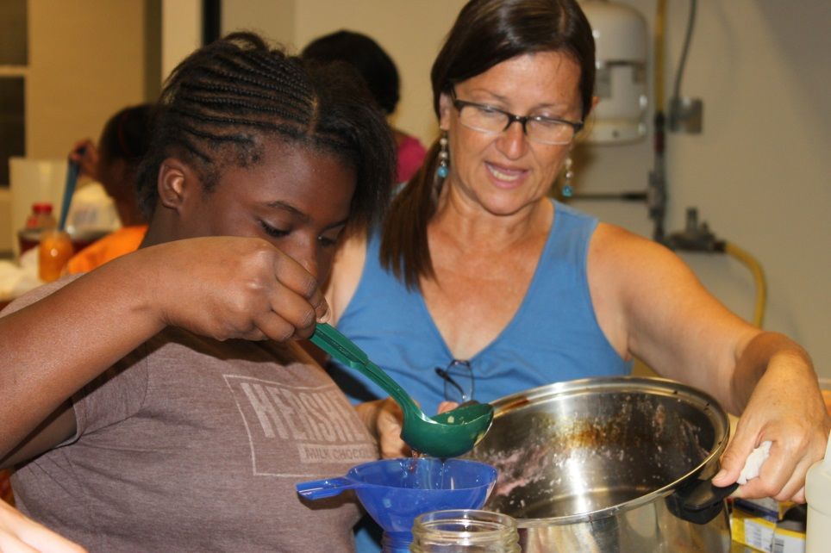
“As a 4-H project leader you have an excellent opportunity to help young people grow and develop in a rapidly changing world. “

