Slide 1
4-H Volunteer Orientation
Oklahoma 4-H Volunteer Development
Revised 1/2024
Notes:
Session for NEW Volunteers being Certified for the first time.
Instructor Preparation – Allow 6-8 hours of preparation for 1 hour of instruction.
Review all materials thoroughly. Do any additional research or preparation to make yourself comfortable with the materials or to give it your personal touch. The content is an introduction to the 4-H program. Future continuing education will give volunteers more time to learn how to apply the information.
Prepare your content for the transition slides, “Time for County Sharing.”
Prepare/print handouts/resources that complement the subject matter.
Allow adequate time with the new volunteer(s). They need time to absorb, process and ask questions.
Relax and enjoy the time getting to know the volunteer(s).

Slide 2
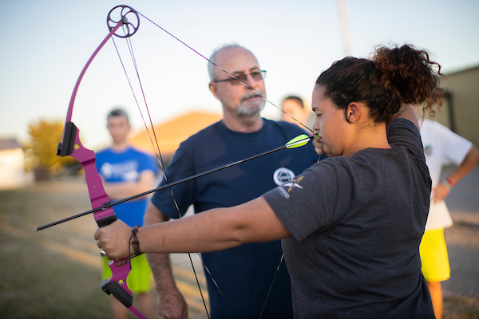
WHY WE CERTIFY VOLUNTEERS
To ensure a safe environment for youth involved in Oklahoma 4-H.
Protect our volunteers and the OK 4-H Program.
Strengthen liability coverage for volunteers under the State Tort Claims Act.
To keep volunteers abreast of the most current youth development practices and enhance personal skills and knowledge through continuing education opportunities at the county, district, state and regional level.
Notes:
To ensure a safe environment for youth involved in Oklahoma 4-H.
Protect our volunteers and the Oklahoma 4-H youth development efforts.
To provide documentation for volunteer activities and to strengthen a volunteer's liability coverage under the State Tort Claims Act.
To keep volunteers abreast of the most current youth development practices and enhance personal skills and knowledge through continuing education opportunities at the county, district, state and regional level.

Slide 3
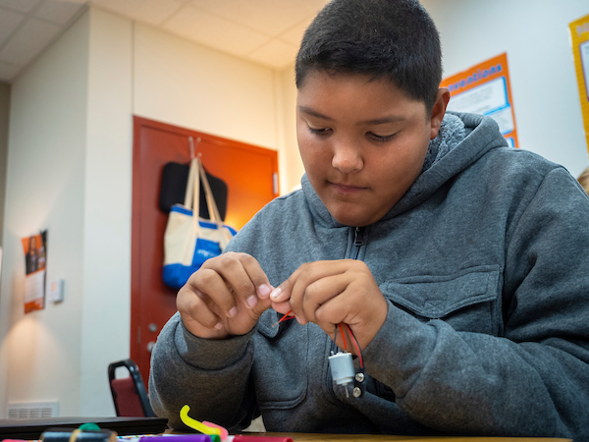
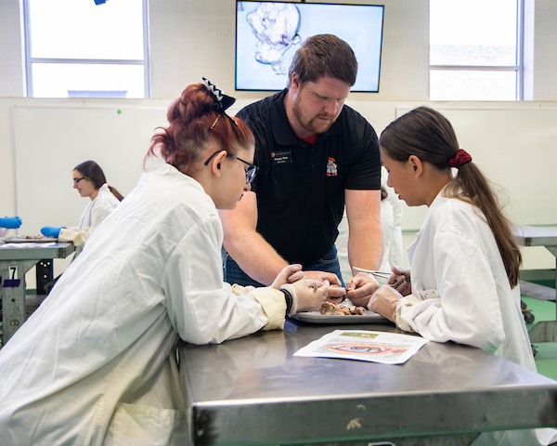
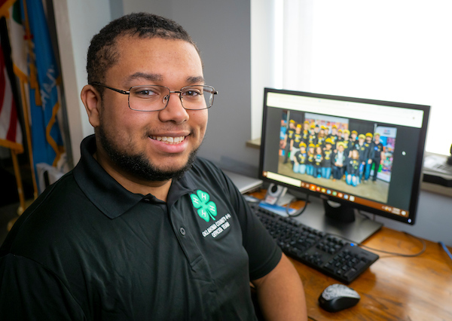
WHO WE ARE…
Oklahoma’s Land Grant Universities
Langston University (1890)
Oklahoma State University (1862)
College of the Muskogee Nation (1994)
Positive Youth Development
Education
Notes:
1) Land Grant System
The Cooperative Extension Service is associated with the land-grant universities in Oklahoma. Oklahoma’s Land-Grant Universities are Oklahoma State, Langston and College of the Muskogee Nation. Each universities has a youth development program which compose the total Oklahoma 4-H program.
Building on its land-grant heritage, Oklahoma State University promotes learning, advances knowledge, enriches lives, and stimulates economic development through teaching, research, extension, outreach and creative activities. (2019)
The term cooperative refers to funding received from federal, state and county governments.
Federal - NIFA-USDA (National Institute of Food and Agriculture-United States Department of Agriculture) (2019)
State – Higher Education Budget
County – Govt. or Sales Tax
2) 4-H is Positive Youth Development
Positive youth development is defined as the ongoing process of building young people’s assets and strengths through social, emotional, cognitive, physical and moral development. Volunteers who have knowledge and understanding of positive youth development are more likely to help youth develop the skills that will allow them to thrive.
All programs and activities conducted by 4-H are:
To create opportunities which promote positive youth development
To teach knowledge and life skills which enhance the quality of life for the individual, family and community
To engage young people in the work of the Land-Grant University
3) 4-H is also about Education delivered through:
Project work – the projects in which youth annually enroll
Local clubs - multi-project and project specific
Short-term Special Interest Groups
County, district and state activities and events
Short-term programs – summer day camps, workshops, overnight camp, and youth conferences
School Enrichment and After-school programs

Slide 4
4-H Youth Development
Notes:
Handouts that complement the section:
4H.VOL.111 – Developing 4-H Project Work
4H.VOL.135 Life Skills Definitions
4H.VOL.105 Recognition Model
4H.VOL.118 Experiential Learning
Positive youth development (PYD) is an approach to working with youth that emphasizes building on youths' strengths and providing supports and opportunities that will help them achieve goals and transition to adulthood in a productive, healthy manner.
4-H promotes positive youth development by giving youth opportunities to get involved and develop to their full potential. Positive youth development is a framework that highlights the things youth need to become successful. It focuses on strengths instead of limitations and is associated with the five Cs- - competence, confidence, character, connection, and caring. Researchers have suggested that a sixth C, contribution (to oneself and others) comes about when the 5 Cs are present in a young person’s life.

Slide 5


WHAT IS 4-H?
4‑H is delivered by Cooperative Extension, a community of more than 100 public universities that provide experiences where young people learn by doing.
4-H programming provides positive learning experiences; positive relationships for and between youth and adults; safe environments; and opportunities for positive risk taking.
Positive youth development engages youth along with their families, and communities, so that youth are empowered to reach their full potential.
4-H learning experiences are reflective and intentional.
4-H learning is progressive, with experiences building on each other over time.
4-H learning is social and connected to a larger, real-world setting.
Healthy
Habits
Building
Capacity
Notes:
2024 Resources with additional information on Positive Youth Development:
https://www.nifa.usda.gov/youth-development-infographics
https://www.nifa.usda.gov/grants/programs/4-h-positive-youth-development#:~:text=The%204%2DH%20program%20is,Program%20Quality%20and%20Accountability

Slide 6

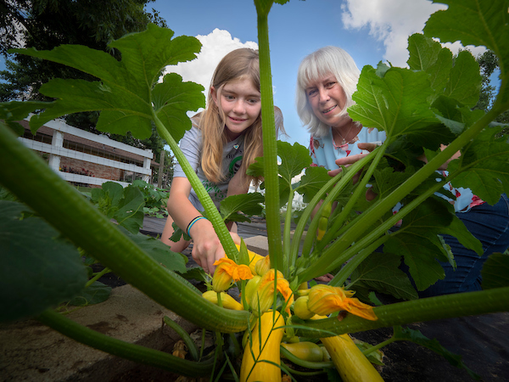
4-H PROJECT WORK…
A teaching tool for developing desirable character traits and project skills.
Provides real life experiences in making decisions.
Age appropriate and flexible for individual development.
Concerned with the optimum development of the individual.
Teaches desirable habits and attitudes
Teaches one to help oneself, which leads to helping others
Notes:
4-H project work is where we find the “spark” or interest which hooks a child’s interest and passion. Just like a sport, project work requires focus, commitment, practice and setting goals.
The term “4-H Project Work” is in reference to a single subject. (i.e. Horticulture, Foods, Safety, etc.) Youth annually enroll in a project or projects. The project is the big picture or long-term goal of what a member wants to learn.
The term “project” is in reference to the individual parts or short-term goals of “4-H project work.” Through individual projects youth develop subject matter skills and knowledge. A skill being defined as a learned ability to do something well.
Practice or replication is important in “mastery” which is the process of building knowledge, skills and attitudes over an extended period of time.
Through project work youth are simultaneously developing “Life Skills.” As volunteers, we help youth develop these Life Skills as we assist them in processing and applying learned skills to real life situations.
Our objective is to help them think beyond the obvious.

Slide 7
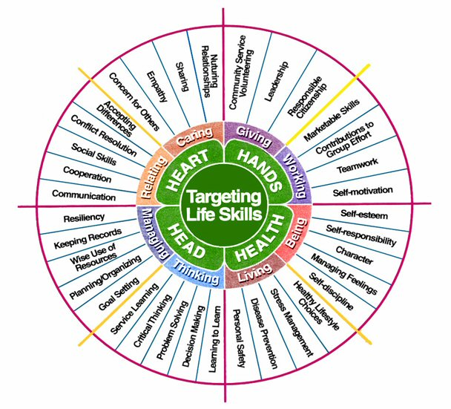
4-H Life Skills Model
Goal Setting – deciding on the purpose or desired result; something to work toward. HEAD
Learning to Learn — acquiring, evaluating and using information; understanding the methods and skills for learning. HEAD
Cooperation — to work or act together for a common purpose or mutual benefit. HEART
Social Skills — skills people use when interacting with others and to behave in the accepted manner or customs of the society in which they live; adapting well to one’s social environment. HEART
Contributions to group efforts – to give or supply along with others for a common purpose. HANDS
Self-motivation — able to make the needed effort to carry out a task or a plan; personal will to take action. HANDS
Self-esteem — pride in oneself; proper regard for oneself as a human being; valuing oneself; a feeling of ability to cope; learning to accept and like oneself. HEALTH
Self-responsibility — taking care of oneself; being accountable for one’s behavior and obligations; choosing for oneself between right and wrong. HEALTH
Notes:
Life skills are essential to the 4-H youth development effort. These skills should be intentionally built into all programming. Here are some key life skills developed through 4-H.
Categories of life skills are identified and divided using Head, Heart, Hands and Health. There are two general categories of skill under each of the four headings.
Heart - Relating and Caring
Hands - Giving and Working
Health - Living and Being
Head - Thinking and Managing
As a volunteer working with youth in developing projects, programs and activities we encourage focusing on one skill from each quadrant to provide balance in the development of the Head, Heart, Hands and Health of our members.
It is important that we diversify our focus and experiences so youth experience multiple life skill during their 4-H career.
Never assume you know the definition of a life skill on the Targeting Life Skills Model. Help sheet 4H.VOL.135 Life Skills Definitions should be kept in your “toolbox” of valuable resources.

Slide 8
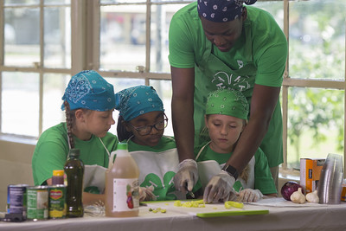
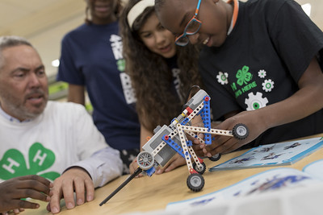
PURPOSE FOR…
4-H Project Works – a tool for mastering skills and knowledge and applying them to real-life experiences. Provide opportunities for career exploration.
4-H Events - provide an opportunity for education, evaluation, and recognition.
4-H Activities - provide an opportunity for education, participation, and fellowship.
Learn by Doing
Life Skill Learning to Learn — acquiring, evaluating and using information; understanding the methods and skills for learning
Notes:
A teaching tool for developing desirable character traits, skills and knowledge.
Provides real life experiences in making decisions.
Age appropriate and flexible for individual development.
Concerned with the optimum development of the individual.
Teaches desirable habits and attitudes
Teaches one to help oneself, which leads to helping others
** Invite 4-H members and parents to attend the orientation and share examples/set-up displays/etc.

Slide 9

4-H Recognition Model
Participation in educational experiences.
Making progress toward self-set goals.
Achieving standards of excellence.
Excelling in peer competition.
Demonstrating excellence in cooperation.
Progress Toward Self-Set Goals
Participation
Cooperation
Peer Competition
Standards
of Excellence
A club and county program should have a healthy blend of all five forms of recognition.
Help Sheet: 4H.VOL.105 Recognition Model
Notes:
Handout – 4H.VOL.105 Recognition Model
There are 5 forms of 4-H Recognition all equally important to positive youth development.
Participation
Progress Toward Personal Goals - setting and achieving personal goals
Standards of Excellence - Danish System of Blue, Red and White Awards
Peer Competition - Placing items First, Second, and Third
Cooperation - involves all parties in the decision-making process.
Cooperation is at the center of the model; it involves all parties in the decision-making process. The primary goal of 4-H is to help young people become self-directing, productive and contributing citizens. 4-H Volunteers should place emphasis on and recognize the importance of working together to learn and achieve goals as a team.
When emphasis is placed on cooperation or working together, our youth learn to examine their own skills and abilities and explore solutions beyond their own ideas
Participation is as simple as taking part or being a member of a group where they feel safe and appreciated is significant for some people. Through participation emphasis is placed on the importance of being involved in an educational experience.

Slide 10

4-H Experiential Learning Model
1. Experience the activity: perform, do it
5.
Apply what was learned to a similar or different situation; practice
Do
2.
Share the results, reactions, & observations openly
Developed by Kolb (1984) and modified by 4-H
Apply
Reflect
In the planning process ask… Have all 5 parts of the experiential learning process been included?
4. Generalize to connect the experience to real world examples
3.
Process by discussing, looking, analyzing and reflecting the experience
Help Sheet: 4H.VOL.118 Experiential Learning
Notes:
Experiential Learning is the foundation of ALL programming and curriculum. As a volunteer it is important understand and apply the model to all program planning, club experiences, activities and events and project work. The model focuses on the “PROCESS” the child experiences and less on the product.
4-H Youth Development effort relies heavily upon the five steps of the experiential learning model to teach skills, communicate understanding and develop life skills.
Each sequential steps helps youth identify what they have learned from a 4-H experience or activity and how to apply that information to other experiences or situations.
The cycle begins again. The Experiential Learning experience is continuous and never stops. As it becomes a standard way of doing 4-H; youth, families and volunteers become natural “Lifelong Learners.”

Slide 11

4-H PLEDGE
I pledge
My head to clearer thinking,
My heart to greater loyalty,
My hands to larger service, and
My health to better living for my club, my community, my country, and my world.
Notes:
There are guidelines governing the use of the clover. See “Oklahoma 4-H Rules and Guidelines.”.
All uses of the 4-H Club Name or Emblem shall be consistent with the educational purposes, character-building objectives, and dignity of the 4-H program. The 4-H Club Name or Emblem shall be given a position of prominence. It is not permissible to superimpose any letter, design, or object on the 4-H Club Emblem, or to materially alter its intended shape.
“4-H Club Name and Emblem” consisting of a green four-leaf clover with stem and the letter “H” in white or gold on each leaflet.
When in doubt on the use of the clover, consult the county Extension office or the state 4-H office.

Slide 12


A Time for County Sharing
Overview and explanation of:
County Project Clubs
4-H Project Manuals
County Activities and Events
Forms of Recognition Practiced
Awards Program(s)
Ribbons
Notes:
At this point, talk about county project clubs – great time to recruit new families.
Explain counties policy for obtaining project materials. Show some copies.
Briefly highlight county activities and events unique to your county educational experience.
Explain about entry forms and evaluation methods provided to the participants and families..

Slide 13
“Certification “

Slide 14


MAINTAINING CERTIFICATION
CONTINUING EDUCATION OPPORTUNITIES
Annually:
Re-enroll
Complete four (4) Continuing Education units
Review/renew University required Working with Minors policy
Review/renew University required OSU Extension: Civil Rights for Volunteer
** A BACKGROUND CHECK will be required every four years, unless deemed sooner.
County/Unit - a minimum or two with county staff
District
State
Regional
National
** CEUs do not include the annual review of WWM/Civil Rights policies.
https://www.facebook.com/ok4hvolunteersandparents
Notes:
Annually certified volunteers are expected to participate in a minimum of 4 continuing education opportunities, as well as renew WWM and Civil Rights. CE may include 2-4 trainings at the county level with your county educator. Two of the four trainings could be any combination District/State/Regional/National 4-H Conferences, workshops or programs, or Professional Development related to youth work or the area in which the volunteer provides expertise (i.e. teacher in-service, law enforcement training in gun safety, etc.)
Any training outside of OCES the volunteer must obtain and return a completed a Continuing Education Credit form to the county extension office or provide some form of documentation of their attendance.

Slide 15
Program Policy & Guidelines
Notes:
Handout:
Oklahoma 4-H Rules and Guidelines

Slide 16
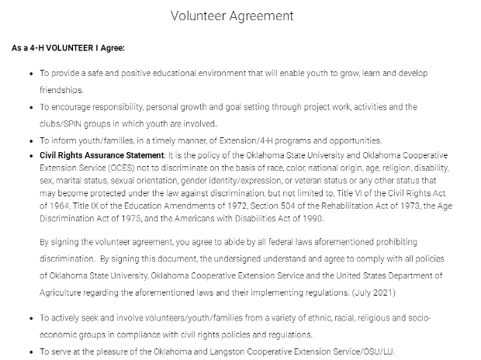
AFFIRMATIVE ACTION
Oklahoma State University, as an equal opportunity employer, complies with all applicable federal and state laws regarding non-discrimination and affirmative action. Oklahoma State University is committed to a policy of equal opportunity for all individuals and does not discriminate based on race, religion, age, sex, color, national origin, marital status, sexual orientation, gender identity/expression, disability, or veteran status with regard to employment, educational programs and activities, and/or admissions. For more information, visit https:///eeo.okstate.edu.
Notes:
This policy should be carried out in the spirit of inclusion with an effort to ensure that all youth and adults are welcome to participate in 4-H programs and other programs of their choosing.
Updated 2023
Revised Slide

Slide 17
Oklahoma 4-H Rules & Guidelines
4-H Year
August 1-July 31
“Age and Grade as of Sept 1”
Livestock show rules and guidelines
Roles
Member, Parent, Family, Club Leader, Project Leader, Volunteer, Extension Educator
Membership
Cloverbuds: non-competitive program for 5–7-year-olds
Traditional membership 8-19 years old
Member in Good Standing
Volunteer: 21+ years of age
Code of Conduct – youth and adult
Academic Eligibility
Dual Membership
Notes:
Handouts – WWM Form 1 and 4-H Membership Guideline
Families are important and enhance the 4-H experience. Parents are encouraged to attend meetings with their children and support the organizational, project and activity leaders as requested. 4-H is best experienced as a “family.”
Parents
Aide in selecting, financing and managing.
Guide and support work without doing it for them.
Encourage follow-through and completion.
Give praise and encouragement.
Assist in gathering tools and supplies.
Encourage record keeping.
Provide support and transportation.
Assist organizational, project and activity leaders and teen leaders.
Become a project or activity leader.
Serve on committees to plan and implement club and/or county activities or project meetings.
Attend parent-volunteer association/leader meetings
Become a certified 4-H volunteer.
Refer to appropriate pages the 4-H Membership Guideline for each slide point.
Family
Encourage participation in 4-H programs at the local and county level and to assist in the development of the 4-H member.
Support local and county 4-H program through time, talent, and financial support.
Work cooperatively with other families and 4-H volunteers.
Participate in Parent-Volunteer Training to enhance personal knowledge of 4-H.
Club Leader
Teach, guide and support experiences without doing it for youth officers or members.
Encourage follow-through and completion.
Give praise and encouragement.
Coordinate organized and educational club meetings.
Delegate leadership opportunities through Youth-Adult Partnerships.
Nurture the development of other adult volunteers.
Encourage committees composed of youth and adults to plan and implement club activities or project meetings.
Certified 4-H volunteer
Volunteer
Provide leadership to the local and county 4-H program. Leadership includes planning, developing, implementing, and evaluating programs and activities.
Work cooperatively with 4-H families, volunteers and extension educators.
Participate in Parent-Volunteer Training to enhance personal knowledge of 4-H and to assist in the development of 4-H members.
Extension Educator
Provide shared leadership and direction to local and county 4-H program.
Provide Parent-Volunteer Training at the county, district and state levels. Training shall provide the tools and knowledge that parents and volunteers need to successfully implement, maintain, and develop 4-H clubs and members.
Provide the support and training for the implementation of a volunteer lead program at the local and county level.
Work cooperatively with volunteers, families and 4-H members.

Slide 18
OTHER ITEMS
Health Forms – youth and adult
Livestock Show Rules and Guidelines
Notes:
Refer to appropriate pages the 4-H Membership Guideline for each slide point.
Handouts – WWM Form 1 and 4-H Membership Guideline
Code of Conduct – All 4-H members and Adult Volunteers complete the code of conduct annually as part of the enrollment process. A code of conduct (pages 5 of Form 1) does not need to be collected at any other time during the year.
Health Forms – Adult and Youth health forms should be kept up to date. Never assume pages 1-4 of the youth Form 1 have not changed from the time the form was first filed for the current program year.
Best Practice – Have a copy of form 1 available for club meetings (especially when parents are not present to assume responsibility for their child's treatment) activities, and when transporting youth.
Health Forms can be managed online through enrollment system or by paper. L-101 Managing Health Form - Event Registration
Each activity or event has its own set of rules and guidelines. It is our responsibility to assist families with having access to the information and helping them to interpret the information.
Any activity or event using the 4-H name and emblem should comply with national guidelines and support our philosophy of Positive Youth Development.
Revised Slide
The Oklahoma 4-H Youth Development Program encourages members to maintain good academic standing at school. Local school districts are expected to inform students and families of the student’s eligibility status. If a family knowingly violates the school’s policy regarding eligibility, 4-H will support the school in any actions taken.
When it is necessary for a 4-H member to miss school to attend a 4-H event, the member and his/her family should work with local school officials regarding his/her absenteeism. Local schools have guidelines regarding attendance polices for activities which qualify for excused absence. Families are responsible for talking to teachers and school administrators about these issues in advance of events and activities requiring an excused absence.
Oklahoma 4-H supports membership in other youth serving organizations. We do not support the policies of organizations who do not allow dual membership in 4-H or any other group or organization. For additional information refer to the OK 4-H Rules and Guidelines, section Oklahoma 4-H Open Membership Guidelines.
Each 4-H program, activity or event may have its own unique rules and guidelines. Care will be taken to avoid rules that exclude youth for reasons they cannot control. Cooperation among Extension staff, volunteers, parents and sponsors is essential to solving specific problems that may arise. It is the family’s responsibility to obtain rules and guidelines for any program/activity/event in which they choose to participate. An animal nomination form does not constitute 4-H enrollment. Enrollment must be completed through 4HOnline enrollment system or paper enrollment signed and submitted to the Extension office and 4-H program fee paid to be considered an “active” enrolled 4-H member.

Slide 19
Time for County Sharing
Overview and explanation of:
Yearbook
Newsletter
Deadlines
Forms
Website(s)
4h.okstate.edu
(Enter County website here)
Notes:
Have copies and share these sources of information unique to your county.
Yearbook – guidelines, forms, calendars, list of club leaders and contact numbers, etc.
Newsletter – How often is it published, how many copies per family, etc.
Deadlines – county policy
Forms – where are they available to families (club leader, county office, online, etc.)
Website – if you have one please share and explain how they can get the most from it’s use

Slide 20
Structure of Local and County 4-H Programs
Notes:
The next few slides are animated and you will need to click and explain each grouping as it becomes visual.
Make adjustments to illustrate activities and events specific to your county.

Slide 21
CIVIC ENGAGEMENT
Family
Friends
Neighborhood
It starts with Me…
Clubs and Groups
Community
Heritage
Government
World
Notes:
Animated slide
Civic Engagement starts with me the person/4-H member and then extends out by gradually growing my skills and knowledge. One ring prepares the 4-H member for the next.

Slide 22
LOCAL 4-H CLUB STRUCTURE
Continuing Education – leadership, life skills, subject matter, systems management
Public Speaking
County Activity Committees
Committees w/designated Activity Leaders
Share the Fun
4-H Member +
4-H Families +
Parents/Guardians + Teen Leaders +
Certified Adult + Volunteers =
4-H Camp
STEM
County Project Leaders
Project Groups w/Project Leaders
Health
Community or Project Club
Officers/Advisory Group/Club Leader
County PVA and/or County Officers, Teen Leaders
Executive Committee
Committee Chairs
Notes:
Animated Slide
[Oval] Membership and families – actively participate in club meetings, committees and activities. Share time, talents and skills with the club. Parents do not run the business meeting but are there to support and guide youth in learning skills.
Teen Leader – Teen’s who assist local leadership. As skills are acquired and strengthened, they may serve as activity and project leaders.
Certified Adult Volunteers serving as …
Activity Leader – primary leadership for planning and coordinating an activity through a committee of youth and adults. (Share-the-Fun, Picnic, Service Project, etc.)
Project Leader – primary leadership educating and training members in a specific subject matter/project. One club meeting each month does not allow adequate time to develop project work. Each club is encouraged to have individual project groups.
Organizational/Cloverbud Leader – primary leadership for 4-H club. This volunteer coordinates, guides, and provide leadership while involving youth and parents. Possess good communication skills and practices teamwork.
Continuing Education - County Educators is responsible for providing volunteers and leaders with the knowledge, skills and training so they can orient, support and guide new and returning families in getting the most out of being a member of the 4-H program.
A club is not one or two families/volunteers carrying the load. The opportunities are divided into smaller and more manageable pieces. With a greater number of parents and volunteers assisting the club leadership a larger number of youth can be reached through 4-H programming. It is a “win”… “win” situation. Click and talk through the animated slide.

Slide 23


OUR 4-H CLUB
Meets regularly providing a safe healthy environment for fellowship and growth
Fun and enjoyable for members and families
Run by youth officers who are supervised and guided by a caring adult
Have an educational emphasis
Provide opportunity for developing communication skills
Encourage cooperation and participation
Notes:
A 4-H Club is…
A group of youth who learn cooperation and leadership through fun and educational programs. Our club meets [share time, place and location]. Example: the first Tuesday of each month at the Green Lake Club House, 444 Park Place, Loserville.
Our clubs encourages:
Decision-making skills – committees, business meetings, project work
Cooperation in groups - “ “ “
Leadership development – Leadership in our club is not just about being an elected officer. We encourage active participation in committee work and/or just helping with projects. Leadership is about developing self-responsibility as a member of our club.
Communication skills – We encourage youth to develop all forms of communication. Finding their passion or strength (see life skill model) We will invite each member to share/speak publicly at meetings. Example: Favorite ice cream and why? What was your best 4-H experience last month?
New ideas - Youth will be encouraged to share ideas for the club, service projects, tours, programs and more
Knowledge and skill development
Pride in group efforts – Club/project group/service-learning experiences youth learn to sets goals and celebrated their completion
Self-confidence – safe environment for making decisions and a healthy environment for processing consequences and what was learned.

Slide 24
LOCAL CLUB STRUCTURE
Chartered 4-H Club
Fun, welcoming environment, enjoyable for members and families
Meet regularly
Run by youth officers/committees, supervised and instructed by a caring adult(s)
Have an educational emphasis
Provide opportunity for developing communication skills
Organized and communicate effectively w/families
Provide appropriate recognition and peer support
Complete an annual assessment to renew Charter
Project Leader
Teen Leader
Club Leader
Extension Staff
Activity Leader
Committee(s)
50% Education
33% Recreation
17% Business
Notes:
Organizational Leader – primary leadership for 4-H club. They coordinate, guide, and provide leadership while involving others. Possess good communication skills.
Activity Leader – primary leadership for planning and coordinating an activity through a committee of youth and adults. (Share-the-Fun, Picnic, Service Project, etc.)
Project Leader – primary leadership educating and training members in a specific subject matter.
Teen Leader – assist local leadership. As their skills are acquired and strengthened, they may serve as activity and project leaders.
Membership and families – actively participate in club meetings, committees and activities. Share time, talents and skills with the club. Parents do not run the business meeting but are there to support and guide youth in learning skills.
Membership and families – actively participate in club meetings, committees and activities. Share time, talents and skills with the club. Parents do not run the business meeting but are there to support and guide youth in learning skills.
A 4-H Club is…
A group of 4-H members who learn cooperation and leadership through fun educational programs and opportunities delivered by means of a Chartered community or project club.
Through an organized leadership structure clubs encourage and develop the following Life Skills (Handout help sheet 4H-VOL-135 Life Skills):
Decision-making skills
Cooperation in groups
Communication skills
New ideas
Knowledge and skill development
Pride in group efforts
Self-confidence
Leadership development
Annually a club charter will be renewed after the club does a self-assessment with the county Extension educator.

Slide 25
COUNTY 4-H PROGRAM STRUCTURE
Club
PVA
Youth Leaders
PAC
Executive
Activity
Event
Project Leaders
Fund Raising
Structure very similar to the Local/Project Club.
Camp
CE
Public Speaking
Share the Fun
Public Speaking
Arts
Disbursement
Activity
Fair
Awards
Horse Show
STEM Fair
Dog
Foods
Donors
ETC.
ETC.
ETC.
Extension Educator
Continuing Education, Management , Delivery Systems
Notes:
Animated Slide
[Click] Our program begins with strong active clubs. The families and members are the foundation of the county program.
[Click] Parent-Volunteer Association/Organization
This organization is much like a PTA/PTO in the school system. It is a group of adults who assist in coordinating committees responsible for the planning, implementing, and evaluation of county 4-H activities and events. The Extension educator serves as the advisor to the group. PVA assists OCES in maintaining and enhancing the growth and development of the Oklahoma 4-H program.
Any 4-H parent/guardian, grandparent, volunteer (certified or episodic), club leaders, etc. may attend and participate in meetings and committee work. An elected group of their peers provides leadership. (It is recommended that officers be “certified volunteers” it sets an example and assures their recognition and coverage by the university system.)
The group may meet monthly, every-other month or quarterly to conduct business meeting. Committee meetings to plan and evaluate county activities and events will be held as needed outside the regularly scheduled business meetings. These meetings should be a model for teaching adults how a local club functions.
The PVA will also assist the Extension Educator in planning and even conducting (when their talents or expertise lend themselves) Parent-Volunteer Continuing Education.
Adults will work to establish and maintain a strong Youth-Adult Partnership with the county Youth Council. Partnership refers to sharing equally in responsibilities and representation on county planning committees. Youth are provided meaningful opportunities to grow and share through their association with adults.
[Click] Youth Council
Council is governed by county youth officers elected by county 4-H members or an electorate composed of organized clubs. The officers will serve as representative for the county membership on committees. The council represents all clubs and ages.
The council may meet 2-6 times a year depending on the county structure.
Youth will work to establish and maintain a strong Youth-Adult Partnership with the PVA. Partnership refers to sharing equally in responsibilities and representation on county planning committees. Youth are provided meaningful opportunities to grow and share through their association with adults.
Teen Leaders Club – some counties have a Teen Leader project club, not to be confused with the Youth Council. The teen leaders are organized to develop leadership and civic involvement of teen 4-H members.
[Click] Program Advisory Committee
An advisory group composed of a diverse group of individuals representing a wide spectrum of experiences, views, and issues related to youth development. The group is representative of the county geographically and ethnically.
Their primary responsibility is to identify needs and trends of county clientele (i.e.. Youth, youth workers, youth agencies). They provide guidance as to possible solutions and assist in the planning and implementation needed.
[Click] Committees - Extension educators rely on county committees to assist in providing a diverse experience of opportunities to 4-H families. Because of limited resources and OCES responsibilities not directly related to 4-H, volunteers will be empowered to plan, conduct, and evaluate county programs, activities, and events with the guidance and support of extension personnel.
Committees will be composed of youth and adults working as peers (youth-adult partnership) to develop and implement programming. Each group brings a unique perspective to the table. [Click] Activities [Click] Events [Click] Project Leaders
[Click] Fund Raising [4-H Foundation]
Some counties will have a 4-H Foundation, this is an incorporated group whose primary responsibility is to locate, recruit and secure finances to support the county 4-H program. This is not a booster organization or a subcommittee of the Parent-Volunteer Association. The “incorporated status” provides donors legitimate tax-deductible charitable donations.
The board is composed of community leaders, businesspeople and alumni who have the contacts and interest in raising funds. These individuals may have limited contact with the youth.
The board is run by a group of officers and advised by the Extension educator. The board will prepare the budget in cooperation with the PVA and Extension educator.
In other situations, Fund Raising efforts may be a responsibility of committee of the PVA. This group will be responsible to locate, recruit and secure finances to support individual activities and event and/or researching county fund raising opportunities to be presented to the PVA for approval.

Slide 26
A Time for Sharing
Overview and explanation of:
Youth Council
Parent-Volunteer Association and opportunities to serve
, etc. County Activity and Event Committees
Other Committees - volunteer development
Program Advisory Committee
Fund Raising
Notes:
Have copies and share these sources of information unique to your county.
Youth Council – other possible names for this group include county officers, ambassadors, teen leaders
Parent-Volunteer Association – other possible name, leaders' council
Committees – Explain county structure for planning activities and events
PAC
Fund Raising – local and county projects/programs/opportunities. How is money used to fund clubs, activities, etc.

Slide 27
Managing Risk
Transportation and Chaperones
Notes:
Handouts - WWM forms 1,3, 4, 5, 7 and 8
Timely Tidbits – Three additional resources for volunteers. https://4h.okstate.edu/educators/risk-management/index.html
The possibility of accidents is always present, 4-H volunteers are to take to take precautions to prevent accidents and to lessen the extent of any unfortunate incidents that do occur. As part of the state 4-H Program Fee an annual $1 group accident policy has been purchased for youth and adults actively enrolled in 4-H. It is a limited policy and can be viewed in full at https://4h.okstate.edu/educators/risk-management/index.html. (2020) For an additional 20-30 cents per day, American Income Life provides special activities coverage which provides increased protection for illness and higher risk activities. https://www.ailife.com/specialriskdivision. (2020)
Forms 1,4, 7 and 8 should be completed and maintained when youth and adults are being transported, attending overnight activities, or when members are in the primary custody of the volunteer or Extension educator.
Other insurance issues volunteers should consider include:
Homeowner’s insurance coverage of meetings held in homes, (check with insurance agent)
Liability and coverage for meetings held in other locations – Oklahoma State University through the State of Oklahoma holds a Certificate of Self-Insurance that volunteers who are functioning within the realm and scope of their duties as outlined in a position description may be included. There is a significant deductible associated with filing a claim. It provides no direct insurance for volunteers, members, or Extension Educators. The coverage is only of value in protecting them in case of damages caused to others.

Slide 28
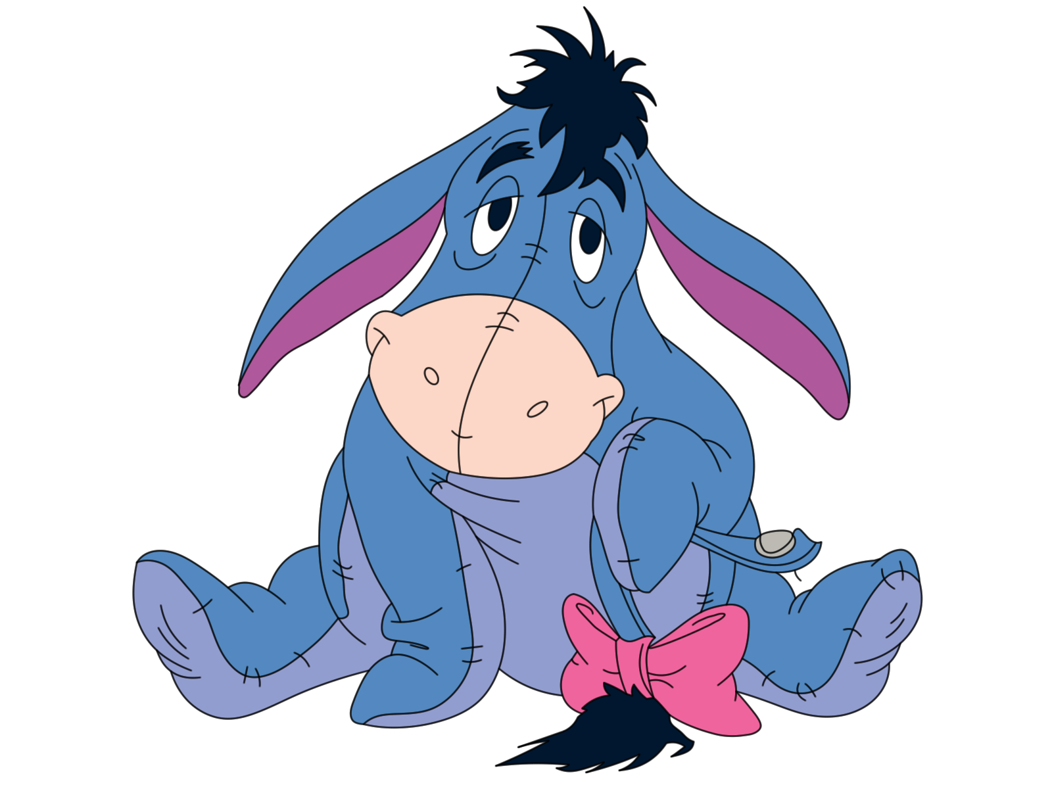
“And Eeyore whispered back: ‘I am not saying there won’t be an Accident, mind you. They’re funny things, Accidents. You never have them till you’re having them.”
A.A. Milne, 1928 “ The House at Pooh Corner”
This Photo by Unknown Author is licensed under CC BY-NC-ND

Slide 29
Under Oklahoma Law
OCES views volunteers as an extended employee when they are acting in the scope of their duties as a sanctioned volunteer for an approved/official 4-H activity.
Under Oklahoma Law…
“…any person who is authorized to act in behalf of a political subdivision or the state whether that person is acting on a permanent or temporary basis, with or without being compensated on a full-time or part-time basis.” (51 O.S. 1991, 152)
Notes:
The Oklahoma 4-H Volunteer Management System was put into place for the protection of both our volunteers and the youth we serve. Certified volunteers are seen as acting on a permanent basis without being compensated. Episodic volunteers are acting on our behalf on a temporary basis. Because an episodic volunteer has not had the training or continuing education provided by OCES they are not viewed as “sanctioned” volunteers who have unsupervised contact with youth.
Episodic volunteers must be supervised by Extension staff or certified volunteers and provided with a written position description prescribing their role and responsibilities. Adult form 5 Risk and Liability Waiver should accompany the position description.
The Oklahoma Governmental Tort Claims Act also provides certified volunteers a limited level of protection. This legislation provides protection for personal liability when the 4-H volunteer is functioning on behalf of Oklahoma State University and within the realm and scope of his or her written position description.

Slide 30

Risks you may face…
Insurance
Torts
Automobile liability
Volunteer Owned Vehicle
University self-insurance
Notes:
If conducting meetings or activities on your personal property, check with your insurance agent regarding your Homeowner’s insurance.
Oklahoma State University through the State of Oklahoma holds a Certificate of Self-Insurance that includes volunteers who are functioning within the realm and scope of their duties as outlined in a position description. There is a significant deductible associated with filing a claim. It provides no direct insurance for a volunteer, member, or Extension Educator. The coverage is only of value in protecting the individual in case of damages caused to others.
Kinds of Tort
Tort as it relates to Law, is defined as: “wrongful act, injury or damage for which a civil action can be brought.
Forms of tort:
Abuse
Assault and Battery
Negligence
Fraud
Slander and Libel
Trespass
Violation of Civil Rights
Automobile liability
Volunteer Owned Vehicle
All drivers by state law are required to have a valid drivers license.
Volunteers using their vehicle in support of a 4-H activity or event must have auto liability insurance.
Vehicles should be safe and in sound condition.
There must be a functioning seat belt for everyone being transported. At no time and under any circumstance should youth be seated in the back of a pickup or in a trailer. (Only exception a Parade and in this instance all youth and adults should receive very specific safety instructions about what is not acceptable.)
OSU’s self insurance can be used when transporting individuals solely as part of a sanctioned/organized 4-H function of a club, county, district or state program. This is why it is extremely important to file form 7 “Activity and Intent Forms” when an activity or event is being conducted outside the local club meeting and all volunteers receive adequate instruction and position description in advance.
Teens are responsible for following local and state law regarding the transportation of other youth and following curfew.

Slide 31

Risks you may face…continued
Automobile liability continued
Transporting children
Extension responsibility
Teen Drivers
Transportation and Chaperone Position Descriptions
This Photo by Unknown Author is licensed under CC BY-ND
Notes:
Volunteers transporting 4-H members
Must be/have:
Certified volunteers – only in extreme emergencies should an episodic volunteer be transporting youth. In an instance where an episodic volunteer is used, they should receive a Transportation Position Description (club or county) and an adequate orientation. The individual should be encouraged to complete certification process as soon as possible.
Current and valid driver’s licenses
A good driving record
Medical Release form for passengers other than their own children/family members.
An itinerary (WWM Form 7) of where they are going, the route to be traveled and scheduled stops. The driver is not to deviate from the itinerary or it can place them at risk for liable. (No side trips.)
Extension Educators and club leaders are to have in place:
Orientation and training process for club leaders and volunteers regarding transportation
Itinerary and instructions and/or position descriptions.
System for reporting accidents (WWM form 8)
System for handling concerns or complaints
Use of Teen Drivers - Use great discretion and limit the need for using teen drivers.
If necessary….
Check for appropriate licenses and car insurance.
Be sure the car is physically safe and provides working seat belts for all passengers.
Put your expectations in writing for the teen and their parent(s).
Teens understand permission is granted for driving themselves to and from the event only! They will be sent home if driving the automobile at any other time while away from home.
When teen is transporting, on behalf of 4-H, i.e. to camp or other event, having a release forms from parents, driver, and passengers will decreases liability.
Medical Release forms for all passengers.
Teens transporting other youth on a regular basis, as to a club meeting, is generally an issue between families and not the responsibility of the club or county leadership.

Slide 32
Everyday Operations…
Participate in sufficient training regarding supervising minors
Help identify risks, report them and/or correct the identified risk(s).
Avoid situations of negligence.
Reduce risk
Be sure insurance is in place or is purchased.
Report plans (form 7) to Extension Office
Report through written documentation claims or losses (form 8): date, time, details leading up to the accident, treatment administered, persons contacted, etc.
Participate in health and safety training.
Notes:
Handouts – WWM Forms 7 and 8
Methods for Controlling Risk
Participate in sufficient training and ask for specific information regarding responsibilities and expectations, especially in the area of supervising minors.
Always act prudently – This means to act with foresight, avoid error or danger using practical discretion.
Reduce risk by taking precautionary safety measures for:
Frequent risks with seemingly small losses.
Infrequent risks which could incur small losses.
High risk activities by identifying and eliminating risks PRIOR to the situation occurring. Eliminating activities is not the best way to prevent accidents, loss or suits. It is better to make sure activities are appropriate to the needs and abilities of the audience we are serving and eliminating or managing potential risks.
Avoid situations of negligence. It is our duty to provide a safe environment – to varying degrees, this is your responsibility to participants, spectators, passer-by, invitees, licenses, and trespassers.
Transfer the risk control to others - contract with others to conduct high risk activities.
Anticipate and have a plan - Forms 7 Activity and Event Intent Plan
Communicate thorough plans with the club leadership and county office. File “Activities and Event Intent Form 7” with county office for any club activity taking place outside of the regularly scheduled club meeting.
Always have copies of form 8 Incident and Accident Report. File a completed form within 3 days of the accident or incident.

Slide 33
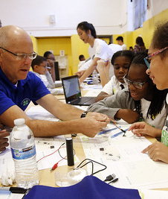
As a Chaperone…
Identify and reduce opportunities for risk
Avoid situations of negligence
Be sure there is insurance for an activity or event
Have a copy of the child’s Medical Release form quickly accessible
Avoid transporting one child
Do not leave children alone
Reduce the need to house youth and adults together
Well oriented/trained in expectations and responsibilities
Notes:
Handouts – Position Descriptions for Chaperone Day Event and Chaperone Overnight
https://4h.okstate.edu/educators/volunteer-management-system/ (2024)
As a Chaperone…
Identify and reduce opportunities for risk.
Avoid situations of negligence.
Be sure there is insurance for an activity or event.
Have a copy of the child’s Medical Release form quickly accessible.
To the greatest degree possible avoid transporting one child, regardless of age or gender.
Do not leave children alone at a meeting site. An adult should be present until the last child is picked up.
Reduce the need to place youth and adults in the same sleeping quarters.
Teens and adults serving as counselors should be well trained in expectations and responsibilities.

Slide 34
County Sharing
Overview and explanation of:
Policy on filing Activity and Event Intent Forms
County or Club Insurance Policy
First Aid Kit
Notes:
Have copies and share these sources of information unique to your county.
Form 7 – Activity and Event Intent

Slide 35
NAME OF PRESENTER
Department of This Slide Goes Last
O | 000.000.0000
C | 000.000.0000
E | name.presenter@okstate.edu
Address Goes Here
City, State
brand.okstate.edu (or other dept. specific URL)

