Slide 1

Experiential Learning Model
1. Experience the activity: perform, do it
Participants experience the activity - perform or do it.
Participants share the results of the experience and their reactions
Participants process the experience to determine what was most important and identify common themes and experiences.
Participants generalize from the experience and connect the discussion and experience to the larger world.
Participants apply what is learned to a new situation and other parts of life.
5.
Apply what was learned to a similar or different situation; practice
Do
2.
Share the results, reactions, & observations openly
Apply
Reflect
4. Generalize to connect the experience to real world examples
3.
Process by discussing, looking, analyzing and reflecting the experience
In the planning process ask… Have I included all 5 parts of the experiential learning process?
Developed by Kolb (1984) and modified by 4-H
Notes:
This model is the foundation of ALL programming and curriculum. It is important to introduce to new parents/families/volunteers and continually reminded them this is the basis of ALL we do. The model focuses on the “PROCESS” not the product.
4-H Youth Development relies heavily upon the five steps of the experiential learning model to teach life skills. The sequential steps of the model help youth identify what they have learned from a 4-H experience or activity and how to apply that learning to other experiences or situations.
The “process” will be applicable to all facets of life.

Slide 2
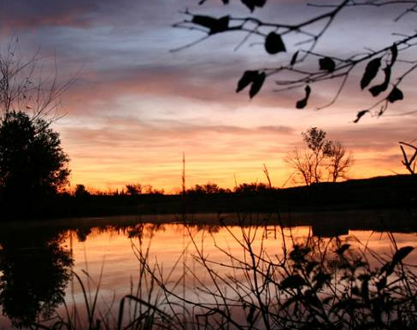

Digital Cameras
…understanding the camera and getting better pictures
Adapted 2014 by OK 4-H from original work of Bob Harlan, Kansas Photography Action Team, 2012
Notes:
Adapt this presentation to fit your needs. Feel free to break it into smaller pieces for multiple lessons.
Some slides are animated and must be clicked to see the next layer of content.
Revised 2022

Slide 3
There are many ways to connect or guide learning opportunities.
In preparing a lesson/activity, ask yourself:
Are you teaching through photography or with it?
Math and Photography
  Calculations with camera, lens, ISO and lighting. Learn about the Rule of Thirds and other proportion tricks.
Science and Photography
  Chemical reactions with film, light, liquids, sensors, etc. Applying filters to photos and properties of light and color. Use of technology - software and hardware.
English and Photography
  Picture is worth a thousand words….. Students can use photography to prompt story telling, story writing or as a artistic statements. Increase verbal skills and reasoning.
History and Photography
  Images document our history! Students could analyze photographs for historical content. Students could write about what they see and know using historical clues within an image (triple integration).
Integration is an opportunity to elevate
knowledge, skills, and life skills.

Slide 4
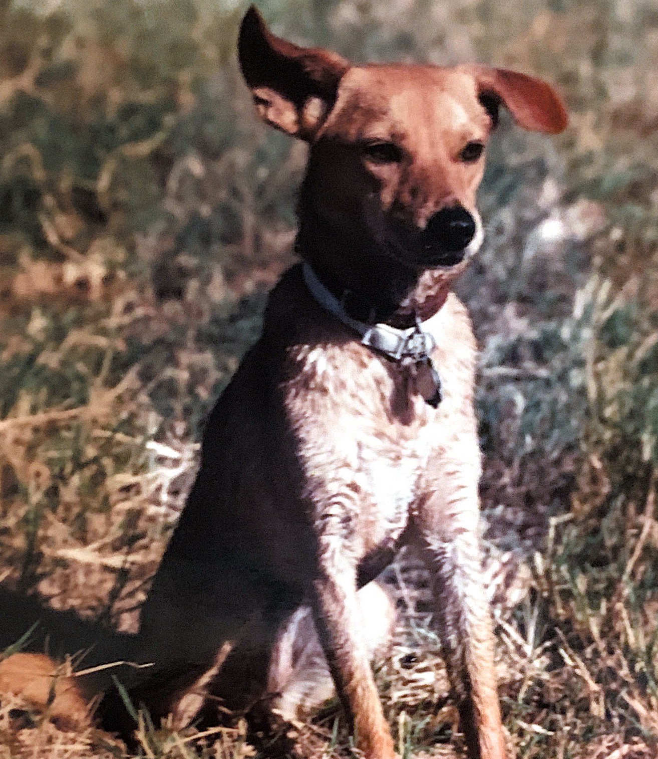
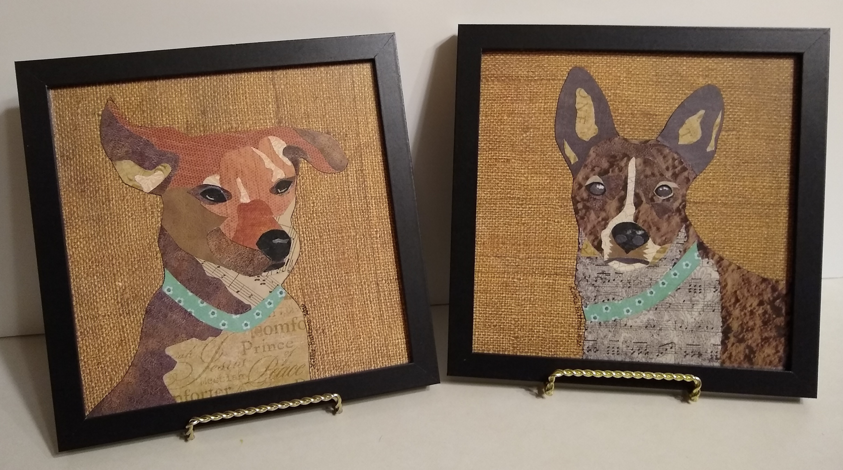
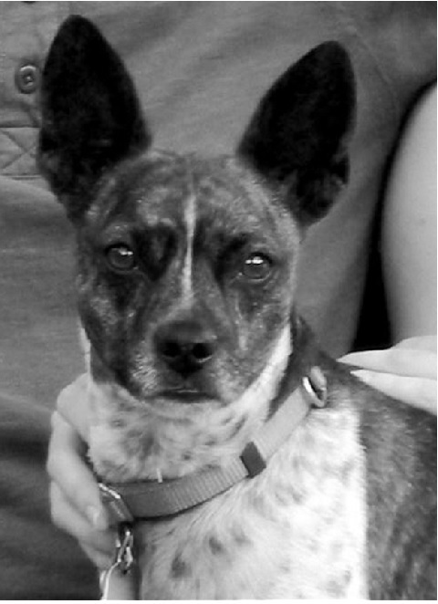
Art and Photography
Notes:
Click on slide to see photos made into art using paper or fabric.

Slide 5
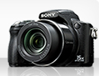
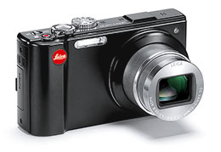

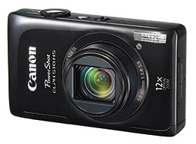

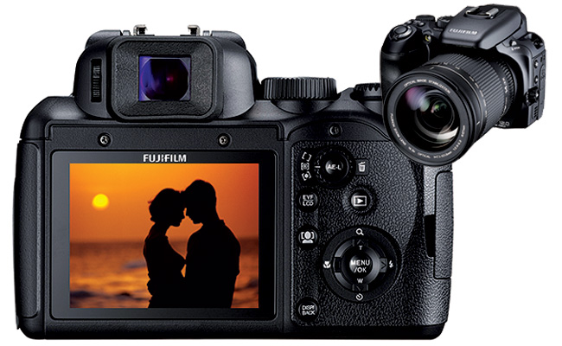
What is the best camera?
The one in your hand!

Slide 6
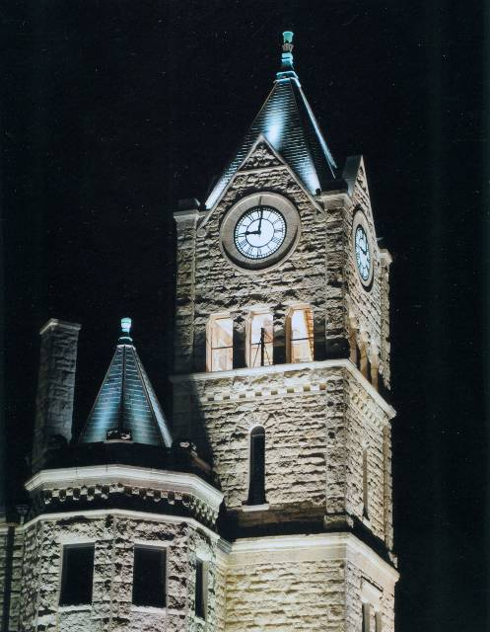
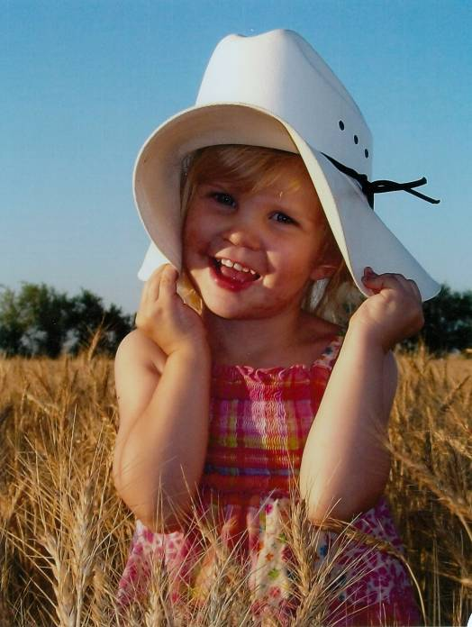
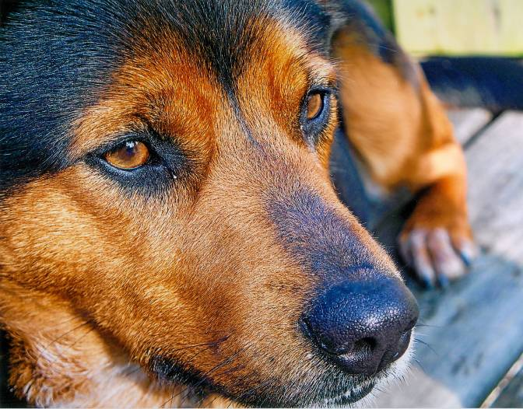
GREAT Photos have…
Sharp focus
Strong Subject
Plain, uncluttered background

Slide 7
Focus
The sharpest focus should be on the subject.
The eyes of people and animals need to be sharp.

Slide 8
Strong Subject
Fills the frame.
Leaves no doubt as to what the subject is.

Slide 9
Plain Uncluttered Background
Background should not distract from the subject.

Slide 10

Elements and Principles in Photographic Composition
The Elements and Principles of Art are used in making photographs – not just taking photographs.
You need to know and understand the elements and principles to see them all around you and capture them in your photos.
This Photo by Unknown Author is licensed under CC BY

Slide 11
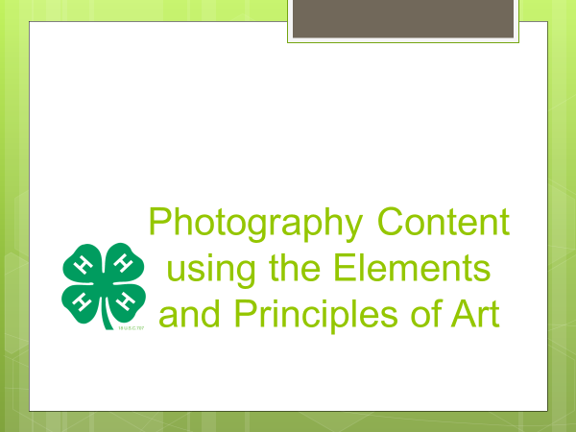
ELEMENTS
The Basic Building Blocks of Art
PRINCPLES
of Art
Line
Shape/Form
Space
Value
Texture
Color
Emphasis
Balance
Unity
Contrast
Movement/ Rhythm
Pattern/Repetition

Slide 12
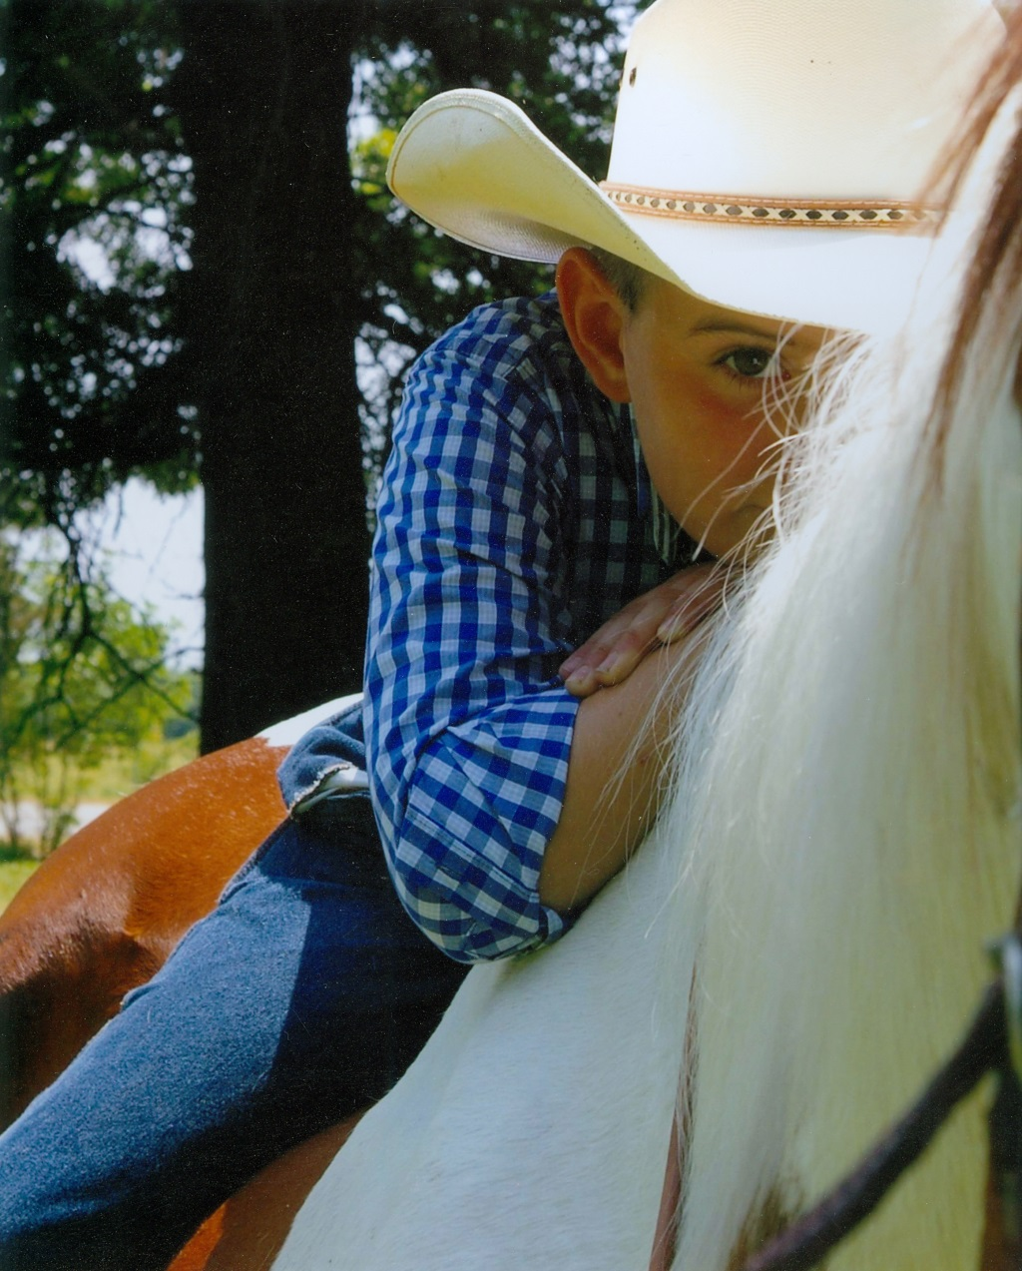
Rule of Thirds
Subject can be on or near 1, 2 or 3 of the intersection of the lines.
Tori Bastion, Crawford Co.

Slide 13
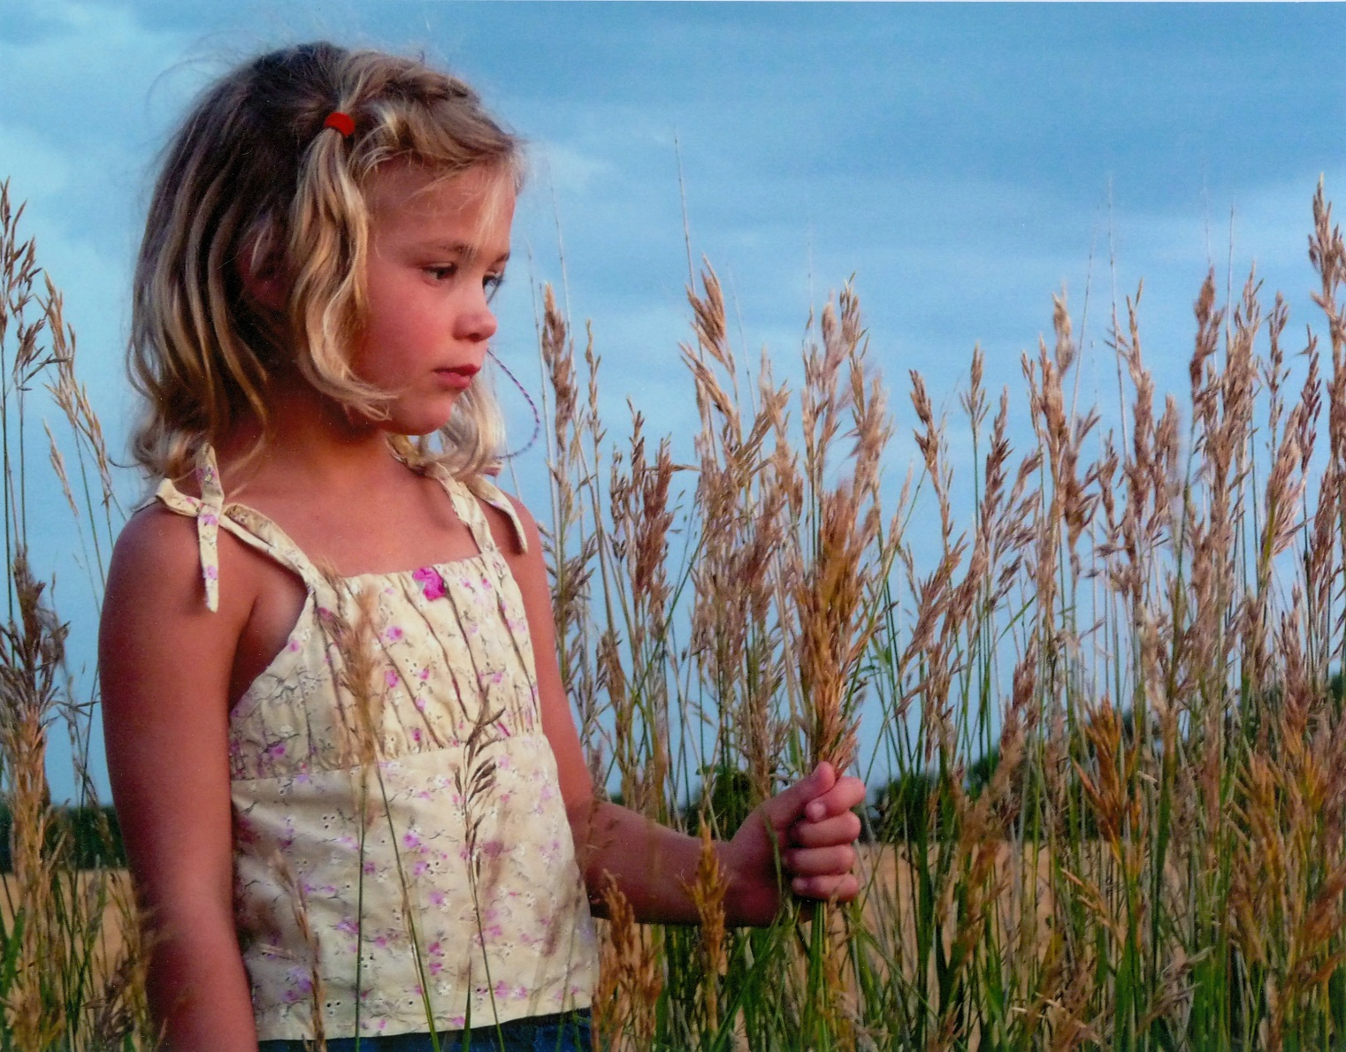
Rule of Thirds example 2
Dominic Jirak, Smith Co.

Slide 14
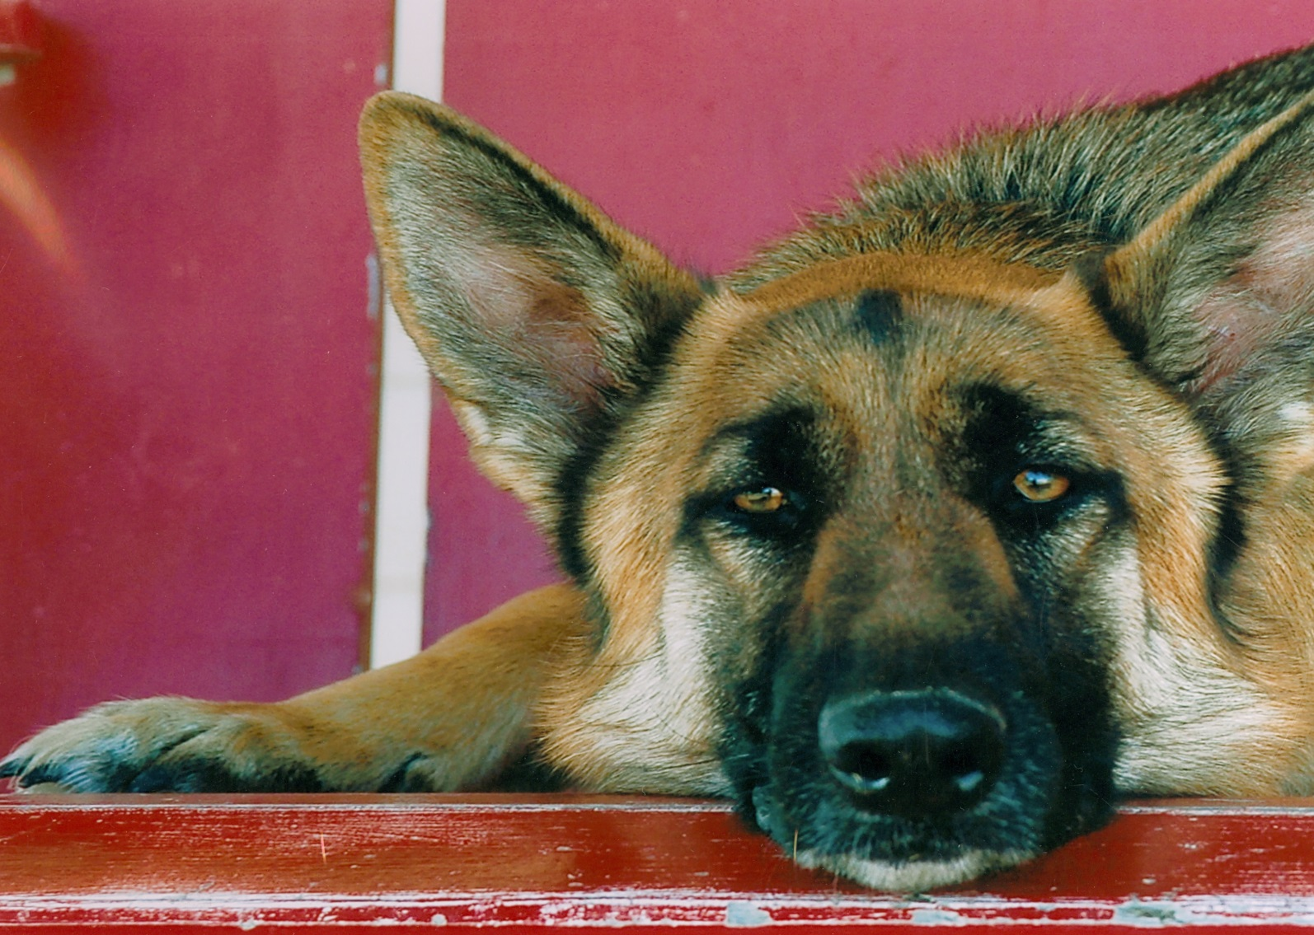
Rule of Thirds example 3
Daniel Johnson, Butler Co.

Slide 15
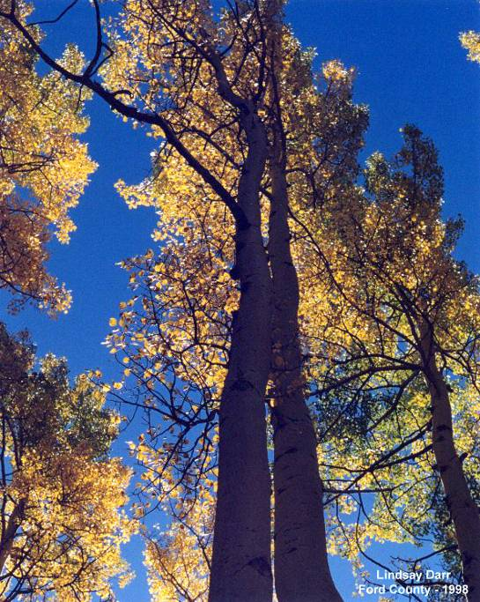
NOT a Rule of Thirds

Slide 16






General Android/iPhone Camera Settings
Each phone and its features are unique.
Each generation offers new features.
System CAMERA APP
PORTRAIT MODE, the camera creates a depth-of-field effect. This lets you capture photos with a sharp focus on the subject and a blurred background.
CUTOUT MODE allows you to snap a photo and then edit it to cut out your subject and replace the background.
MACRO photography is where you get very close to your subject in order to reveal levels of detail not typically appreciable with the naked eye.

Slide 17
General Android/iPhone Camera Settings continued
SPOT COLOR allows you to choose one color and turn the rest of the photo black and white.
CINEMAGRAPHS allow you to animate part of your photo while the rest remains still.
PANORAMA is a wide shot — it works by panning across a scene. The Camera app then stitches together several images to build the panorama.
LIVE FILTERS provide a way of applying creative effects to your images whilst retaining the ability to modify the effect settings or remove the effect altogether. The filter is added to the active layer, similar to applying Adjustment Layers.

Slide 18

General Terms to Know
Depth-of-field – the area in front of and beyond the point of focus that will still be in focus.
Exposure – The amount of light that reaches the camera sensor. Determined by shutter speed and size of lens opening.

Slide 19
Auto Mode
Auto
When you just want to point and shoot leaving all the decision making to the camera
When set to Auto, the camera does everything and locks out any adjustment and makes an average picture.

Slide 20

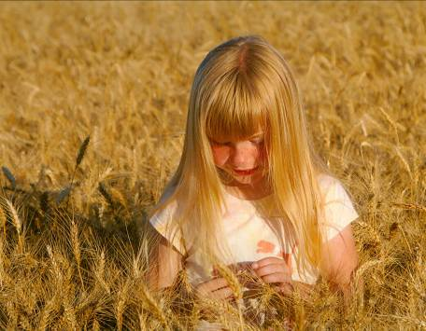
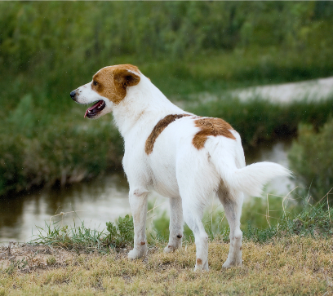
Portrait Mode
Think shallow depth-of-field
The mode emphasizes the subject by de-emphasizing the background. The camera selects the largest possible lens opening to minimize depth-of-field for a softened background.

Slide 21

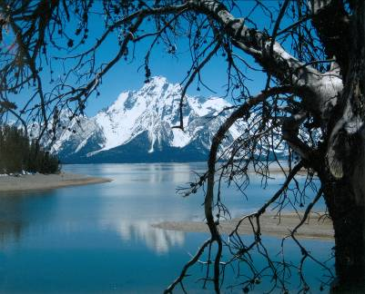
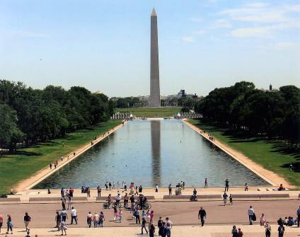
Landscape or Scenic Mode
Think large depth-of-field
In Landscape mode, your camera will select the smallest possible lens opening to maximize depth-of-field in the image. Your image will be as sharp as possible under the conditions in both the foreground and background.

Slide 22

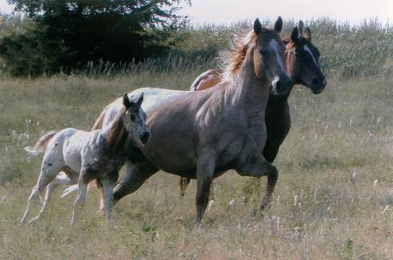
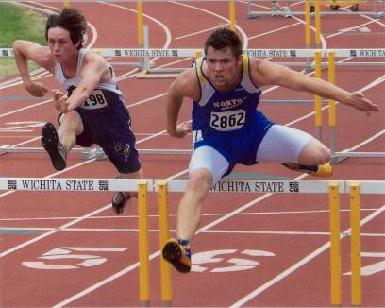
Sports Mode or Kids & Pets
Think fast shutter speed
Speed is the name of the game in Sports mode. The camera will automatically choose the fastest shutter speed possible and will enable continuous high-speed shooting if available.

Slide 23

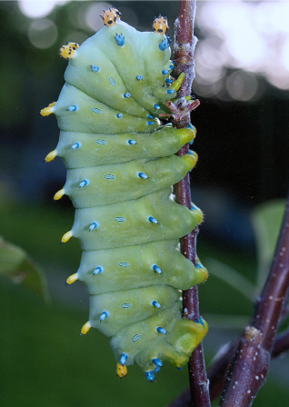
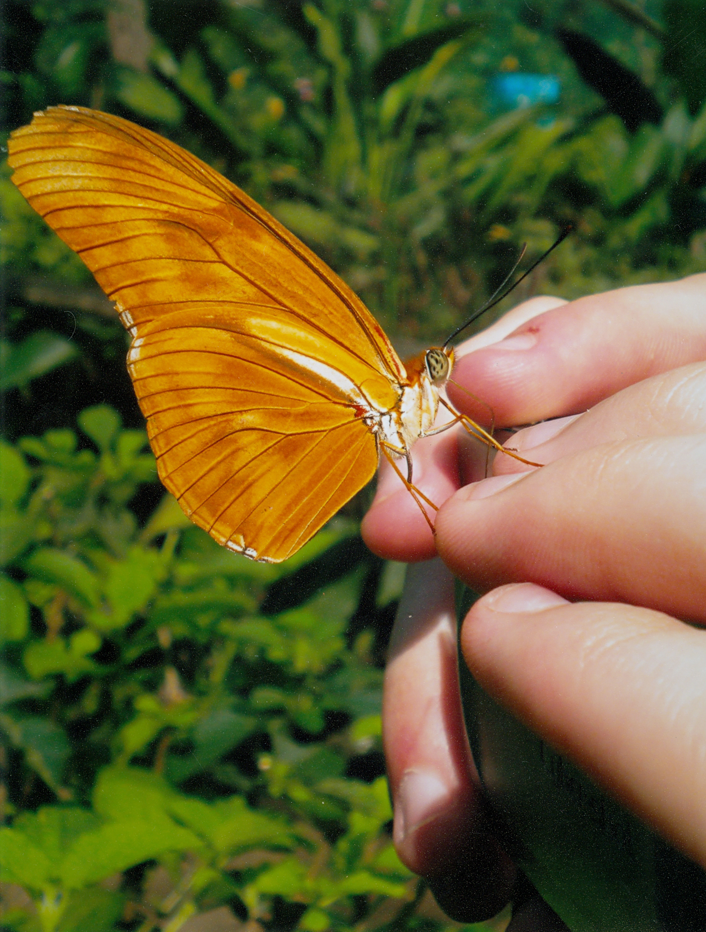
Close-up (Macro) Mode
Think small subject
Macro shots can be an interesting window into a smaller world that we don’t usually notice. Macro mode allows you to focus on objects extremely close up.

Slide 24

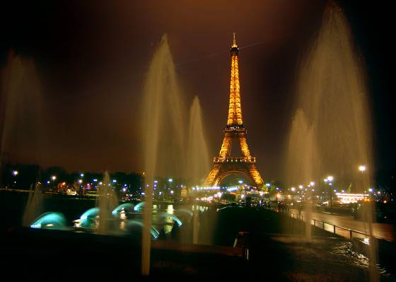
Night Mode
Think slow
Successful night photography requires a slow shutter speed for a long exposure without flash. The exposure may last several seconds, so use a tripod when shooting in this mode or place your camera on a solid platform. Also, be aware that most digital sensors generate image noise during exposures of more than a few seconds.

Slide 25

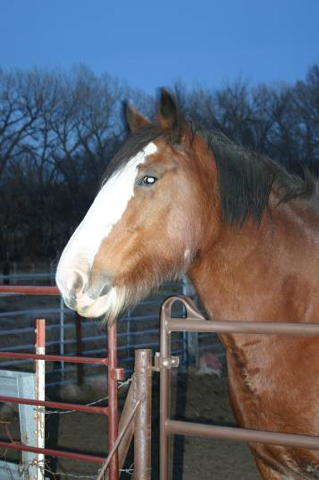
Night Portrait Mode or Night Scene
Think slow with flash
For flattering portraits in dark conditions, you want a combination of flash with a long exposure to pick up ambient background lights. In this mode, the flash fires to freeze the action of your subject amid the lengthened exposure.

Slide 26

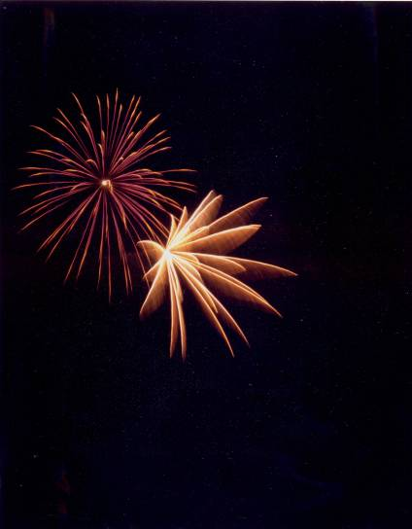
Fireworks
Captures fireworks in the sky sharply and at optimal exposure.

Slide 27

Program Mode
The camera lets you make some of the decisions. The camera selects shutter speed and aperture but allows you to decide what white balance and ISO settings to use.

Slide 28

Video
Many digital/cell phone cameras take good video.

Slide 29

ISO Settings
Sets the cameras sensitivity to light.
Cannot be changed when in auto modes.
Can be changed as you go.
Higher numbers increase the sensitivity to light.
More noise at higher numbers.
Use the lowest number that will give a good exposure.
Notes:
Digital camera ISO settings produce the same results as changing film speeds. Use ISO 400, 800 or higher for low light conditions and 100 or 200 for bright conditions.
Noise
Image artifacts caused by complex variations with color that manifest themselves as grain on an image. Excessive noise, which is most often seen first in shadows, usually results in an objectionable-looking image. High-resolution digital cameras with small image sensors, where more pixels are forced to live in a smaller space and have physically smaller photodiodes are more subject to noise than sensors with larger photodiodes. High ISO (light sensitivity) also generates image noise. Most digital cameras are equipped with some form of noise reduction that is either automatically triggered with high ISOs or long exposures or, in higher-end cameras, can be turned on and off manually. When noise reduction is applied in camera (or via image-editing software), it can result in softened or blurred details to lessen the visibility of the noise.

Slide 30
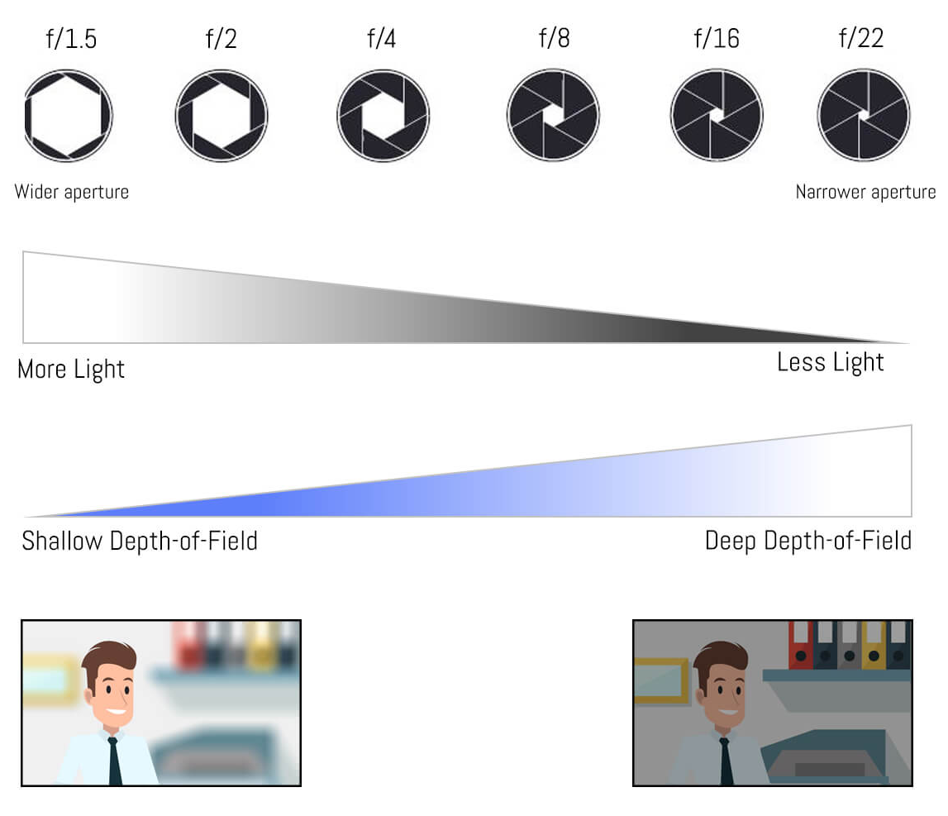
Aperture
Aperture is the opening in the camera lens through which light enters the camera. How dark or bright the photo that the camera produces will turn out is determined by the size of this opening, the size of which is expressed in f-stops.
The smaller the f-stop number, the wider the opening and, ultimately, the more light reaches the sensor.
Aperture can be adjusted on traditional cameras but smartphone cameras commonly have a fixed aperture.
Source – 9/2022

Slide 31

Focusing
Know the auto focus points in your camera.
Single or continuous auto focus.
Face detection.
Use focus lock.
Try manual focus.
Notes:
Most cameras will not take a picture unless the autofocus has focused on something.
Continuous focus best for moving subjects.
Different cameras use different focal selection areas. Some have several points spread across the image area, some have focal zones.
Be sure the camera focuses on the subject of your photo. It may focus on the background or foreground.
Some cameras allow you to select one of the focus points for the auto focus.
Use focus lock, point a focal point or zone at the subject press shutter button half way down to lock focus, hold it down and recompose your photo and shoot.
Try manual focus for:
Low-contrast subjects.
Subjects in low light.
Extremely backlit and reflective subjects.
Overlapping near and far subjects.
Most compact cameras use passive contract-based auto focus Contrast-based auto focus is slower because the system has to make multiple readings and lens adjustments to establish focus and isn’t as good for action shots.

Slide 32

White Balance
Camera adjustment for different kinds of light
Pre-sets usually give better results than auto
Use as a creative tool
AWB – Auto White Balance
Daylight
Shade
Cloudy, Twilight & Sunset
Flash
Fluorescent
Tungsten
Custom
Notes:
Auto white balance for general use, camera reads the light and sets the white balance. Camera can be fooled some times.
Daylight sets the exposure for sunlight. Use when shooting in the middle of the day, sunsets and sunrises. Will record color similar to daylight film.
Shade sets the exposure for shade outdoors. Will add orange/yellow to your picture. The light in open shade is very blue.
Cloudy is similar to shade but in less amounts.
Flash is designed to give good color when using on camera flash.
Fluorescent will add a pinkish color to balance the overall green cast of this light source.
Tungsten adds blue to overcome the heavy orange cast of tungsten light.
Custom is the most accurate of all of the settings.
Simulate the subtle shades of sunrise and sunset by adjusting the preset white balance on your camera. Choose the tungsten setting to add a bluish morning cast or the shade setting (cloud icon) to add the warm, brownish tones of dusk.

Slide 33
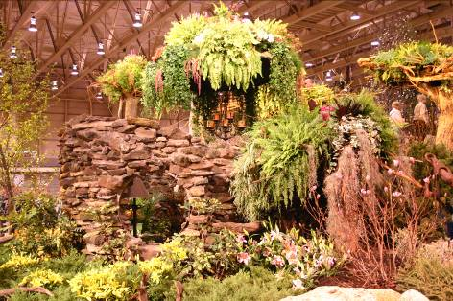
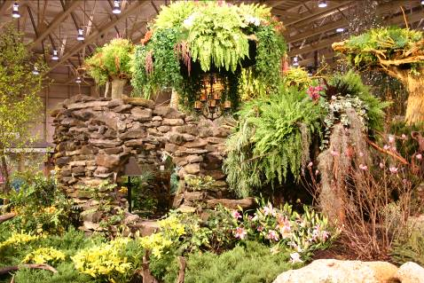
White Balance continued
Available light for these photos was tungsten
Auto
Tungsten

Slide 34
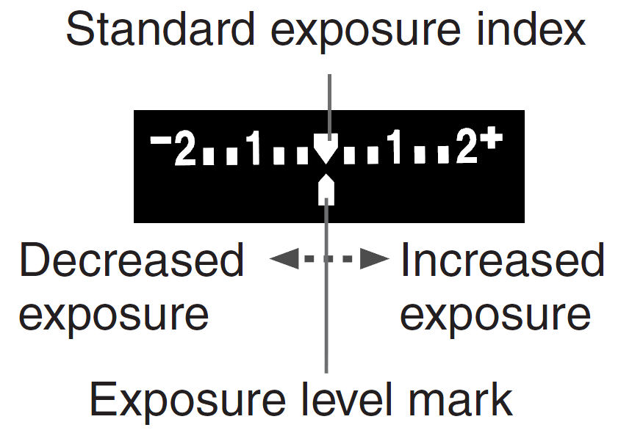
Exposure Compensation
Exposure compensation is used to alter the camera’s standard exposure setting. You can make the image look lighter or darker.

Slide 35
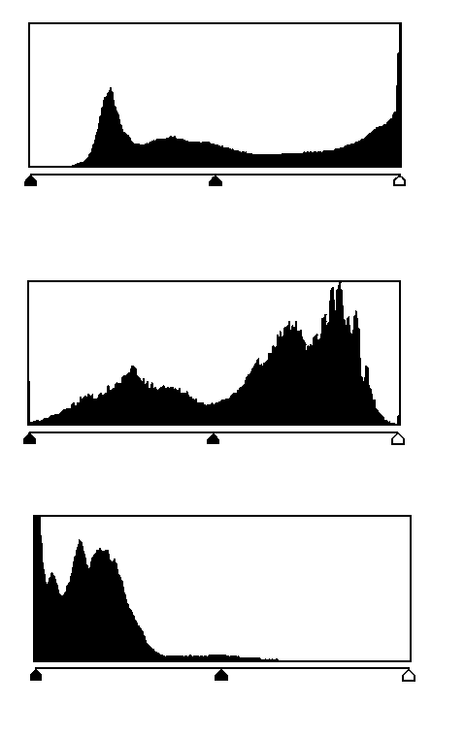
Exposure and the Histogram
Overexposed
Checking the exposure on the LCD screen can be misleading when viewed in bright sunlight or in a darkened room
Underexposed
Notes:
The histogram is a graph of the number of pixels with specific brightness values from dark (on the left) to bright (on the right).

Slide 36
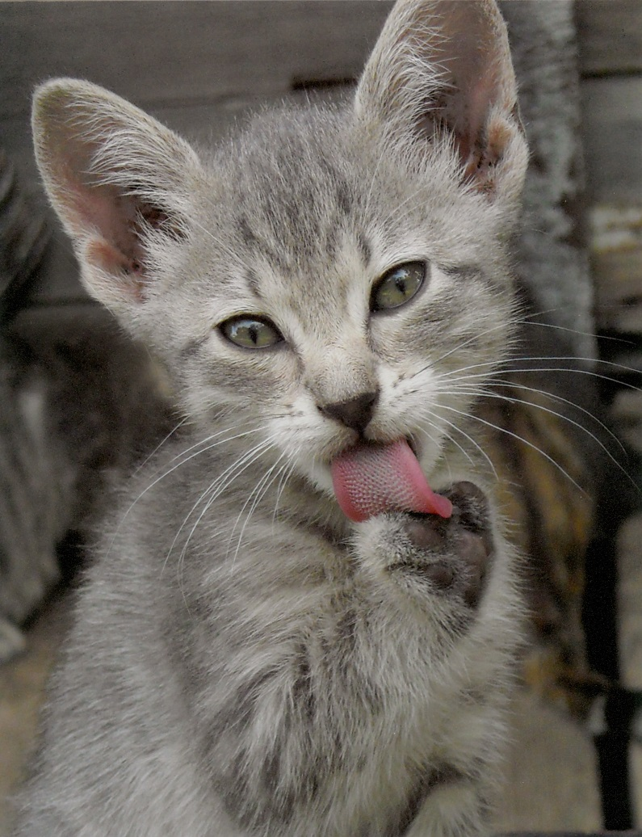
Be Ready….
Reset to preferred defaults to be ready for the next photo opportunity

Slide 37

Photographic Composition
4-H PHOTOGRAPHY

Slide 38
Strong Subject Example
Fills the frame.
Leaves no doubt as to what the subject is.
Kaylee Littrell, McPherson Co.

Slide 39
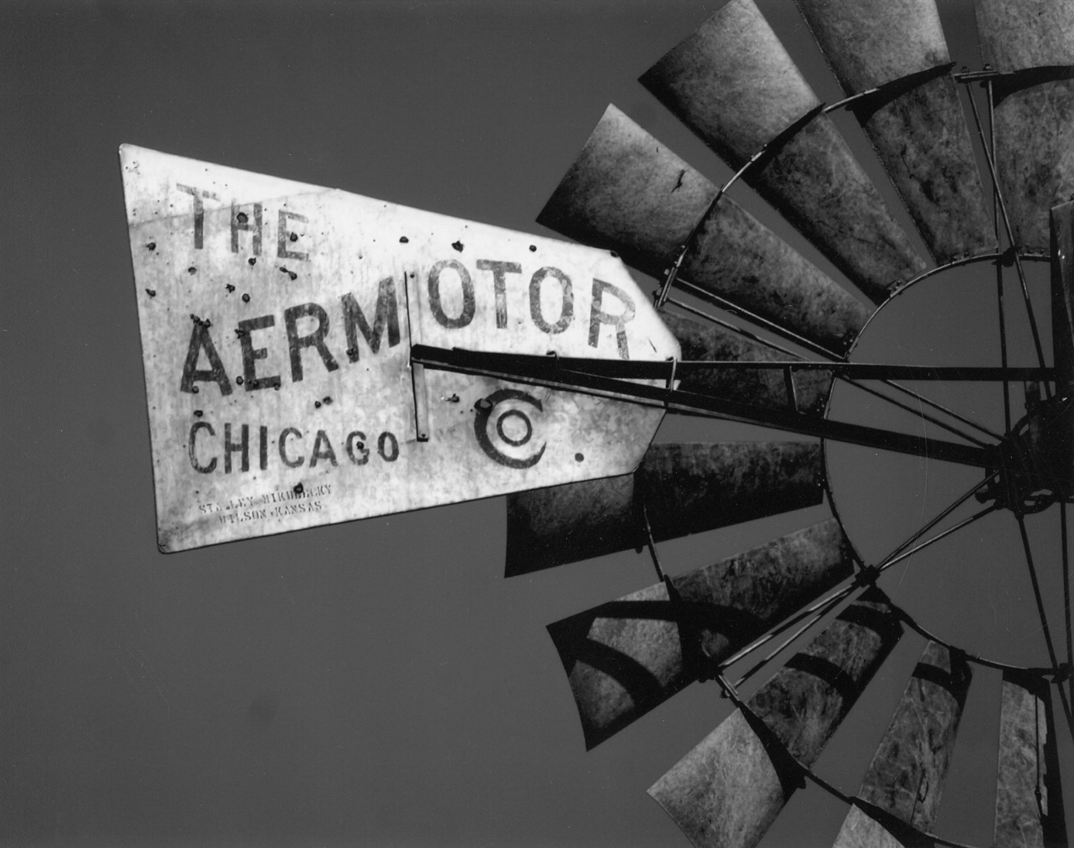
Strong Subject example 2
Katy Nuss, Ellsworth Co.

Slide 40
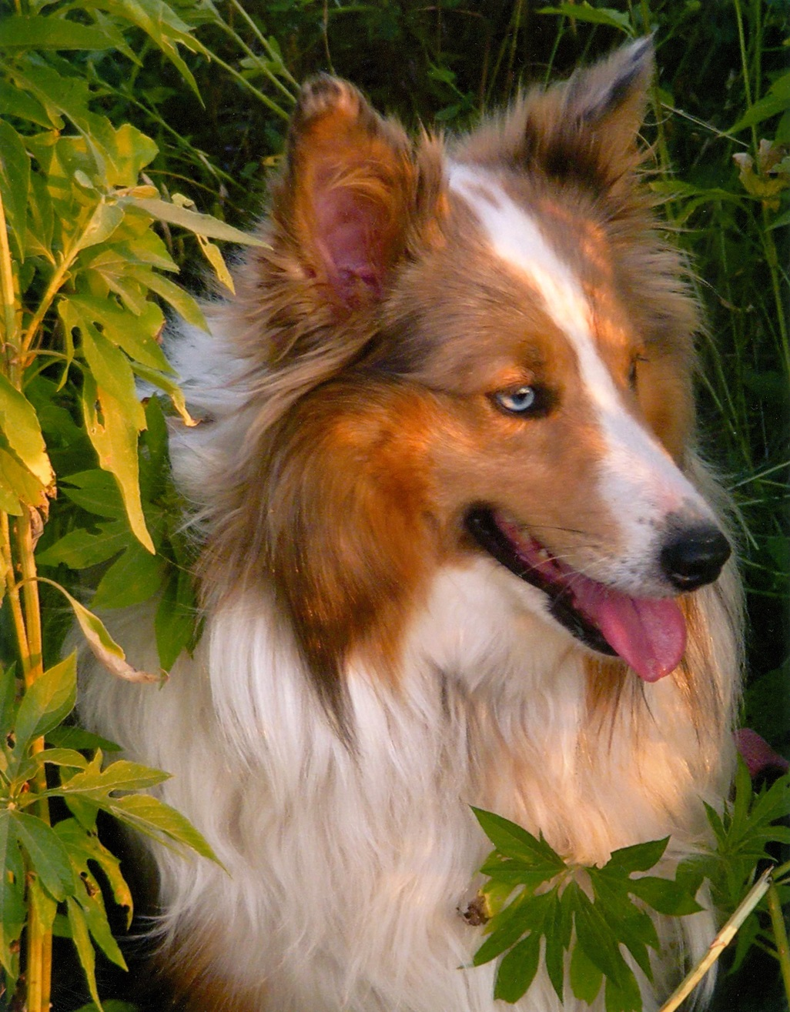
Strong Subject example 3
Michaela Sellers, Dickinson Co.

Slide 41
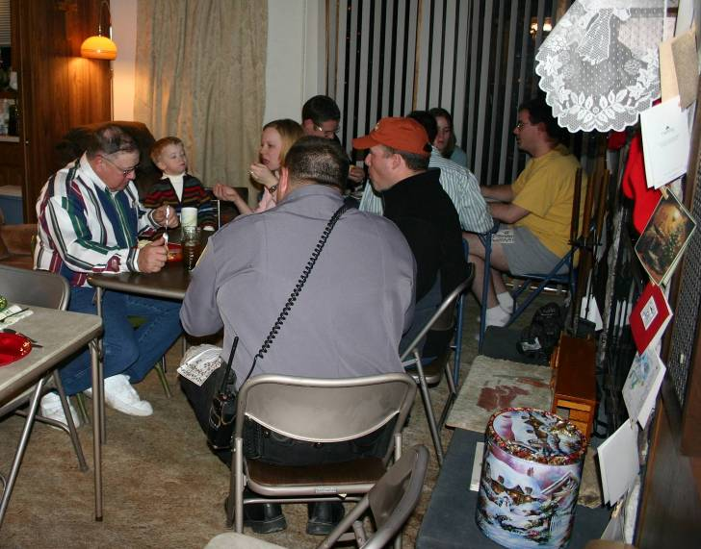
NOT a Strong Subject

Slide 42
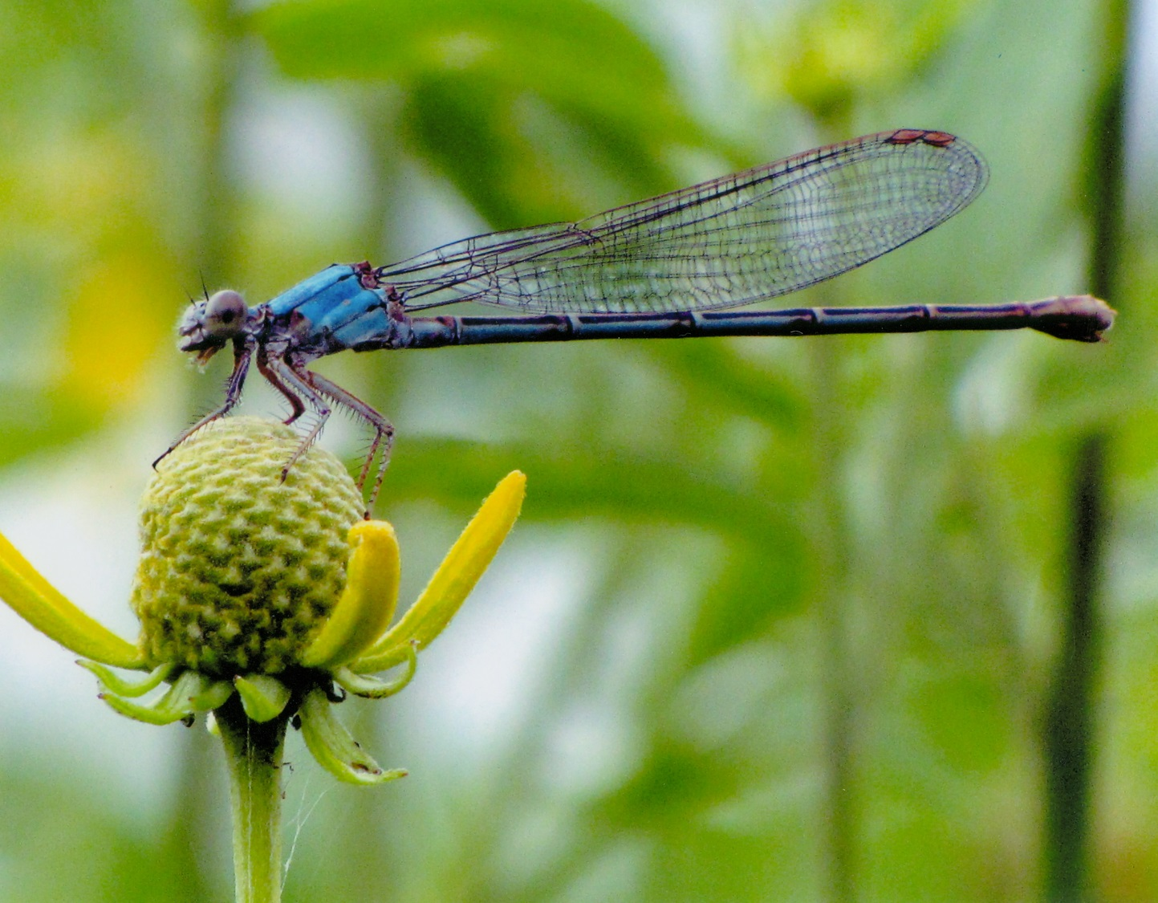
Get Close
Allie Ifland, Smith Co.

Slide 43
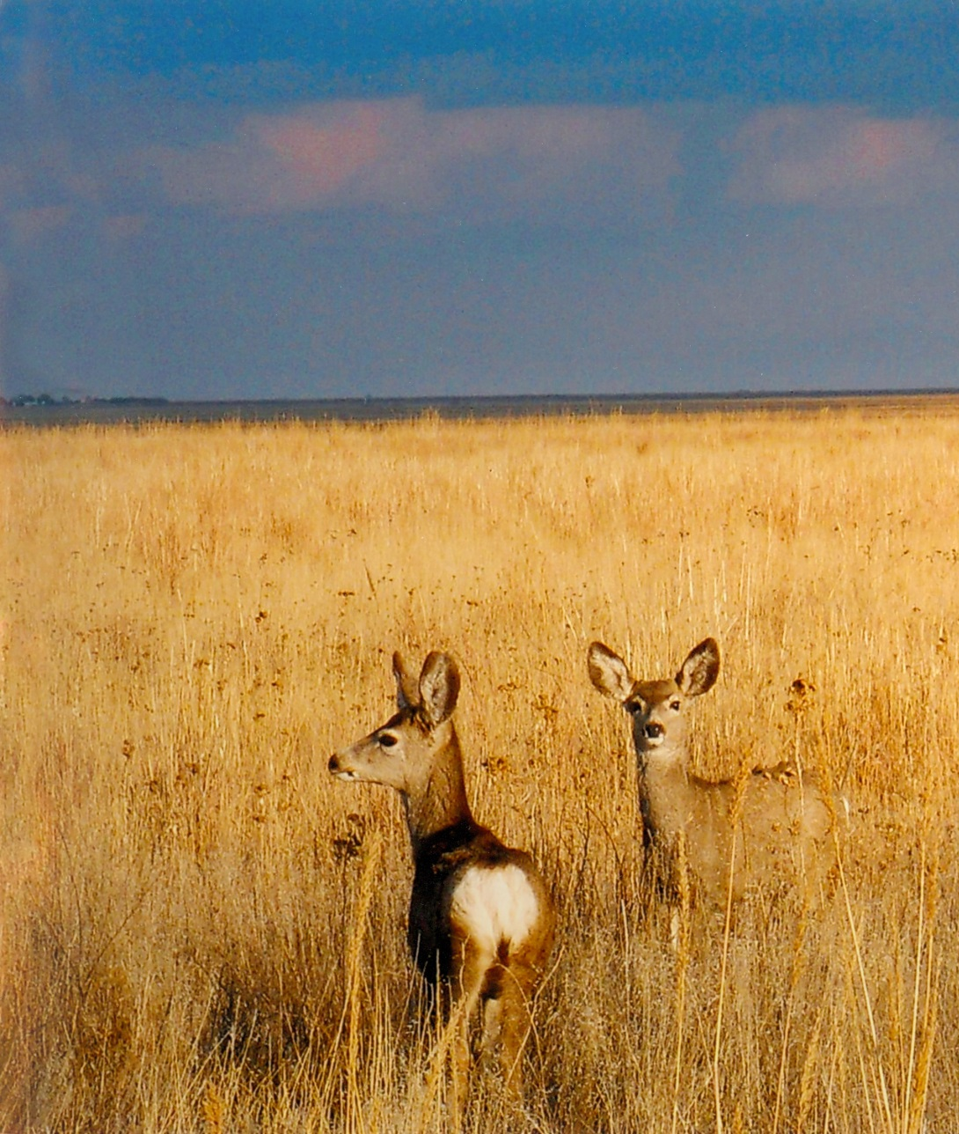
Plain Uncluttered Background Example
Background should not distract from the subject.
Sydnee Hale, Grant Co.

Slide 44
Focus Example
The sharpest focus should be on the subject.
The eyes of people and animals need to be sharp.
Morgan Poole, Morris Co.

Slide 45
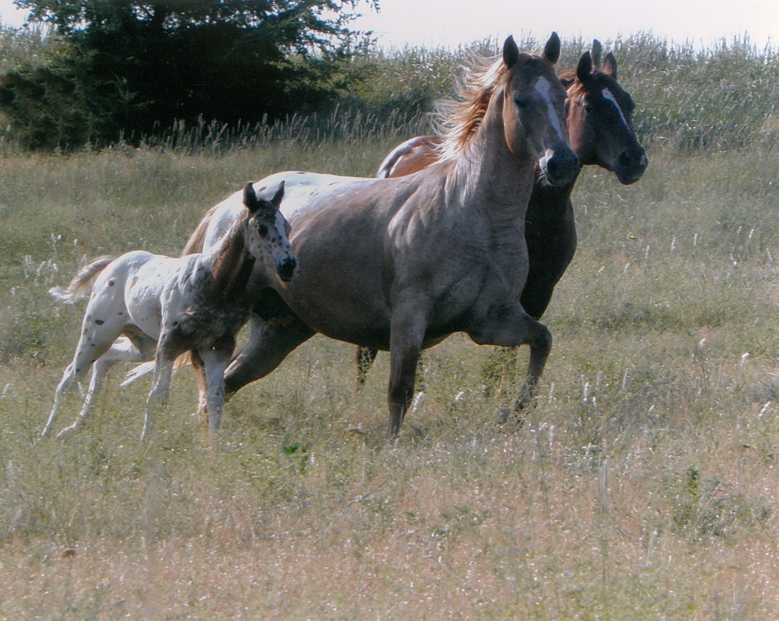
Horizon
HIGH HORIZON
Better if horizon is not centered.
Keep it high or low.
Centered divides the picture in two.
Taylor Bunch, Ellsworth Co.

Slide 46
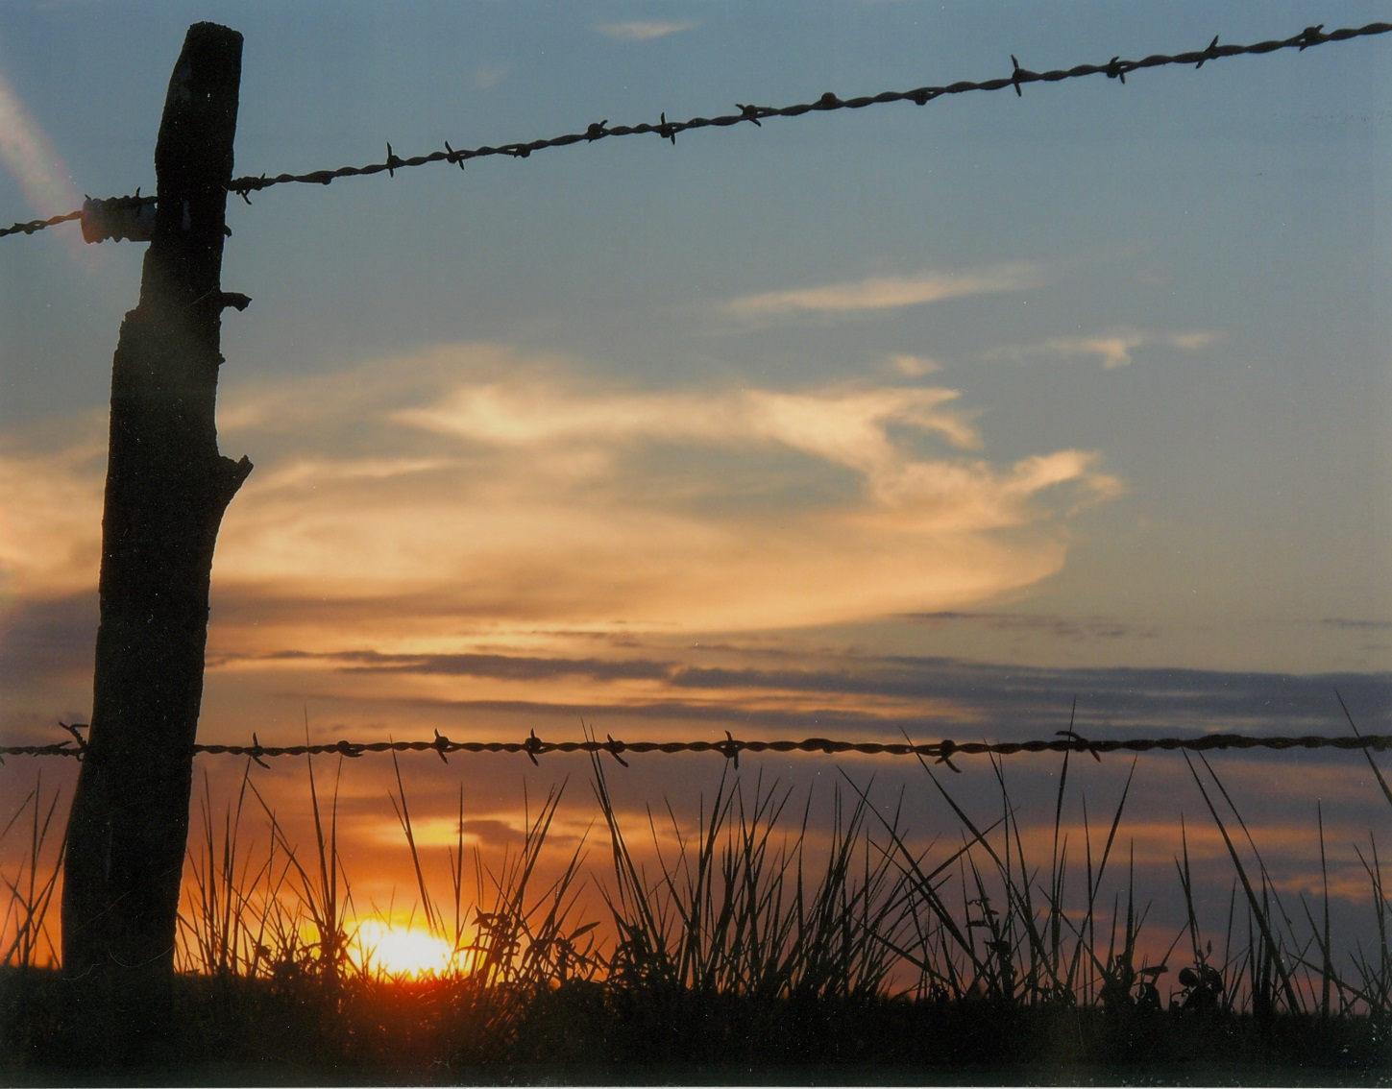
Horizon – Low Horizon
LOW HORIZON
Karsen Odle, Mitchell Co.

Slide 47
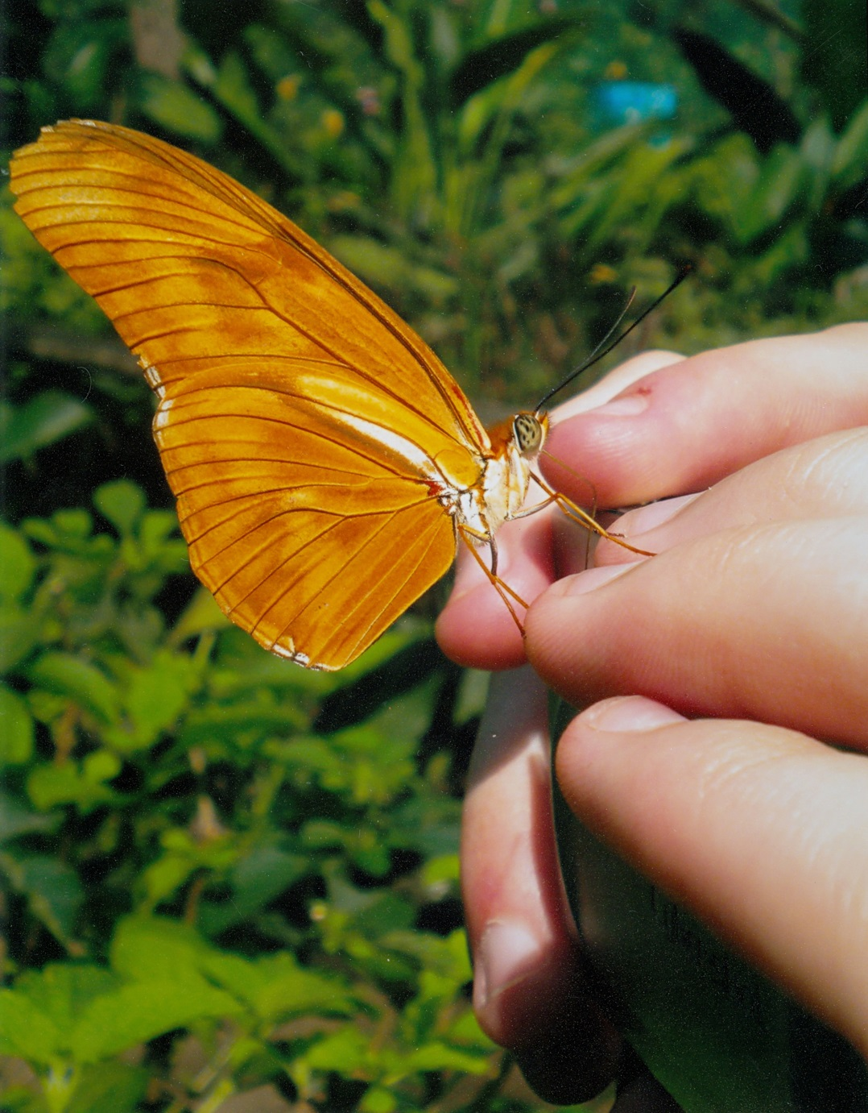
Front Lighting
The light shines on the side of the subject that is toward the photographer.
Rachel Juenemann, Thomas Co.

Slide 48

Backlighting
Karsen Odle, Mitchell Co.

Slide 49
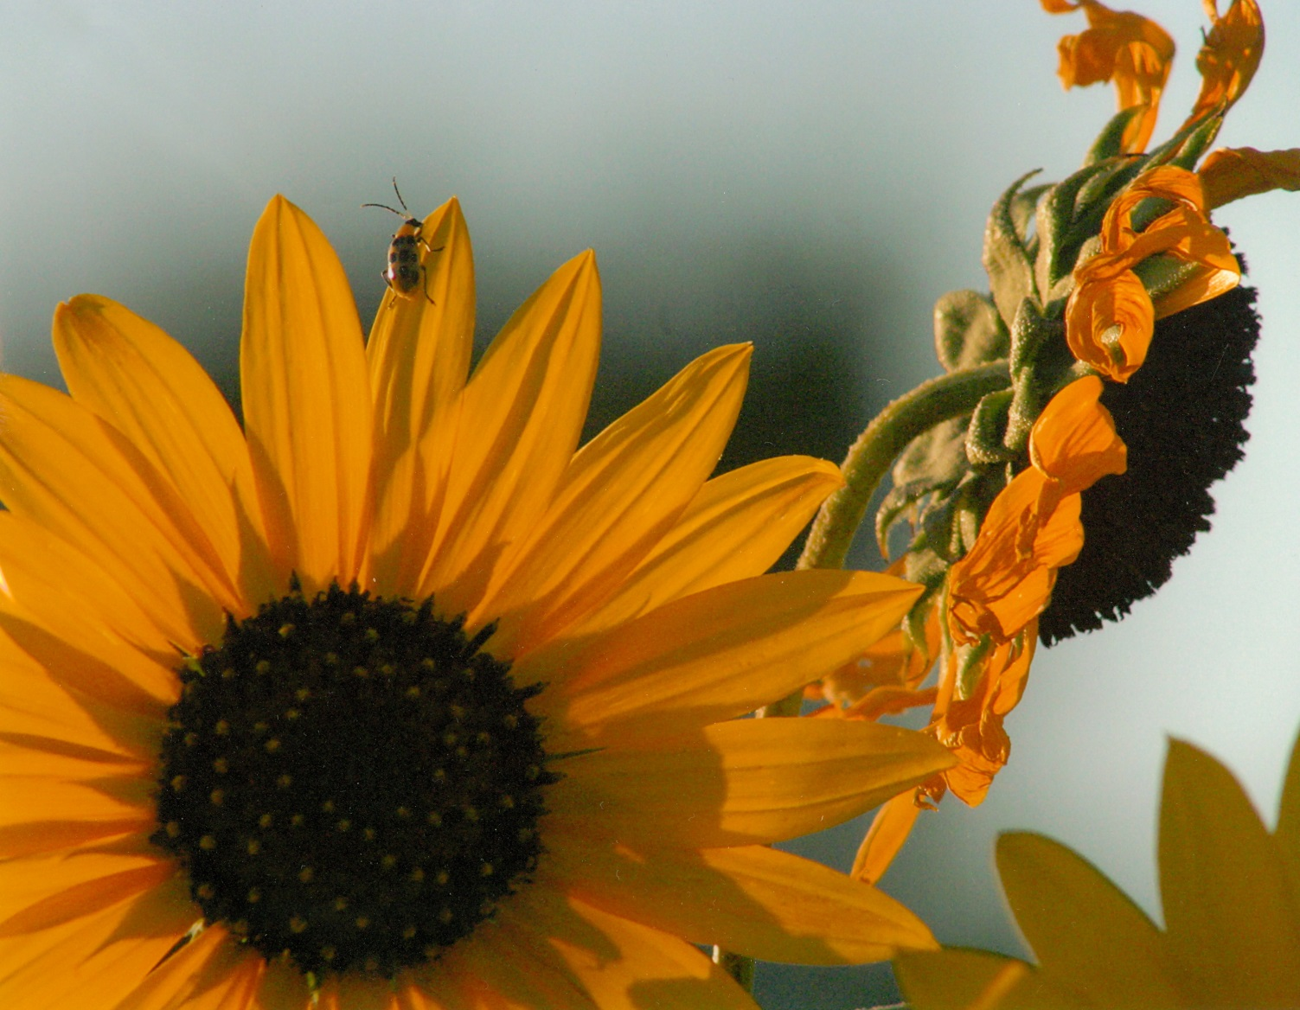
Backlighting Example
Stacy Cox, Butler Co.

Slide 50
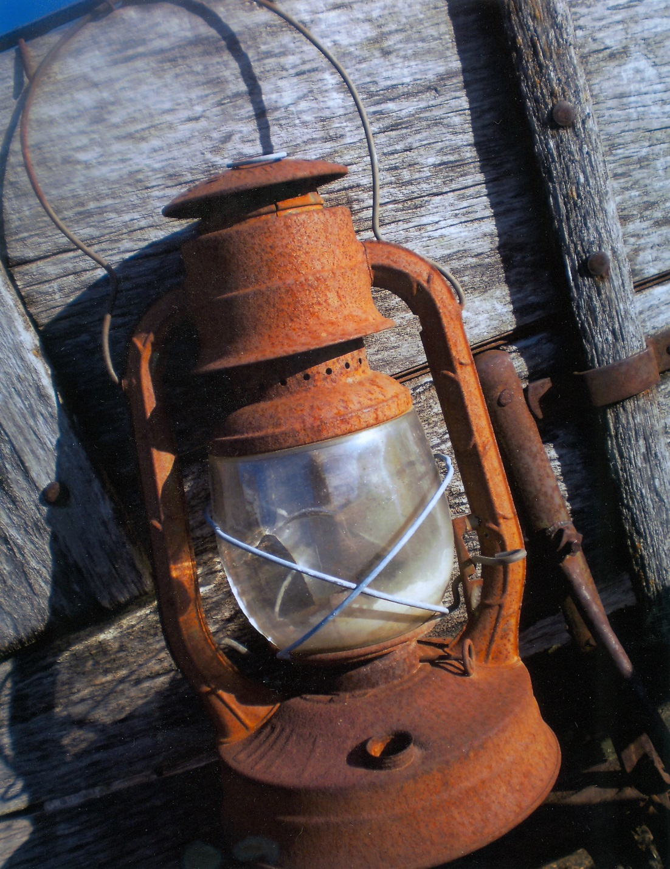
Backlighting example 1
Shows the texture of the subject better and adds depth to the image.
Kimberly Doman, Barber Co.

Slide 51
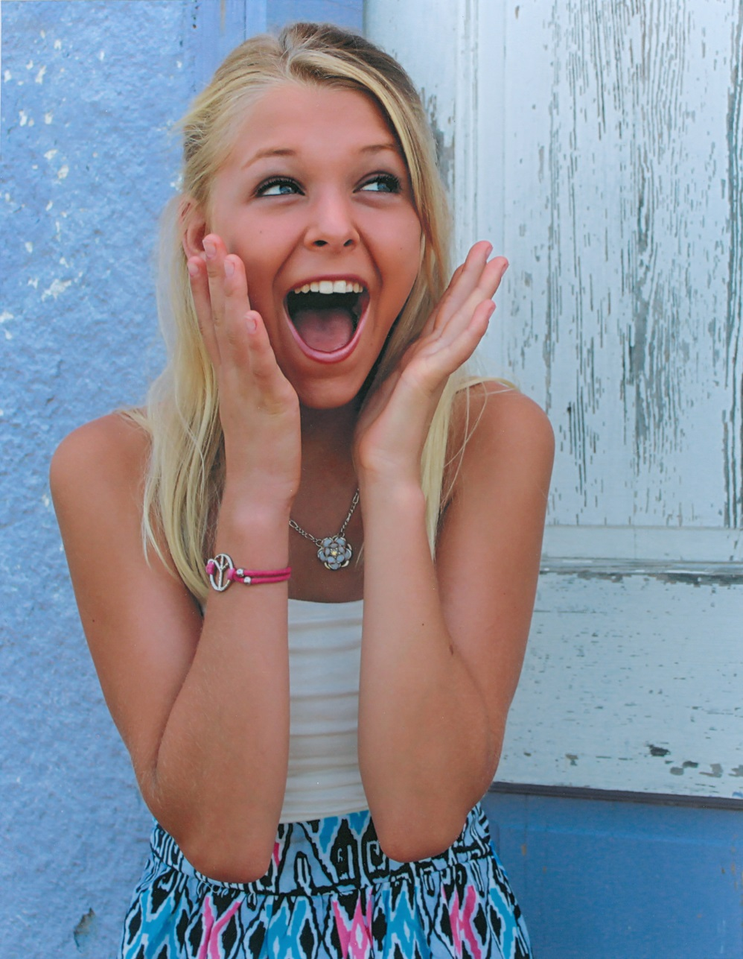
Diffuse Lighting
Soft light, no distinct shadows, can be found in shade, indoors near a window, on cloudy days.
Katelyn Niehues, Nemaha Co.

Slide 52

Diffuse Lighting Example
Marcus Resco, Cloud Co.

Slide 53
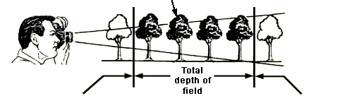


Depth-Of-Field
Depth-of-field – the area in front of and beyond the point of focus that will still be in focus
Focus at the subject distance, 10 ft
 | 6.61 ft
7.69 ft |  | 14.3 ft

Slide 54
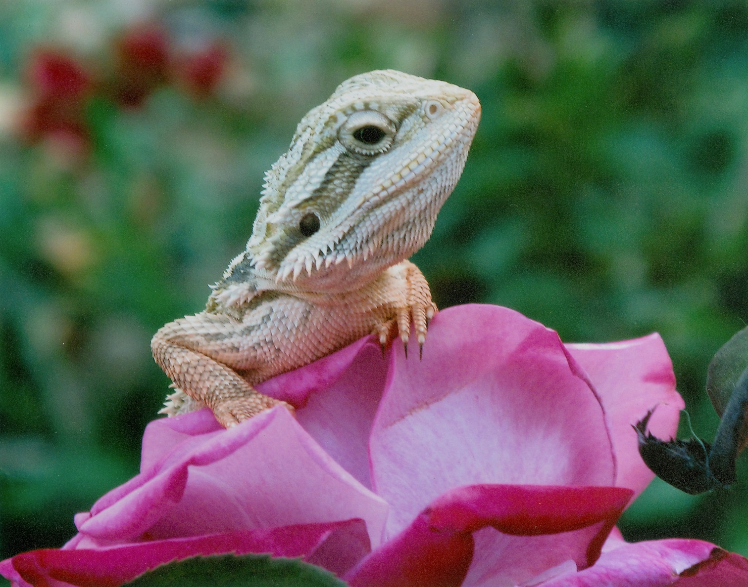
Shallow depth of field
Dillon Mccosh, Ottawa Co.

Slide 55
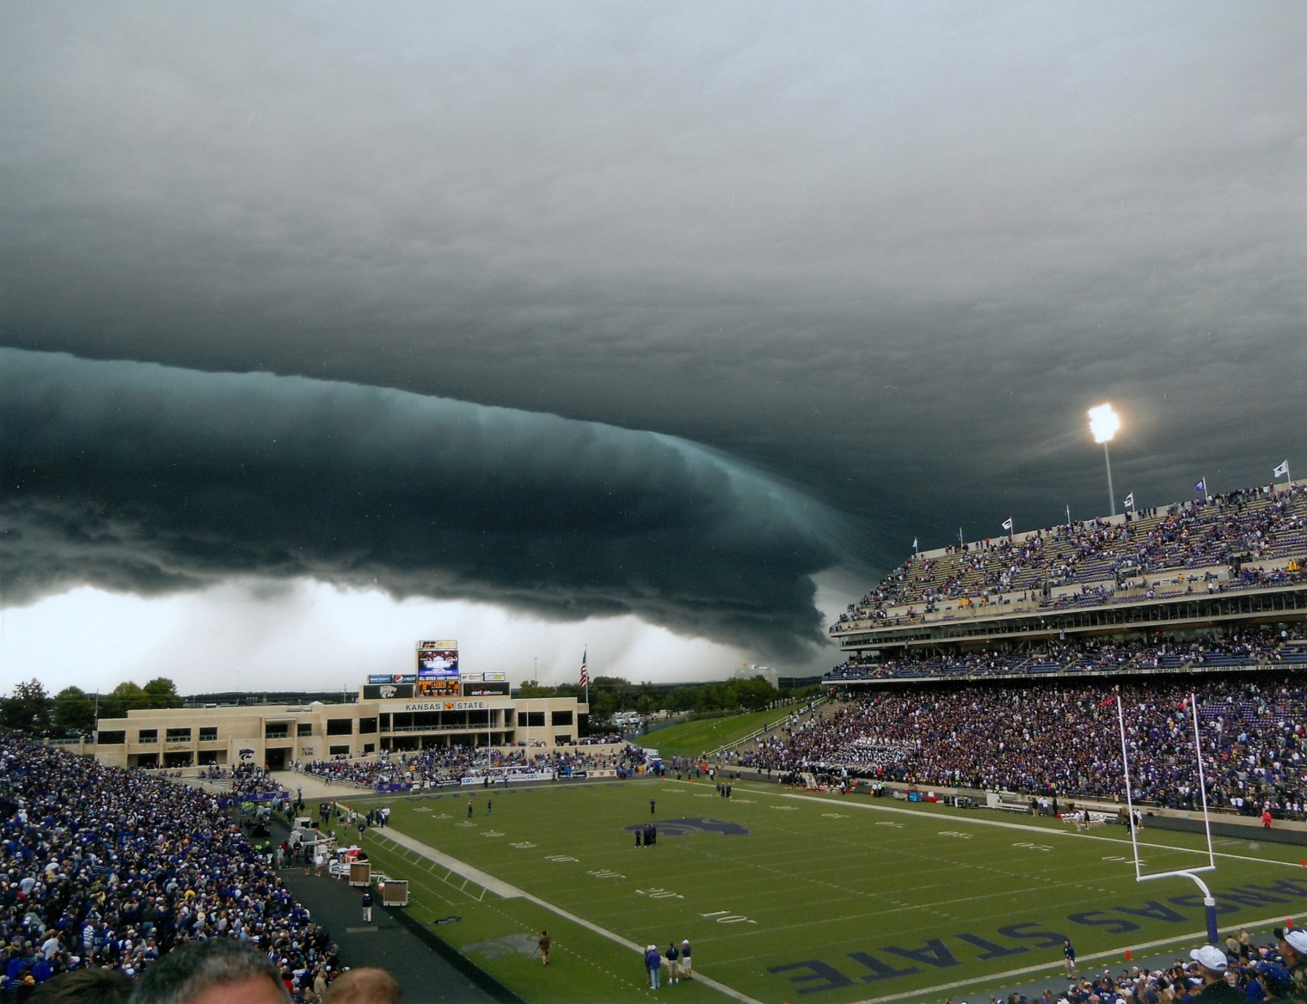
Large depth of field
Abigail Bauer, Cowley Co.

Slide 56
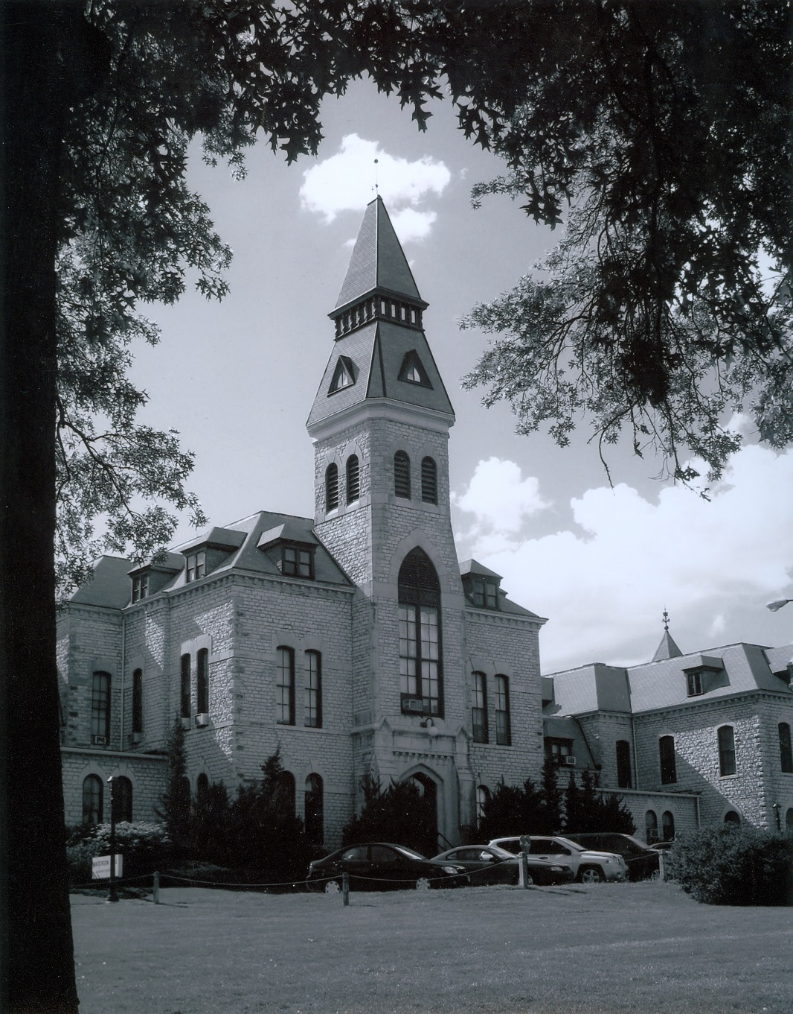
Framing
Use objects to frame the subject to direct the viewer to the subject.
Ann Clawson, Meade Co.

Slide 57
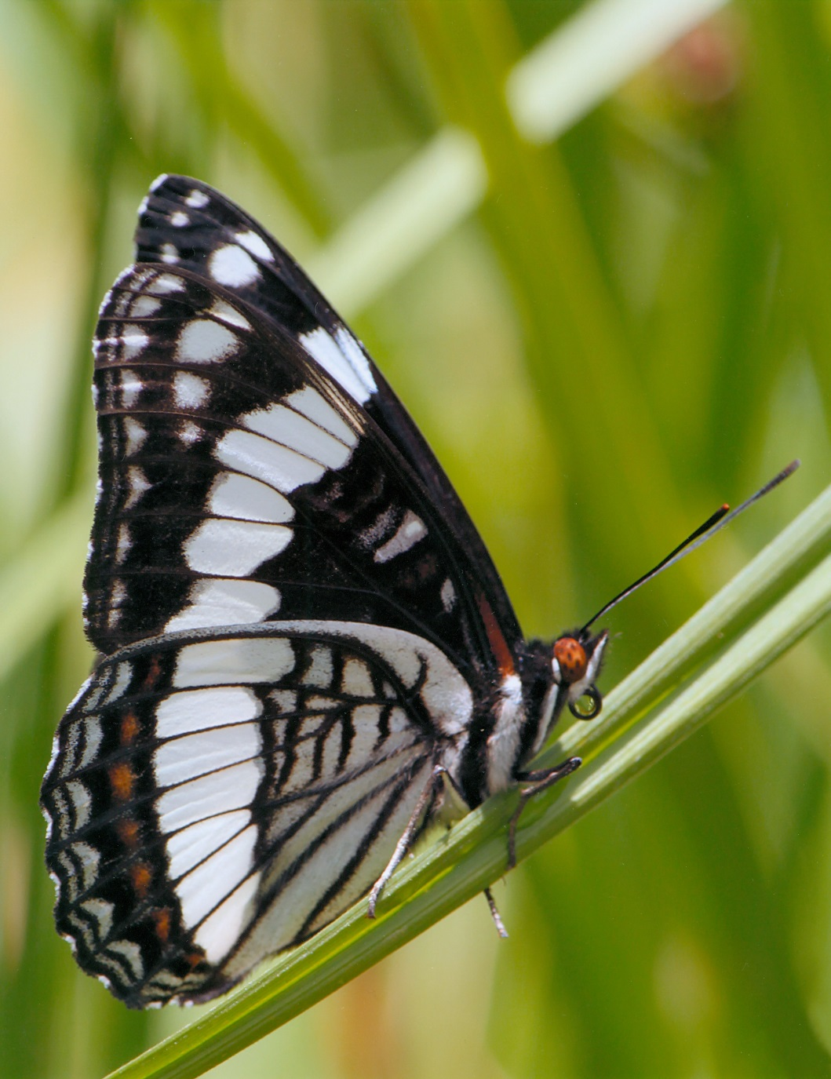
Angles
Make photos more pleasing.
Wade Stroda, Riley Co.

Slide 58
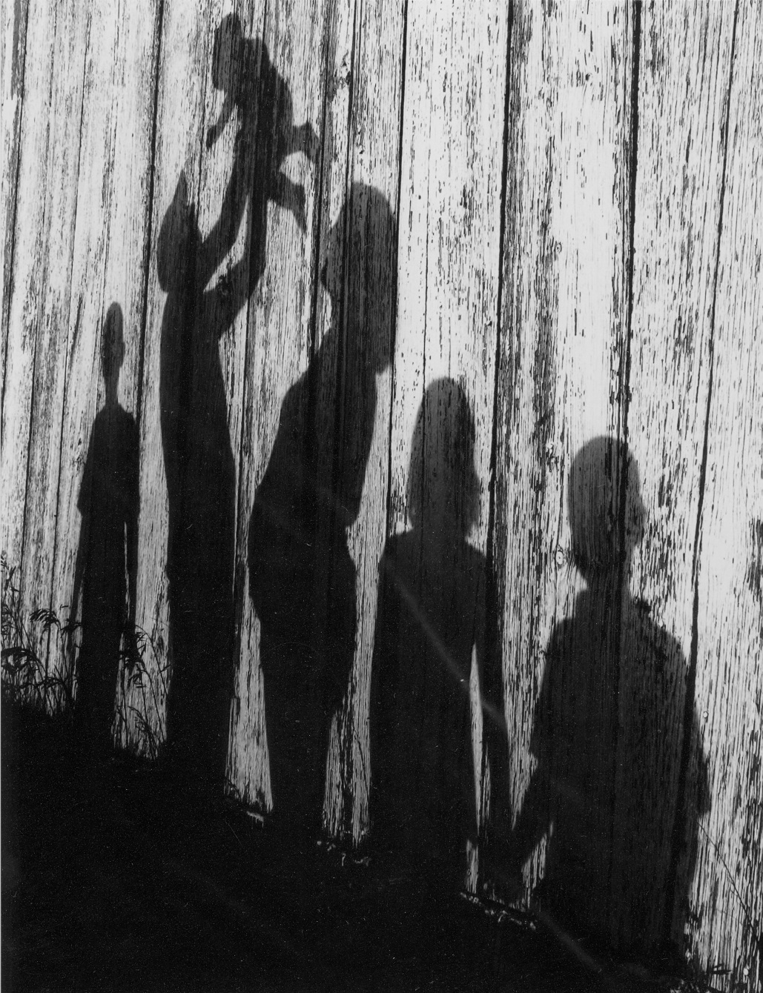
Angles Example
Grant Fincham, Marshall Co.

Slide 59

Angles
Example 1
Show buildings at an angle to show depth.
Kaylee Littrell, McPherson Co.

Slide 60
Photographic Composition
Continued
4-H PHOTOGRAPHY

Slide 61

Top Photos
Allison Simon, Greenwood Co,

Slide 62

Top Photos example 1
Adam Lattin, Montgomery Co.

Slide 63

Top Photos example 2
Anna Wenner, Shawnee Co.

Slide 64

Top Photos example 3
Erin Leach, Leavenworth Co.

Slide 65

Top Photos example4
Brooklyn Storrer, Allen Co.

Slide 66

Top Photos example5
Shandle Ratzlaff, Clark Co.

Slide 67

Top Photos example6
Shiloh Murray, Pratt Co.

Slide 68

Top Photos example 7
Anthony Fallett, Cowley Co.

Slide 69

Top Photos example 8
Annie Braggs, Cleveland Co.

Slide 70

Top Photos example 9
Annie Braggs, Cleveland Co.

Slide 71

Top Photos example 10
Annie Braggs, Cleveland Co.

Slide 72

Top Photos example 11
Annie Braggs, Cleveland Co.

