Slide 1

CSI Day Camp:
Who Done It?
Notes:
Welcome Detectives and thanks for coming to our CSI STEM Day!
(All instructors should introduce self and tell a little bit about themselves.)
Are you ready to become crime scene investigators?
Today, you’re going to learn how to collect evidence—just like real forensic scientists do at a crime scene! Evidence is anything that helps us figure out what happened, who was there, or when it happened.
What do you think evidence means? What are some examples of evidence?
(give participants a chance to give examples)
Great ideas! Evidence can be anything left behind—like fingerprints, footprints, hair, fibers, notes, or even a cookie crumb!

Slide 2
Overview
01
02
03
04
Evidence Collection
Shoe Prints
Fingerprints
DNA
05
Handwriting
Notes:
We are going to focus on the following types of evidence:
Trace evidence
Shoe prints
Fingerprints
DNA
Handwriting

Slide 3
01
EVIDENCE COLLECTION
Notes:
Before we can look at the other kinds of evidence, we need to talk a little bit about evidence collection.

Slide 4
Rules to Protect Evidence
Look, don’t touch
Take notes
Take photos and make sketches
Collect carefully
Notes:
When we go to a scene where something mysterious happened, we follow special rules to protect the evidence:
Look, don’t touch—until you’re ready to collect!
Take notes—what do you see? Smell? Hear?
Take photos and make sketches—this helps us remember everything.
Collect carefully—we use gloves, tweezers, and little bags so we don’t ruin the clues.

Slide 5
Chain of Custody
Evidence Bags and Logs are used to track evidence.
On your evidence bag label:
Case name or number
Evidence description
Date collected
Time collected
Location of collection
Collected by (name)
Notes:
Forensic scientists also keep a record of who handles the evidence so we know it hasn’t been tampered with. This is called a 'Chain of Custody.' Evidence bags and logs are used to track the evidence so we know who had it, when they had it, and what they did with it.
Imagine if someone found a fingerprint, but we lost track of where it went or who had it. A judge or police officer might say, 'We can’t trust this clue—it could have been changed!' So real forensic scientists have to be super careful to keep track of every piece of evidence.
Crime Scene Investigators use gloves and sometimes tweezers or other methods to collect evidence. Why don’t they just pick up evidence with their bare hands?
(give participants a chance to answer)
Awesome job! Yes, we want to make sure we don’t contaminate the evidence with our fingerprints, DNA, etc.
As you can see, there is some trace evidence on your table (the pom poms, or other item). Let’s practice collecting evidence. Put on your gloves and place the evidence in your baggie.
Once we collect our evidence, we will label it accordingly by filling out the information on the baggie
Labels for Ziplock baggies:
· Case name or number
· Evidence description
· Date collected
· Time collected
· Location of collection
· Collected by (name)

Slide 6
Reflection
Reflection
Why is it important to carefully collect evidence and log the chain of custody?

Slide 7
02
SHOE PRINTS
Notes:
Detectives! We just got a new clue at the crime scene…It’s a footprint! Or more exactly… a shoeprint. Do you think shoeprints can help us figure out who was at the scene?
Every shoe leaves a different kind of mark. Think about it—your shoes have different shapes, patterns, and sizes. Some even have letters or pictures on the bottom. These are called tread patterns.

Slide 8
Tread Patterns
Take a look at the bottom of your shoe. What do you notice?
What do you think shoe prints can tell us?

Slide 9
Shoe Prints can tell us…
What kind of shoe it was (boot, sneaker, sandal)
The size of the shoe
If the person was running, walking, or dragging their feet
And even what direction they went!
Notes:
Sometimes detectives match shoeprints to the shoes someone was wearing—just like matching puzzle pieces!

Slide 10
Make your own Shoe Prints
Use the foam brush to paint the bottom of the shoe with paint – be careful to not use too much paint!
Press the shoe onto the paper and lift straight up.
Clean off the bottom of the shoe using a baby wipe.

Slide 11
Analyze your Shoe Prints
Talk a look at your shoeprint:
  What patterns do you see?
  Is it a small or large shoe?
  Are there any unique marks?
  What could this tell you about the person who made it?
Trade papers with another group and observe their print:
  What do you notice?
  How is it similar or different from the print you made?

Slide 12
Reflection Continued
What are some things we can learn from shoeprints?
What can they NOT tell us?
Do you think shoeprints are a good piece of evidence? Why or why not?

Slide 13
03
FINGERPRINTS
Notes:
Fingerprints are another clue that can be left behind at a crime scene.

Slide 14
Fingerprint Fundamentals
A fingerprint is an individual characteristic
A fingerprint pattern will remain unchanged for the life of an individual, but scars may change the print itself
Fingerprints have general characteristic ridge patterns
Notes:
According to criminal investigators, fingerprints follow 3 fundamental principles:
A fingerprint is an individual characteristic; no two people have been found with the exact same fingerprint structure - not even identical twins!
A fingerprint pattern will remain unchanged for the life of an individual; however, the print itself may change due to permanent scars and skin diseases.
Fingerprints have general characteristic ridge patterns that allow them to be identified and matched to a specific individual.

Slide 15
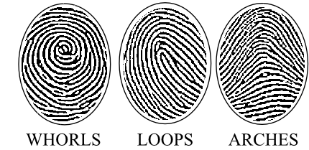
3 Types of Fingerprints
60% of people have loops
35% have whorls
5% have arches

Slide 16
Giant Fingerprints
Stretch your balloon several times so it is easy to blowup.
Lay the balloon on the table and flatten an area big enough to fit a fingerprint making sure there are no creases in the balloon.
We are going to make 2 fingerprints: one on the notecard and the second on the balloon.
Press your finger into the ink.
First press you finger on the note card.
Then lightly press your inked finger onto the balloon.
Blow up the balloon and tie it off.

Slide 17
Fingerprint Observations
What do you observe?
What kind of fingerprint do you have?
Look at the fingerprints of your group members. What do you notice?
Do you think all YOUR fingerprints are the same? Why or why not?

Slide 18
Did you Know
Did you know?
Dactyloscopy is the study of fingerprint identification. Police investigators are experts in collecting “dactylograms”, otherwise known as fingerprints.

Slide 19
Fingerprint Reflection
Reflection
What is something you learned about fingerprints?
Do you think fingerprints are a good piece of evidence? Why or why not?

Slide 20

04
DNA

Slide 21
What is DNA
DNA stands for Deoxyribonucleic Acid
Contains the genetic information & instructions living things need
DNA is found in all living organisms - from strawberries to people!

Slide 22
DNA Extraction
Remove stems/leaves and place strawberries in plastic zip-top bag. Seal well, trying to remove all air pockets.
Gently crush strawberries in the sealed zip-top bag.
Add two teaspoons of extraction liquid into the bag, press out air and reseal.
Gently squeeze bag until liquid is combined with the strawberries (try to avoid making bubbles).

Slide 23
DNA Extraction Continued
Place a coffee filter over a plastic cup and secure with a rubber band.
Slowly pour the contents of the bag into the coffee filter – it’s ok to leave some of the solution in the bag.
Allow contents to seep through the filter. This may take several minutes. Be careful not to rip the filter!

Slide 24
DNA Extraction Cont.
Note the amount of strawberry liquid in the cup. Carefully pour an equal amount of cold rubbing alcohol down the side of the cup. Do not mix.
Observe DNA forming a layer over the strawberry liquid. DNA will resemble a white stringy substance.
Use a clean coffee stirrer or toothpick to pick up the DNA strands.

Slide 25
DNA Reflection
Reflection
What do you notice?
What is DNA?
Where can DNA be found?

Slide 26
DNA Analysis
Once Extracted, one way DNA is further analyzed is using Gel Electrophoresis to create a profile.
This DNA profile can be compared to other samples to identify a match.
Notes:
In Forensics, DNA samples are collected at a crime scene and the DNA is extracted and analyzed. Through a process call gel electrophoresis, a profile is created. This profile can then be compared to DNA samples from a suspect, or with the with Combined DNA Index System (CODIS) to look for a match.

Slide 27
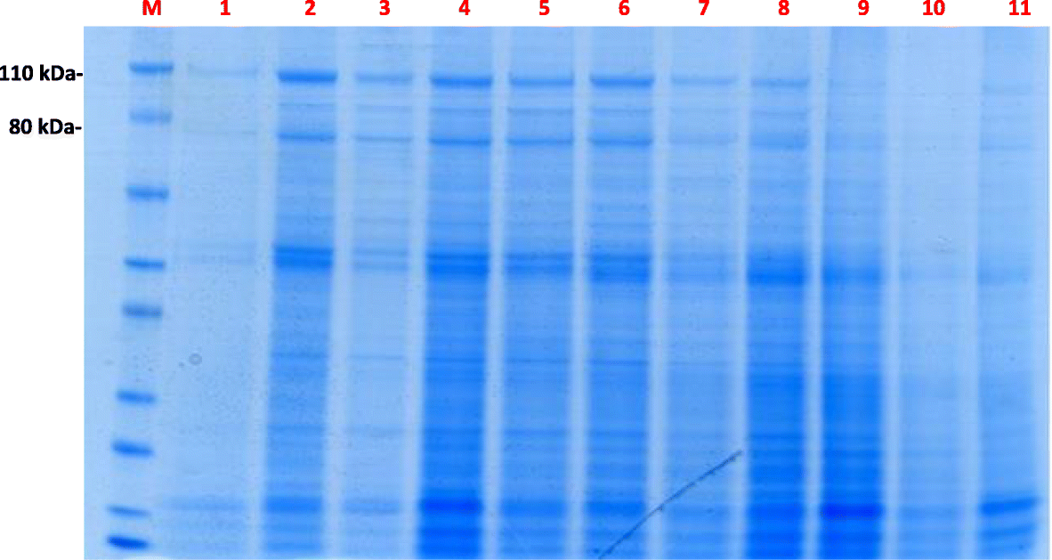
Gel Electrophoresis Example
Notes:
Image Credit: https://link.springer.com/article/10.1186/s12610-018-0076-0/figures/1

Slide 28

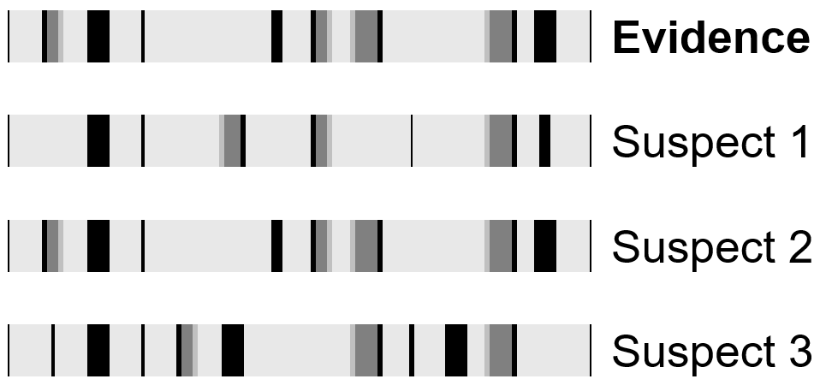
DNA Comparison Process
Whose DNA matches the evidence collected at the crime scene?
Notes:
We will be using much simpler examples for our activity!

Slide 29
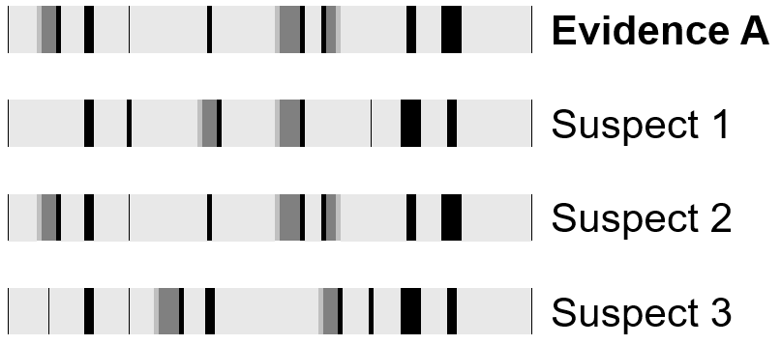
DNA Analysis & Matching Activity
Complete the worksheet by circling the suspect DNA sample that matches the evidence found at each crime scene.

Slide 30
DNA Analysis & Matching Answers
Evidence A = Suspect 2
Evidence B = Suspect 3
Evidence C = Suspect 1
Evidence D = Suspect 3
Evidence E = Suspect 2
Evidence F = Suspect 5
Evidence G = Suspect 4
Evidence H = Suspect 3

Slide 31
DNA Reflection Cont.
Reflection
Do you think DNA is a good piece of evidence? Why or why not?

Slide 32
05
Handwriting
Notes:
Next, we are going to look at forensic handwriting analysis! This is a real tool used by forensic scientists to figure out who wrote a note, signature, or even a ransom letter! Let’s see how your own handwriting can be like a fingerprint—unique just to you.”

Slide 33
Questions to consider
Have you ever tried to copy someone’s handwriting?
Do you think two people can have exactly the same handwriting?

Slide 34
Handwriting Features
Slant – Does the writing lean left, right, or straight up and down?
Spacing – Are the letters and words far apart or squished?
Pressure – Is the writing dark and heavy or light and faint?
Letter shape – Are the o’s round or oval? Loopy or sharp?
Baseline alignment – Do letters float, dip, or stay on the line?
Notes:
Handwriting analysts look at 12 key features in writing to compare samples. Today, we’ll look at a few:
Slant – Does the writing lean left, right, or straight up and down?
Spacing – Are the letters and words far apart or squished?
Pressure – Is the writing dark and heavy or light and faint?
Letter shape – Are the o’s round or oval? Loopy or sharp?
Baseline alignment – Do letters float, dip, or stay on the line?

Slide 35
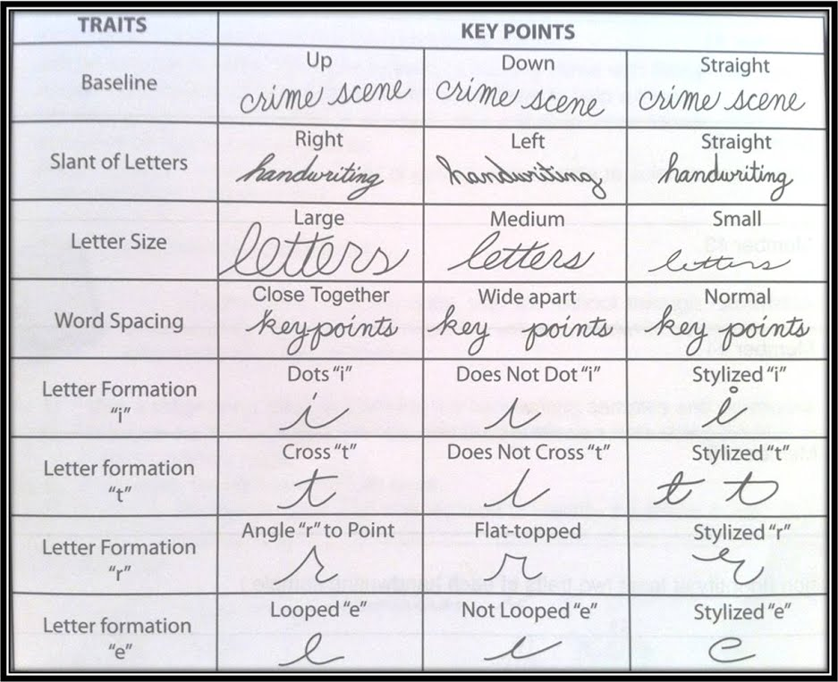
Handwriting characteristics
Notes:
Image Credit: https://bluejayblog.wordpress.com/2018/01/21/thinking-about-graphology/

Slide 36
Handwriting Analysis
Write out the following sentence in cursive or print on your worksheet where it says “Handwriting Sample 1”:
“Meet me at the park at midnight.”
Switch papers with a partner and have your partner write the same sentence where it says “Handwriting Sample 2”
Compare each one using the analysis traits.

Slide 37
Reflection Continued
What did you notice?
What surprised you about handwriting analysis?
Do you think handwriting is enough to identify a suspect on its own? Why?
Notes:
Reinforce:
Handwriting is unique, but it’s not always perfect science. Forensic handwriting analysis can help rule suspects in or out, but it’s most powerful when used with other types of evidence.

Slide 38
Lunch Time!
Notes:
Ok, we are going to go outside for a picnic lunch and a game. While you are all outside, we will set up dessert!

Slide 39
Review
What were some things you learned this morning?
Can you rely on just one piece of evidence to tell the story of what happened? Why or why not?

Slide 40

Who Stole the Cookies?
Time to put your skills to the test!
In your groups, assign the following roles:
Fingerprint Specialist
DNA Analyst
Shoe Print Specialist
Handwriting Analyst
Notes:
Oh No! While we were outside someone came and stole all the cookies! Now is the time to put your skills to the test. In each group, decide who will fill the following roles:
Fingerprint specialist
DNA Analyst
Shoe Print Specialist
Handwriting Analyst

Slide 41
Who Stole the Cookies? Continued
Before you touch anything – Sketch the crime scene on the back of your worksheet!
Keep a record of your findings using your Crime Scene Investigation Report
Use the Suspect Profiles to identify the culprit
Put together a “story” of what happened
Briefings will be held at: ____________
Notes:
In the packets at your tables, you have the list of suspects. Each suspect has provided a DNA sample, fingerprint, shoe print, alibi, and handwriting sample.
Investigate the scene and solve the crime!
Before you touch anything, draw a picture of the crime scene on the back of your worksheet. Be sure to note the location of any evidence you notice.
Keep a record of your findings using the worksheet as a guide.
Work with your group to put together a “story” of what happened
You will be briefing the rest of the group on your findings at ______________!

Slide 42
Results Briefings
Notes:
Give each group time to present their “story” of the crime.

Slide 43
Overall Reflection
Reflection
Were you successful in solving the crime?
What did your group do well? What were some challenges you had?
Was some of the evidence misleading? Explain.
What challenges do you think real investigators might have?

Slide 44
Review Cont.
What was the most interesting thing you learned today?
Can you rely on just one piece of evidence to tell the story of what happened? Why or why not?
Which evidence do you think is the most important? Why?
Are you interested in a career in Crime Scene Investigation?

Slide 45
Great Job!
Thanks for Coming!

Slide 46

Conclusion
This CSI Day Camp was developed by Oklahoma STEM Innovators, Kate Wardlaw, Kara Wardlaw, Lauren Guthrie, with guidance from Oklahoma 4-H STEM Specialist Kelly Wardlaw. These activities are based on training they received during the Innovate Leadership Summit from Caitlin Porterfield at the University of Central Oklahoma Forensic Science Institute.
Please contact Kelly Wardlaw, k.wardlaw@okstate.edu, with any questions or comments.
Oklahoma State University, as an equal opportunity employer, complies with all applicable federal and state laws regarding non-discrimination. Oklahoma State University is committed to a policy of equal opportunity for all individuals and does not discriminate based on race, religion, age, sex, color, national origin, marital status, disability, or veteran status with regard to employment, educational programs and activities, and/or admissions.
Notes:
May 2026

